Slide 1

Information Security – Theory vs. Reality
0368-4474, Winter 2015-2016
Lecture 3:
Power analysis, correlation power analysis
Lecturer:
Eran Tromer

Slide 2
Power Analysis
Simple Power Analysis
Correlation Power Analysis
Differential Power Analysis

Slide 3
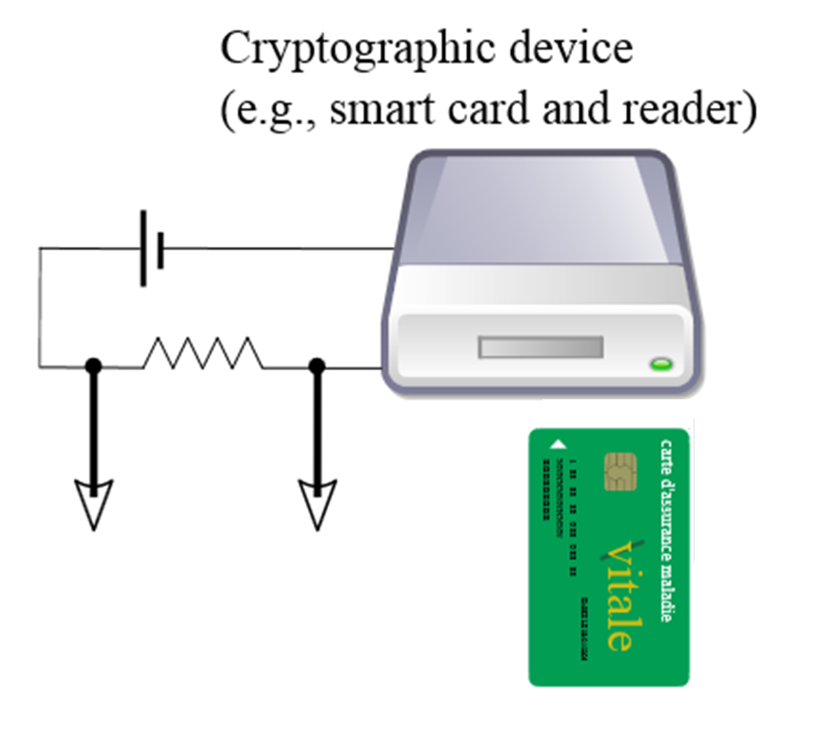
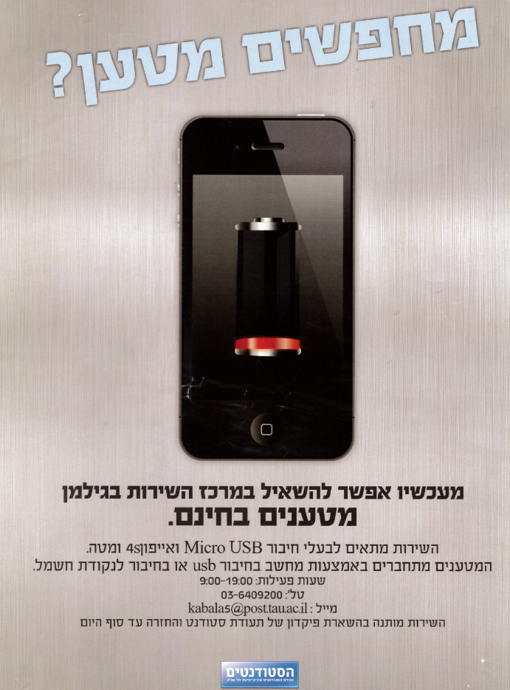
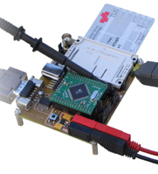
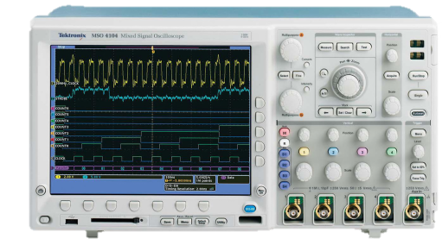
Power analysis
Power analysis: measure device’s power consumption.

Slide 4
The AES Cipher
AES
Plaintext
Ciphertext
Key
Notes:
יש הרבה טעמים ווריאציות – זה הכי בסיסי
128 bits = 8 bytes
8-bit architecture in this talk

Slide 5
AES symmetric cipher:
Lookup-based implementation
char p[16], k[16]; // plaintext and key
int32 Col[4]; // intermediate state
const int32 T0[256],T1[256],T2[256],T3[256]; // lookup tables
...
/* Round 1 */
Col[0]← T0[p[ 0] ⊕ k[ 0]] ⊕ T1[p[ 5] ⊕ k[ 5]] ⊕
T2[p[10] ⊕ k[10]] ⊕ T3[p[15] ⊕ k[15]];
Col[1]← T0[p[ 4] ⊕ k[ 4]] ⊕ T1[p[ 9] ⊕ k[ 9]] ⊕
T2[p[14] ⊕ k[14]] ⊕ T3[p[ 3] ⊕ k[ 3]];
Col[2]← T0[p[ 8] ⊕ k[ 8]] ⊕ T1[p[13] ⊕ k[13]] ⊕
T2[p[ 2] ⊕ k[ 2]] ⊕ T3[p[ 7] ⊕ k[ 7]];
Col[3]← T0[p[12] ⊕ k[12]] ⊕ T1[p[ 1] ⊕ k[ 1]] ⊕
T2[p[ 6] ⊕ k[ 6]] ⊕ T3[p[11] ⊕ k[11]];
...

Slide 6
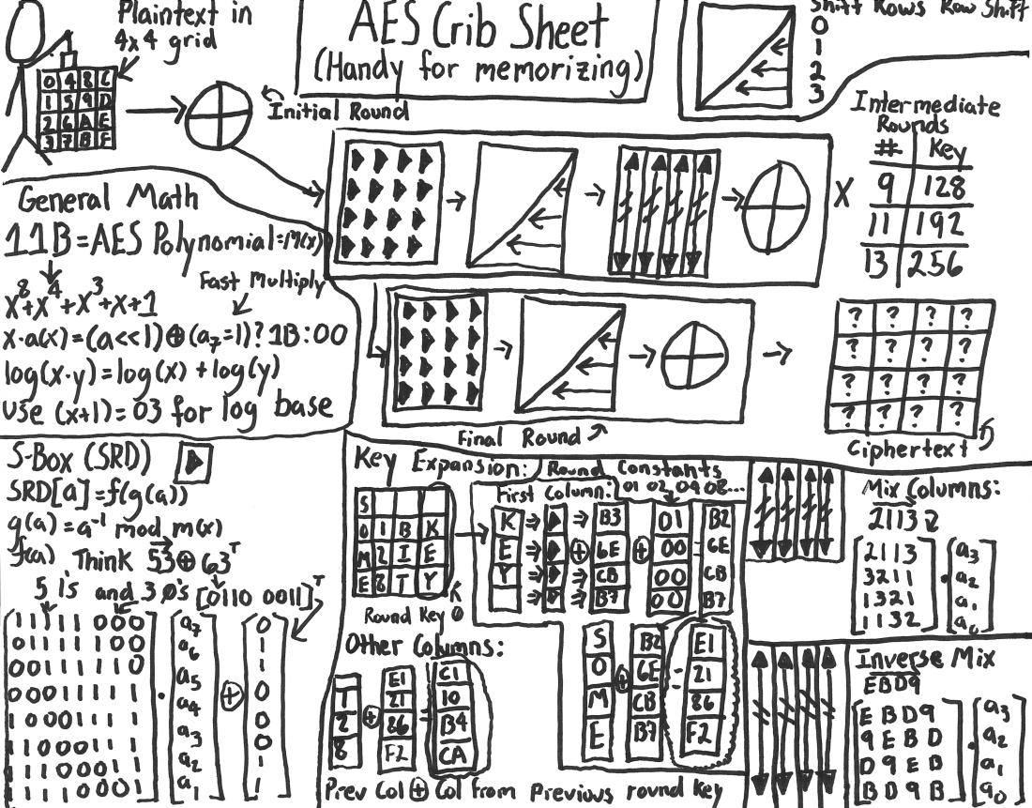
AES symmetric cipher:
“Algebraic” implementation
Source: http://www.moserware.com/2009/09/stick-figure-guide-to-advanced.html

Slide 7
AES symmetric cipher:
“Algebraic” implementation in code
void AESEncrypt( u8 input[16], u8 output[16] ) {
[…]
for (r=1; r<=9; r++)
{
ByteSub(state);
ShiftRow(state);
MixColumn(state);
KeyAdd(state, roundKeys, r);
}
[…]
Source: http://users.ece.utexas.edu/~gerstl/ee382v-ics_f09/soc/tutorials/System_C_Code_Examples_2/date04_examples/cosimulate/sw_only/
Notes:
Subbytes – operation that uses small amounts of plaintext and key – useful for us as we’ll see later

Slide 8
Theory of power analysis
Power consumption is variable
Power consumption depends on instruction
Power consumption depends on data
Notes:
Two hidden assumptions:
Power consumption can be measured
Data and instruction can be deduced from power consumption

Slide 9
Data-dependent power consumption: gate capacitance
V_{dd}
P1
C1
a
q
q
C2
N1
Power consumption
A
GND
The power consumption of a CMOS gate depends on the data:
q: 0->0 almost no power consumption
q: 1->1 almost no power consumption
q: 0->1 high power consumption (proportional to C2)
q: 1->0 high power consumption (proportional to C1)
Notes:
The capacitors come from the physical form of the circuit

Slide 10
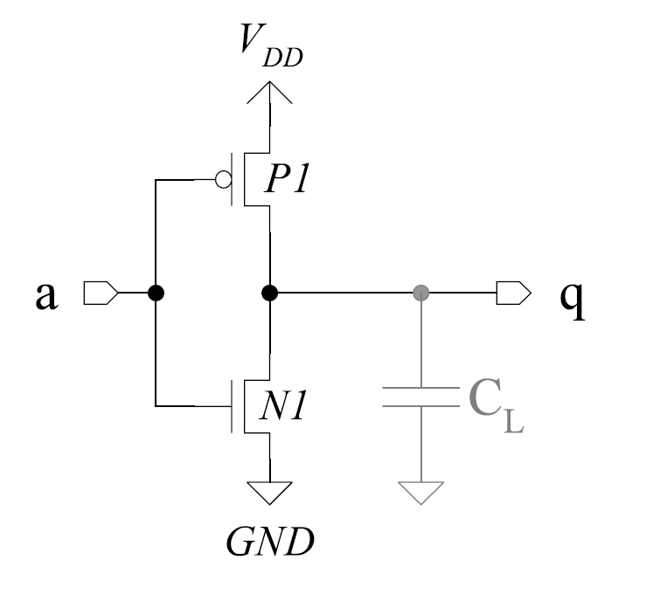
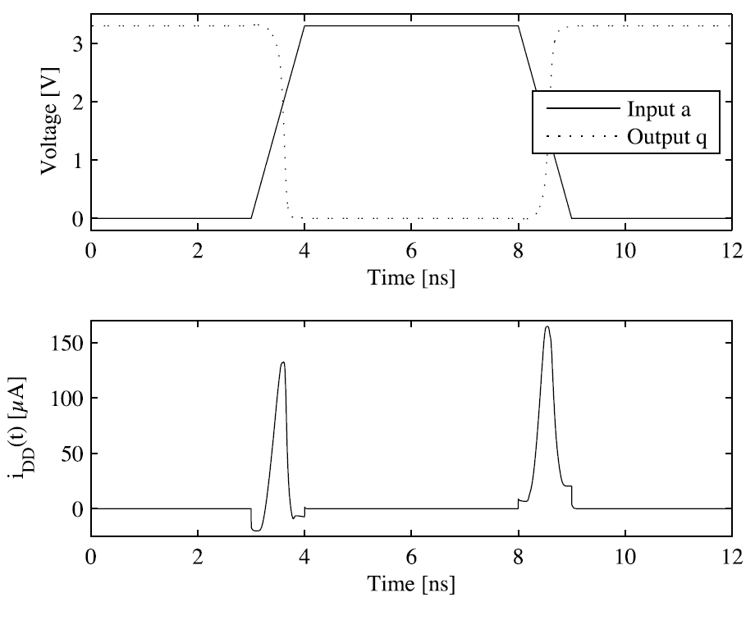
Data-dependent power consumption: wire capacitance
Capacitance of last cells in this inverter, outgoing wire, and first cells in next gate
Source: DPA Book
Notes:
להסביר למה – קבל נטען ונפרק, זרם זורם מהר ברגעי ההתחלפות

Slide 11
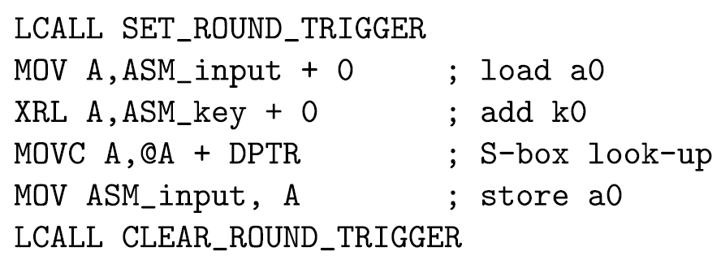
Power Depends on Instruction, Locally
Source: DPA Book
Notes:
Why? ALU, MMU
Already enough to attack some ciphers (e.g. Keeloq SW Decryption)

Slide 12
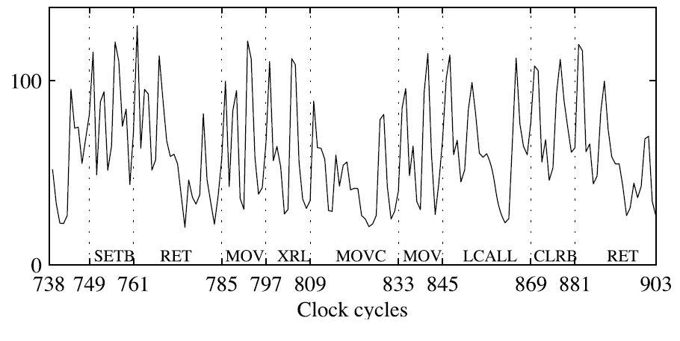
Power Depends on Instruction, Locally
Source: DPA Book
Notes:
Why? ALU, MMU
Already enough to attack some ciphers (e.g. Keeloq SW Decryption)

Slide 13
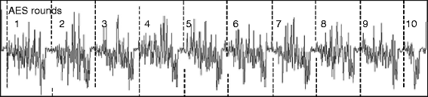
Power Depends on Instruction, Globally
  Example: AES [Joye Olivier 2011]
Notes:
How was this trace captured – measure the power consumption of the device – more on the setup later
Shown – SPA on RSA squaring

Slide 14
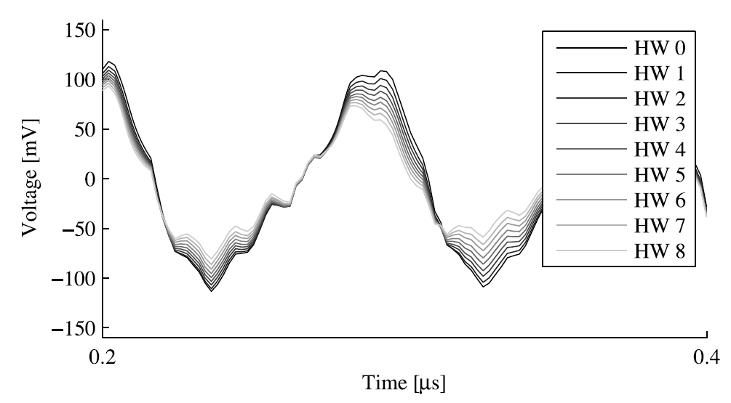
Power Depends on Data
Source: DPA Book
Notes:
Precharge to 1

Slide 15
Power Analysis
Simple Power Analysis
Differential Power Analysis
  Warm-up Correlation Power Analysis
  Full Correlation Power Analysis

Slide 16
Power Analysis Attack Scenario
Plaintexts and ciphertexts may be chosen, known or unknown
Crypto Device
Plaintexts
Ciphertexts
Key
Power
Notes:
We have (limited) access to the device
Our goal is the key
Repeat thousands of times

Slide 17
Theory of power analysis
Power consumption is variable
Power consumption depends on instruction
Power consumption depends on data

Slide 18
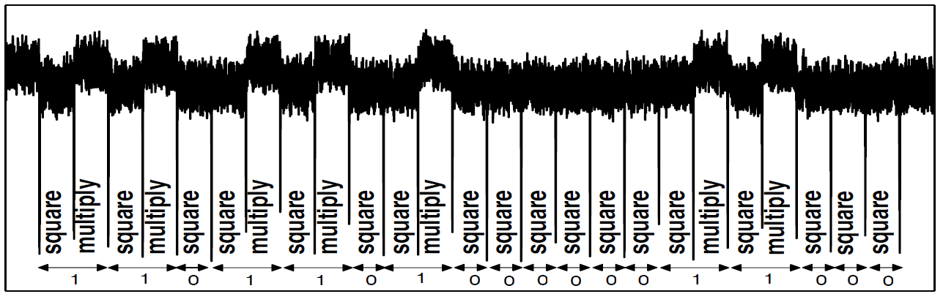
Simple Power Analysis (SPA)
  Example: square-and-multiply RSA exponentiation.
Pros:
  Single trace (or average of a few) may suffice
Cons:
  Detailed reverse engineering
  Long manual part
  Hard to handle bad signal-to-noise ratio, especially for small events, (e.g., AES)
Notes:
How was this trace captured – measure the power consumption of the device – more on the setup later
Shown – SPA on RSA squaring

Slide 19
Differential Power Analysis (DPA)
Use statistical properties of traces to recover key
Pros:
  Very limited reverse engineering
  Harder to confuse
Cons:
  Large amount of traces
Two main types of DPA:
  Difference of means (traditional DPA)
  Correlation power analysis (CPA)

Slide 20
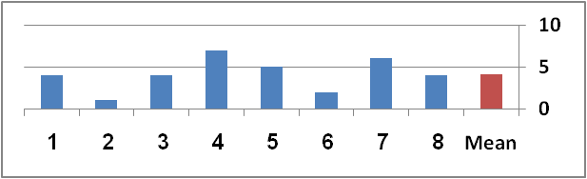
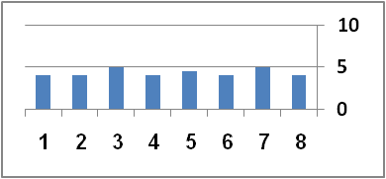
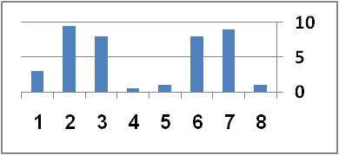
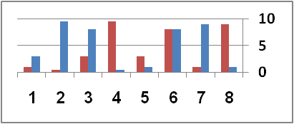
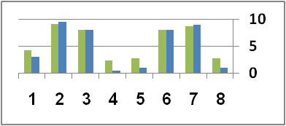
Mean, variance, correlation
⇐ Low Variance
High ⇒ Variance
⇐ Low Correlation
High ⇒ Correlation
Notes:
Normalized – centered around 0 with a unit variance

Slide 21
CPA Basics
We want to discover the correct key value (c_{k}) and when it is used (c_{t})
Idea:
  On the correct time, the power consumption of all traces is correlated with the correct key
  On other times and other keys the traces should show low correlation

Slide 22
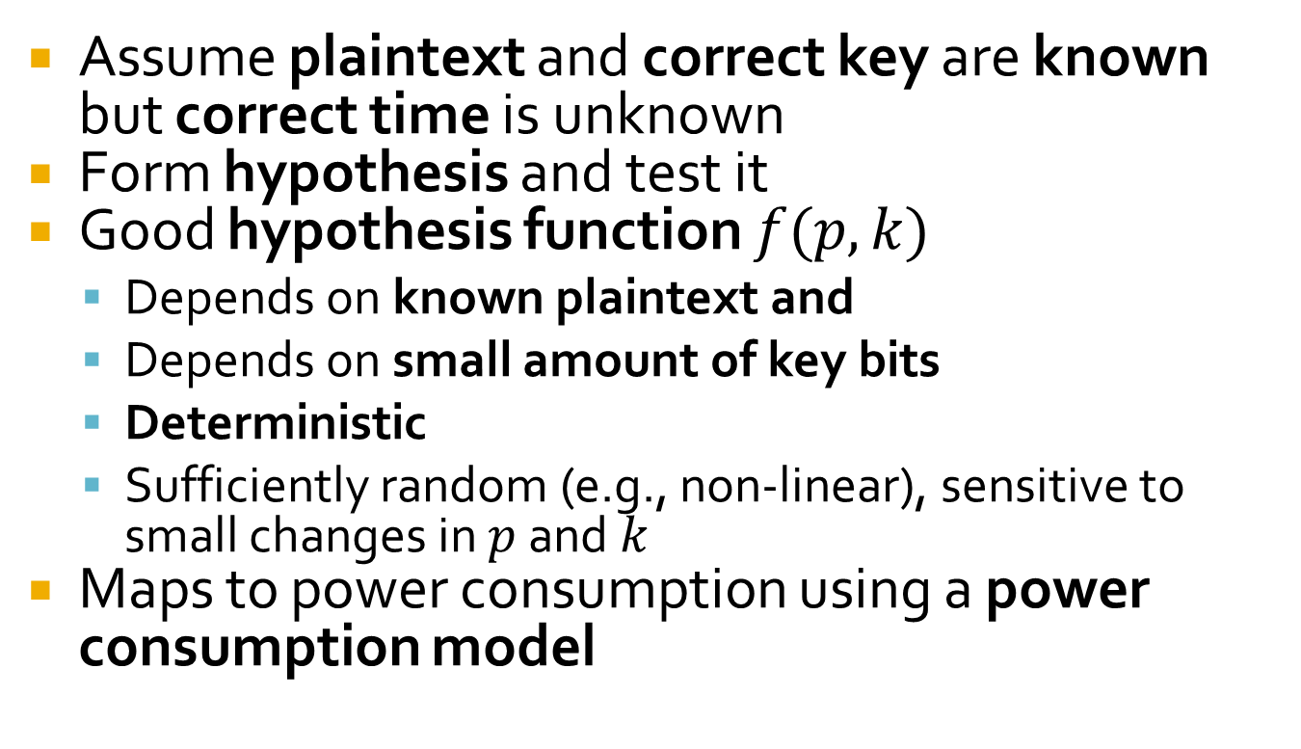
Warm-up CPA
Notes:
Model depends on implementation – more on that later

Slide 23
Warm-up CPA in Numbers
1000 traces, each consisting of 1 million points
Each trace uses a different known plaintext – 1000 plaintexts
1 known key
Hypothesis is vector of 1000 hypothetical power values
Output of warm-up CPA: vector of 1 million correlation values with peak at c_{t}

Slide 24
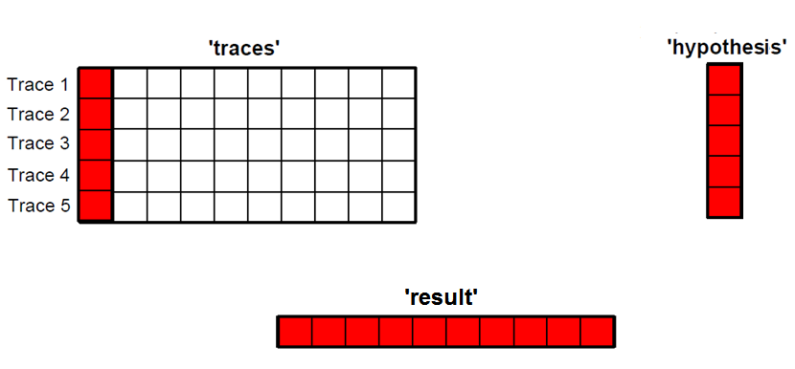
Warm-up CPA in Pictures

Slide 25
Full CPA
Plaintext is known, but correct key and correct time unknown
Idea: run warm-up CPA many times in parallel
Create many competing hypotheses

Slide 26
Full CPA in Numbers
1000 traces, each consisting of 1 million points
Each trace uses a different known plaintext – 1000 plaintexts
Key is unknown – 256 guesses for first byte
Hypothesis is matrix of 1000X256 hypothetical power values
Output of full CPA: matrix of 1,000,000X256 correlation values with peak at (c_{k},c_{t})

Slide 27
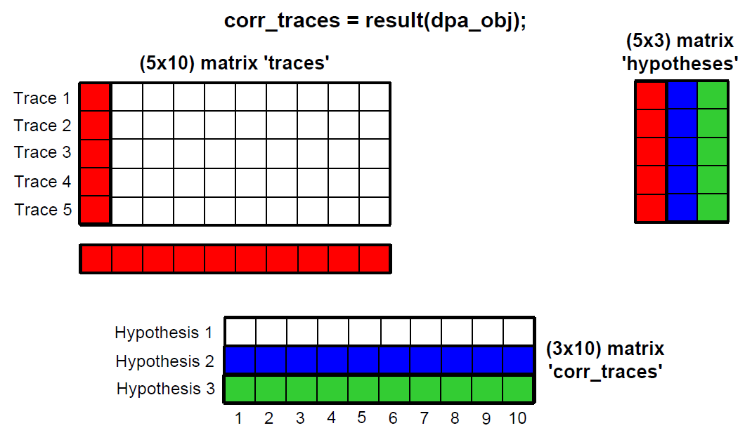
Full CPA in Pictures

Slide 28
Full attack
Acquire traces
For every key fragment and corresponding hypothesis function:
  Compute matrix of hypotheses
  Compute correlation (score) matrix
  Find maximum in correlation matrix and deduce value of key fragment

Slide 29
Discussion: effects and tradeoffs of parameters
Number of traces
Trace length
Number of hypotheses (i.e., number of relevant key bits affecting the hidden state being modeled)

Slide 30
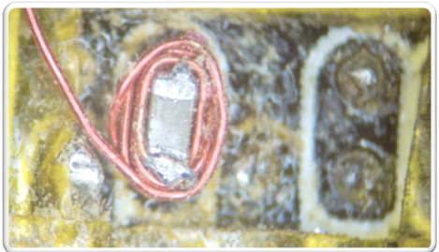
Assumptions/complications/mitigation
Assumptions/Bottlenecks
Mitigations
Alignment (shifts, fragmentation)
  Handling algorithmically (e.g., cross correlation, string alignment)
  Physical synchronization via triggering
Data size: #traces, trace length
Assuming fixed over all traces:
  Key
  Computation progress and flow
Measurement quality
  Physical access, noise, transmission
  Equipment cost
  Expertise
Timing
  Unstable clock
  Randomize control/instruction flow
  Insert random/key/plaintext-dependent delays
Change protocol to roll keys often
Add power noise
0.5mm
Example: probing an “decoupling capacitor”
(SMD 0402) close to the microcontroller chip.
[O’Flynn 2013]

Slide 31

Further Reading
http://www.dpabook.org
http://www.springerlink.com/content/g01q1k

