Slide 1
Price Of Anarchy: Routing
Lecturer: Yishay Mansour
Ido Trivizki and Mille Gandelsman

Slide 2
Routing – Lecture Overview
Optimize the performance of a congested and unregulated network:
  Network.
  Rate of traffic between each pair of nodes.
  Latency function.
Selfish behavior does not perform as well as an optimized regulated network.
Investigating the price of anarchy (PoA) by exploring the characteristics of Nash Equilibrium and mininal latency optimal flow.

Slide 3
Lecture overview – cont.
We will prove that:
  If the latency of each edge is a linear function, PoA is at most 4/3.
  In atomic routing the PoA is bounded by 2.6.
  I the latency function is known to be continuous, non-decreasing and differentiable, there is no bounded coordination ratio.

Slide 4
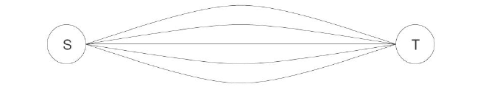
Introduction
Job scheduling, discussed last time, can be viewed as a private case of routing.
Each player has to choose exactly one line to pass his traffic through.
Parallel lines routing:

Slide 5
Introduction – cont.
Today – the problem of routing traffic in a network:
  Given a rate of traffic between pairs of nodes in the network, find an assignment of the traffic to paths so that the total latency is minimized.
It is often impossible to impose regulation, so we are interested in those settings where each user selects his minimum latency path:
  Non-cooperative game in which each player plays best response – expect the routes to form a Nash Equilibrium.

Slide 6
Two player models
Non-atomic: we can split up traffic to several paths.
Atomic: each user chooses a single path on which he transports all of his traffic.
The global target function in both cases is to
minimize the total latency suffered by all users.

Slide 7
Reminder: The Price of Anarchy
The ration between the worst value of an equilibrium and that of the optimal:
Where OPT denotes the minimum latency among all feasible flows and C(x) is total cost of flow x.
Our goal is to bound the PoA.

Slide 8
Example 1: routing on parallel lines
n players with weights
m lines with speeds
The players are allowed to split their flow between different lines.
Nash Equilibrium is achieved when the load on each line is:

Slide 9
Example 1 – cont.
Routing on parallel lines
The optimum is achieved by dividing the flow equally between the lines.
Therefore – we achieve a PoA=1

Slide 10
Example 2:
Pigou’s Network
C(x)=1
Nash flow will only traverse in the lower path.
OPT will divide the flow equally among the two paths.
S
T
C(x)=x

Slide 11
Example 2 – cont.
The target function is and it reaches minimum with value ¾, when x=1/2, giving a PoA of 4/3.
Combing the example with the tighter upper bound to be shown, it is a demonstration of a tight bound of 4/3 for linear latency functions.

Slide 12
Example 3:
Pigou’s Non-Linear Network
C(x)=1
The flow at Nash will continue to use only the lower path.
S
T

Slide 13
Example 3 – cont.
Let (1-x) be the flow on the upper path in the optimum solution, and x - the flow on the lower path, respectively.
The overall cost is .
Proof that :
  if we choose :

Slide 14
Example 3 – summary
In this case
It means that the PoA cannot be bounded from above in some cases when nonlinear latency functions are allowed.

Slide 15
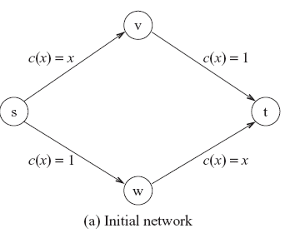
Example 4 – Braess’s paradox
There are exactly two disjoint paths from s to t, each of them follows exactly two edges.

Slide 16
Example 4 – cont.
The optimal flow coincides with the Nash equilibrium:
    half of the traffic takes the upper path, and the half the lower.
The latency perceived by each user is 3/2.
In any other non-equal distribution, there will be a difference in the total latency.
Users will be motivated to reroute to the less congested path.

Slide 17
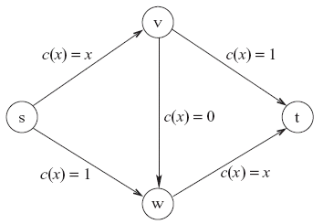
Example 4 – cont.
Consider adding a fifth edge with latency 0.
The optimal flow stays 3/2.
Nash will only
occur by routing the
entire traffic on the
single s→v→w→t
path.

Slide 18
Example 4 – cont.
The latency each user experiences increases to 2.
Amazingly, adding a new zero latency link had a negative effect for all agents.

Slide 19
Formal Definition of the Problem
Consider a directed graph
Input:
  k pairs of source and destination vertices
  Demand ( the amount of required flow between and ). Assume: .
  Each edge is given a load dependant non decreasing and differentiable latency function
Output:
  Flow - a function that defines for each path a flow . induces flow on edge :

Slide 20
Formal Definition – cont.
We denote the set of simple paths connecting the pair by and let .
Solution is feasible if .
The latency of the a path is defines as:
Our goal is to find a flow that will minimize the total social cost of a flow is defined as:
The cost of player :

Slide 21
Flows at Nash equilibrium
Lemma:
  A feasible flow for instance is Nash Equilibrium if for every and
Corollary:
  is a flow at Nash Equilibrium for instance
  if and only if , where

Slide 22
Optimal Solution – flow
Our goal is find a feasible flow that will minimize the total cost.
  Let .
  Clearly, it follows that
  To find the optimal flow , we will look at .
  We assume that for each edge : is convex and therefore is also convex.
  is differentiable.

Slide 23
The Optimality Condition
Define: and
Let be a dividable game. For each edge
the function is convex, continuous and differentiable function.
A flow is optimal for if and only if:

Slide 24
The Optimality Condition – cont.
Notice the resemblance between the characterization of optimality conditions and Nash Equilibrium.
An optimal flow can be interpreted as a Nash Equilibrium with respect to a different edge latency functions.
We will use this resemblance to reach the bound on PoA.
Where OPT denotes the minimum latency among all feasible flows and C(x) is total cost of flow x.
Our goal is to bound the PoA.

Slide 25
The Optimality Condition – cont.
Let:
Corollary:
  is an optimal flow for if and only if it is Nash Equilibrium for the instance
Proof:
  By the optimality condition: is optimal for
  if and only if , if and only if (by def.) , if and only if is Nash Equilibrium for .

Slide 26
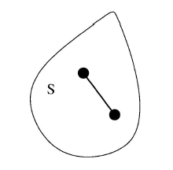
The optimality condition - proof
Definition: a set is called a convex set if
Intuitively it means that a
set is convex if the linear
segment connecting two
points in the set, is entirely
in the set.

Slide 27
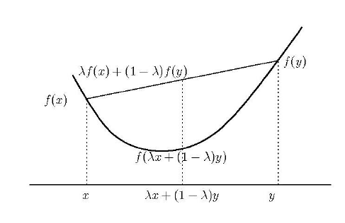
The optimality condition - proof
Definition: a function is called convex function if

Slide 28
The optimality condition - proof
Let be a convex function, and a convex set.
A convex programming is of the form:
Lemma:
  If is strictly convex, then the solution is unique.
Proof:
  Assume that are both minimum solutions.
  Let , because is convex: .
  Since is strictly convex: , contradicting and being minimal .

Slide 29
The optimality condition - proof
Lemma:
  If is convex, then the solution set is convex.
Lemma:
  If is convex and is not optimal then is not a local minimum. Consequently, any local minimum is also a global minimum.
Proof:
  Assume that is not optimal, i.e.
  let , Since is convex:
  for every .

Slide 30
Existence of flows at Nash Equilibrium
Theorem: For every splittable game
  There exists at least one Nash Equilibrium
  If and are Nash equilibria then for every ,

Slide 31
Existence of flows at Nash Equilibrium - Proof
Define: , so that
Further define a potential function:
is non-negative, monotonous, increasing and differential. Is a convex function.
Nash equillibrium flows are global minimizers of

Slide 32
Existence of flows at Nash Equilibrium – Proof Cont.
By Weierstrass’s Theorem, has a minimum, and therefore Nash equilibrium exists.
Let and be Nash equillibria:
  Define
  and minimize , and we get
  is sum of convex functions, and therefore it’s possible only if all members of the sum are equal, and therefore:

Slide 33
Bounding the Price of Anarchy
Theorem: If there exists a constant
such that then
  Corollary: If the latency function is polynomial function of degree , then

Slide 34
A tight bound for linear latency functions
A natural example for such a model: Network with congestion control (e.g.: TCP)
Using the corollary, we get a bound of 2
We’ll show a bound of 4/3 (which is tight, as we’ve seen in Example 2)
When , both Nash and OPT (equal) will route all the flow in the shortest paths.

Slide 35
A tight bound for linear latency functions - Proof
Lemma (proof is trivial and omitted):
is a flow at Nash equilibrium, and is an optimal flow. Given a flow let

Slide 36
A tight bound for linear latency functions – Proof Cont

Slide 37
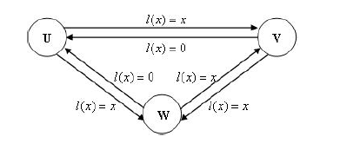
Unsplittable (Atomic) Routing
Example 1:
  4 players, all with
  demand 1 (r = 1):
  (U,V), (U,W),
  (V,W), (W,V)
  An optimal and Nash equilibrium flow would use only edges with at total cost of 4

Slide 38
Unsplittable (Atomic) Routing – Exmaple 1 Cont.
Example 1 (cont.):
  But the optimal
  solution is not the
  only NE.
  Another Nash equilibrium:
  Player 1: U->W->V; Player 2: U->V->W;
  Player 3: V->U->W; Player 4: W->U->V
  With total cost of 10, which gives PoA = 2.5.

Slide 39
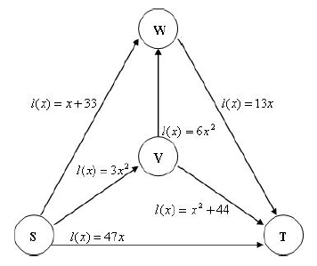
Unsplittable (Atomic) Routing – Exmaple 2
Both players have
s=S and t=T, but,
player 1 has r=1,
While player 2, r=2.
Possible paths S->T:
p1: S->T; p2: S->V->T; p3: S->W->T;
p4: S->V->W->T

Slide 40
Unsplittable (Atomic) Routing – Exmaple 2 Cont.
In this example
there is no pure
equilibrium.
Easy to show the
following facts:
  If player 2 chooses p1 or p2, player 1 will choose p4.
  If player 1 chooses p4, player 2 will choose p3.
  If player 2 chooses p3 or p4, player 1 will choose p1.
  If player 1 chooses p1, player 2 will choose p2.

Slide 41
Unsplittable (Atomic) Routing – Existence of Nash Equilibrium
We’ve shown that NE does not always exist.
Theorem: If is an unsplittable game with then there exists a Nash equilibrium.
  Proof:
  Define a potential function
When player I moves from p to p’:

Slide 42
Unsplittable (Atomic) Routing – Existence of Nash Equilibrium
Cont.
And:
So:
So when the players plays “best response” the potential decreases, and as it’s non-negative,
s series of “best responses” will converge to a Nash equilibrium.

Slide 43
Bounding the price of anarchy for unsplittable linear games
Theorem: let be an unsplittable routing game with linear cost functions, then
Proof:
  Let be a nash equillibirim (we assume it exists) flow, and be an optimal flow.

Slide 44
Bounding the price of anarchy for unsplittable linear games – Cont.
Lemma:
  Proof (of lemma):
Using Cauchy-Schwartz:

Slide 45
Bounding the price of anarchy for unsplittable linear games – Cont.
We get:
Solving the equation for
We get :

