Slide 1
Computational Game Theory
Lecture 4 - Price of Stability & Strong Price of Anarchy

Slide 2
Overview
Existence of a Nash equilibrium
  Define a class of games called congestion games and we’ll show the existence of a pure Nash Equilibrium in any congestion game.
  Define a class called potential games and we’ll study the existence of pure equilibrium in those games. (Actually the two classed are equivalent)
Price of anarchy & Stability
  Study two variants of a Network Creation game (unfair and fair), and analyze the price of anarchy (when a Nash equilibrium exists)

Slide 3
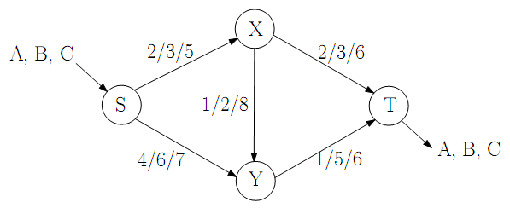
Congestion Game – Example

Slide 4
Congestion Game – Example
Players: A,B and C.
Goal: go from point S to T in minimal cost.
  using road segments(edges) SX,XY,...etc.
Roles:
  Each player pays for using a edge
  Numbers on edges denote the cost
    The cost is a function of the number of players using that edge.
    For example: if segment SX is used by a two player, those two players will pay 3 “money points” each for using that edge, if three players will use it than each one of them will pay 5.
  The total cost for a player is the sum of the costs on all segments he/she uses.

Slide 5
Congestion game – Definition
A congestion model is defined as follows:
N = {1, 2, ..., n} denote the set of n players.
M = {1, 2, ...,m} denote the set of m resources.
= set of strategies of player i.
  where each strategy is a non empty subset of the resources.
= vector of costs
  where is the cost related to resource j, if there are exactly k players using that resource.

Slide 6
Congestion game – Definition
Let be the set of all possible joint actions.
For any and for any j∈M, let be the number of players using resource j, assuming is the current joint action, i.e.
The cost function for player i is:

Slide 7
Congestion game
Remark 4.1 In our example we used Routing with unspllitable flow. This game can be easy viewed as a congestion game. The resources are the edges M=E, the possible strategies are the possible routes for player i:Ai = Pi and the cost of the edge is it's latency, i.e. ce(k)=le(k)

Slide 8
Congestion game – Pure Nash equilibrium
Theorem 4.2 : Every finite congestion game has a pure Nash equilibrium.

Slide 9
Proof Theorem 4.2
- joint action
- potential function
- change in cost
  player i changes its strategy from to
Notes:
explanation: change in cost = cost related to the use of new resources minus cost related to use of those resources which are not in use anymore due to strategy change

Slide 10
Proof Theorem 4.2 - cont
- change in the potential caused by change in strategy
Thus we can conclude that for a single player’s strategy change we get: .
Remark 4.3 Φ is actually an exact potential function (as we will define shortly)
Notes:
explanation: immediate from potential function’s deﬁnition

Slide 11
Proof Theorem 4.2 - cont
We start from an arbitrary joint action
Each step one player apply his best response
  thus reducing his own cost
  Φ is reduced (identically)
Eventually reach a local minima
  since Φ can accept a finite amount of values
That point is Nash equilibrium
  since no player can achieve any improvement

Slide 12
Potential functions
- game
- set of all pure strategy actions in G
Definition: is exact potential in game G if:
  i.e:

Slide 13
Potential functions
is a vector of positive numbers (weight vector)
Definition: is weighted potential in game G if:
  i.e:

Slide 14
Potential functions
Definition: is an ordinal potential for a minimum game G if :
  i.e:
Remark 4.4 The two previous definitions are special cases of the above definition.
Notes:
Intuition: when a player decreases his cost, the potential function also decreases

Slide 15
Potential games
Definition a game G is called an ordinal potential game if it has an ordinal potential function.
Theorem 4.5 Every finite ordinal potential game has a pure equilibrium.

Slide 16
Proof Theorem 4.5
Analogous to the proof of Theorem 4.2:
Given an initial strategy vector
Each time a player changes strategy
  reduces his cost
  the potential function also decreases
Eventually reach a local minima
  since this is a finite game, the potential function can have a finite set of values and therefore the process of successive improvements by players must reach a local minima of the potential function.

Slide 17
Proof Theorem 4.5 – cont
Reach Nash equilibrium
  No improvements (by any player) are possible at this point, and therefore this is a pure equilibrium
Remark 4.6 any congestion game (as defined earlier) is an exact potential game. The proof of Theorem 4.2 is based on this property of congestion games

Slide 18
Example – Exact potential game (party affiliation game)
Consider an undirected graph G = (V,E)
Weight function on its edges.
Players are the vertices
Goal: partition the vertices set V into two distinct subsets D1,D2 (where D1∪D2=V).
Player goal: Maximize its utility function.

Slide 19
Example – Exact potential game
Every player i choose si∈{−1, 1}
  si=1 means that i∈D1
  si=−1 means that i∈D2
Player utility function
  The weight on each edge denotes how much the corresponding vertices ’want’ to be on the same set.
  Thus, define the value function of player i as:
  a player ’gains’ ωi,j for players that are in the same set with him.
  a player ’loses’ ωi,j for player in the other set.
  Note that ωi,j can be negative.

Slide 20
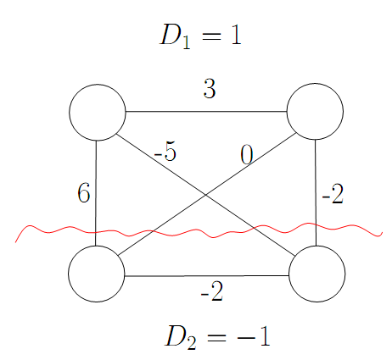
Example – Exact potential game
On the example given in Figure
  U1 = +3 + 5 - 6 = 2
  U2 = +3+0+2 = 5
  U3 = -6 + 0 - 2 = -8
  U4 = -2+5+2 = 5
Players 1,2 and 4 have no interest in changing their strategies.
P1
P2
P3
P4
Player 3 is not satisfied
  he can increase his profit by changing his set to D1
  Resulting in U4 = +6+0+2 = 8

Slide 21
Example – Exact potential game
- our potential function
let us consider the case where a single player i changes its strategy (shifts from one set to another):
which means that Φ is an exact potential function, therefore we conclude that the above game is an exact potential game.

Slide 22
Weighted potential game
Model –
  M identical machines
  N jobs
  weight vector
  - joint action
Load on a machine
  the sum of weights of the jobs which use it
Player cost function

Slide 23
Weighted potential game
Potential function
Change in cost
  M1,M2 two arbitrary machines
  job i shifts from M1 to M2
    Explanation: change in job’s load = load on new machine minus load on the old machine
Notes:
We would like to define a potential function whose change in response to a single player’s strategy change will be correlated with the change in the player’s cost function.

Slide 24
Weighted potential game
Let ∆Φ be the change in the potential caused by the strategy change:
Therefore, we can conclude that load balancing on identical machines is a weighted potential game.

Slide 25
Weighted potential game
Lemma 4.7 For every game G such that for every joint action any path of best-response actions is finite (i.e. a path of best-responses gets to equilibrium), there exists an ordinal potential function Φ.

Slide 26
Proof Lemma 4.7
  length of the longest possible improvement path (path of best-response actions) in the game G starting from .
  The function Φ is well defined because of the property of G assumed in the lemma.
Consider an improvement step from to .
In contradiction, assume that .
Therefore from there exists an improvement path of length .
  which is a contradiction to being the longest improvement path starting from .
This shows that .
That means Φ is an ordinal potential function.

Slide 27
Connection Game (General Cost Sharing)
G=(V,E) - graph
C(e) – price for edge e∈E
Each player i
  has two nodes and that he wants to connect
  player action is a vector
    meaning player i offers for the edge e.
p – the joint action of the players

Slide 28
Connection Game
– the graph resulting from the players’ strategies
  Where iﬀ
– player i’s cost function
  if and connected
  otherwise ∞
The player’s aim is to minimize this cost
– social cost

Slide 29
Connection Game
Remark 4.8 Notice that in a Nash equilibrium the players will pay exactly the cost of each edge bought in G(p) and every one of them will have a path from to in G(p).
Theorem 4.9 a pure Nash equilibrium does not always exist for in a network creation game.

Slide 30
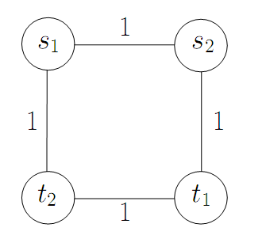
Proof Theorem 4.9
In every NE the players will buy exactly 3 edges.
Without loss of generality assume that the edges bought are:
  (s1, s2)
  (s1, t2)
  (t1, s2)

Slide 31
Proof Theorem 4.9
Only player 1 pays for (s2, t1)
  he’s the only player who needs it
Only player 2 pays for (s1, t2)
  he’s the only player who needs it
Without loss of generality, suppose player 1 pays (at least ϵ) for (s1, s2).
Player 1 can change his strategy and:
  not pay for (s1, t1) and (s1, s2) gaining (1 + ϵ).
  buy (t1, t2) paying 1.
Thus there is no pure Nash equilibrium

Slide 32
Proof Theorem 4.9
Remark 4.10 In the above proof, the problem is that player 1 ignores the fact that in the resulting network player 2 has no motivation to continue paying for (s1, t2). This is a serious weakness of the Nash equilibrium concept: it ignores the fact that other players can and might react to a certain player changing his strategy.

Slide 33
Connection Game PoA
Social cost function .
G a game in which there exists a Nash equilibrium.
PoA ≤ N:
  the cost for player i of connecting si to ti
    at most the cost of connecting them regardless of the other players (given the other players actions). Which in turn is at most the total cost of the optimal solution.
  So every player pays at most OPT.
  The total cost in a NE is at most N·OPT.

Slide 34
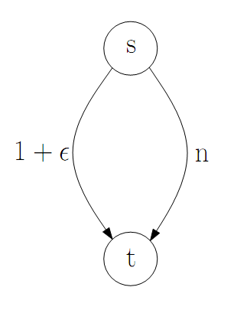
Connection Game PoA
PoA≥N: (Consider the following figure)
  Network
    single source
    single sink
    N players.
    All the players want to connect the
    top vertex s to bottom vertex t.
  In the social optimum solution
    all the players buy together the left edge from s to t.
    Each player pays only (1+ϵ)/N
    The social cost in this case is 1+ϵ.

Slide 35
Connection Game PoA
PoA≥N:
  Worst case Nash equilibrium
    In this case each player pays his part in buying the right edge
    Thus each player pays 1.
      (notice that this is indeed equilibrium since each player will pay more if he decides to buy the left edge alone).
    The social cost in this case is N.
  PoA=N/(1+ϵ)
  Therefore for ϵ→0 we get PoA≥N.

Slide 36
Connection Game PoS
Definition Price of Stability
In the previous example the PoS is 1 since the optimum is a Nash equilibrium.

Slide 37
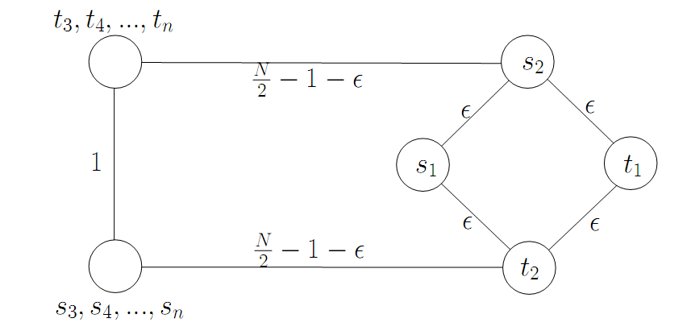
Connection Game High PoS

Slide 38
Connection Game High PoS
The social optimal cost is 1+3ϵ
  when the players buy the leftmost path and 3 of the ϵ edges in the square on the right.
Lowest cost achieved in an equilibrium is N−2+ϵ
  when the players buy the two edges with cost N/2−1−ϵ and three ϵ edges in the right square.
  note that there is no other Nash equilibrium due to the square on the right(which we have shown that does not admit a Nash equilibrium).

Slide 39
Network Creation Game with fair cost sharing
We will consider a modification of the previous game.
Instead of allowing the players to directly set the cost, players will choose the edges and the cost will be divided equally between all players participating in an edge.

Slide 40
Network Creation Game with fair cost sharing
The strategies for player i are
The cost of edge e to the player choosing it is
The total cost for player i is
The social cost is

Slide 41
Network Creation Game with fair cost sharing
We can define the game as a congestion game with
Since this is a congestion game it is an exact potential game and thus always have a pure Nash equilibrium
Remark 4.11 the previous example about PoA still holds, thus PoA ≤ N

Slide 42
Network Creation Game with fair cost sharing
Next, we show that the price of stability is only logarithmic.
Theorem 4.12

Slide 43
Proof Theorem 4.12
Consider which is obviously a Nash equilibrium.
- the optimal solution

Slide 44
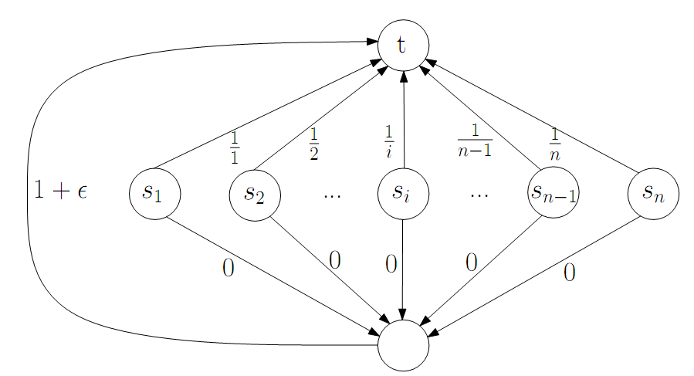
Network Creation Game with fair cost sharing
Theorem 4.13

Slide 45
Proof Theorem 4.13
This is a single target game with N players
Social optimal solution
  Each player would buy
    the 0 cost edge from him to the bottom node
    the 1+ϵ edge (whose cost will be shared equally between all players)
  The social cost in this case is 1+ϵ
Nash equilibrium
  Only one exists in this case
  Each player i buys the 1/i edge from him to t
  Social cost is H(N)

Slide 46
Proof Theorem 4.13
We will show that this is the only Nash equilibrium
Each player i has only 2 ways to connect si to t
Let’s assume that a group Γ is connecting using the 1+ϵ edge
Let’s I be the player with the highest index in the group Γ
  Player i would pay in this case (1+ϵ)/|Γ|
  If he chooses to use the 1/i edge from him to t he would pay 1/i
  Since |Γ|≤i, player i would the 1/i edge
Therefore this is not an equilibrium
  In this case PoS≥H(N)/1+ϵ

Slide 47
Strong Equilibrium - Symmetric Games
Definition a symmetric connection game is a connection game where all players have the same source s and the same sink t.
Theorem 4.14 In every symmetric connection game there exists a strong Nash equilibrium.
Notes:
As we shall see in the next section, a strong equilibrium doesn’t always exist. However,
for a class of games called symmetric games a strong equilibrium is guaranteed to exist.

Slide 48
Proof Theorem 4.14
Consider a state of the game where all players fairly share the cost of the shortest path from s to t.
We claim that this state is a strong equilibrium.
For every coalition of players that may consider moving to a different path, the cost of this path is obviously not less than the price of the shortest path.
The price of the new path will be shared by at most n players, so clearly there will be a player of the coalition which will not benefit of the move.

Slide 49
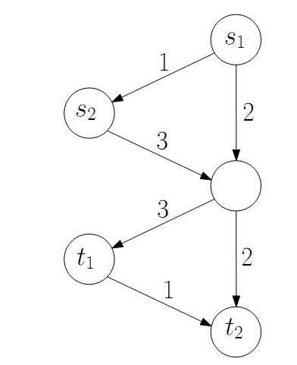
Strong Equilibrium - Fair Cost Sharing
A strong equilibrium doesn’t always exist in a connection game with fair cost sharing.
Example:
  Each player has only 2 paths that lead from his source to his sink
    a path of length 2
    a path of length 3
Notes:
length is the number of edges

Slide 50
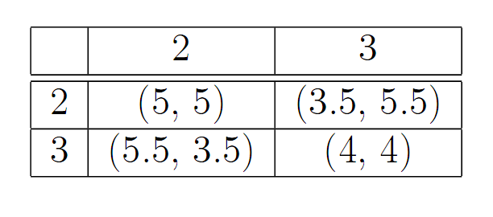
Strong Equilibrium - Fair Cost Sharing
Example cont:
  We represent the game as a 2x2 table:
  We conclude that this game is equivalent to the prisoner’s dilemma, and has no strong equilibrium.

Slide 51
Strong Equilibrium - Fair Cost Sharing
Next, we can look at a strong equilibrium(in fair cost sharing game) SPoA and prove a non-trivial upper bound of H(n)≈log(n).
Theorem 4.15 For every fair cost sharing game, if a strong equilibrium exists then SPoA≤H(n).
Notes:
recall that in the previous section we showed an upper bound of only n for PoA

Slide 52
Proof Theorem 4.15
S - a strong equilibrium
- an optimal solution
  a coalition of all players
Because S is a strong equilibrium, there exists a player k that will not benefit from moving to the optimal solution:

Slide 53
Proof Theorem 4.15
Assume k=n (WLOG)
    new coalition by removing player n
  We apply the same argument again (k=n-1, WLOG)
  We continue this way to define coalitions
      for every 0≤k≤n

Slide 54
Proof Theorem 4.15
- the game played only by the players of
  The players play according to S
  players not in are not existent in the game
– the same as only according to
Clearly,
  since the players in play the same
  and the number of players is reduced in

Slide 55
Proof Theorem 4.15
Fair cost sharing game is a congestion game
We can define the potential function
Therefore
Using all the claims we made so far we get:
Notes:
and it holds that a change ∆uk in the utility of a player equals the change ∆Φ in the potential function.

Slide 56
Proof Theorem 4.15
Summing up on k we get the desired bound:

Slide 57
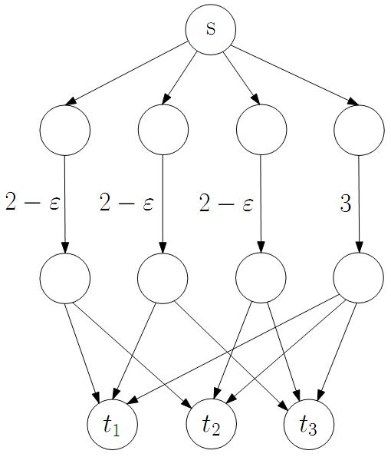
Strong Equilibrium - General Cost Sharing
A strong equilibrium doesn’t always exist in a connection game with general cost sharing
Example:
  Consider the single source game of 3 players (edges with no price tag are free, i.e. zero cost):
Notes:
Even for a game where all players have the same source s, a strong equlibrium doesn’t always exist (recall that we proved that if all players have the same source and sink, a strong equilibrium does exist).

Slide 58
Strong Equilibrium - General Cost Sharing
Example cont:
  If all 3 players choose the edge of price 3
    there are 2 players which pay together at least 2
    they can unite and migrate to an edge of price 2−ε and improve their utility.
  If 2 players share an edge of price 2 − ε
    the third player pays at least 2 − ε for his edge
    all 3 together pay 4 − 2ε and thus can improve their benefit if all would move to the edge of price 3.
  So in any case, there is a coalition of players that can change their move and benefit
  It follows that a strong equilibrium doesn’t exist

Slide 59
Strong Equilibrium - General Cost Sharing
As before, we’ll bound the SPoA when it does exist. In fact, we’ll show SPoA=1.
  meaning that a strong Nash equilibrium has an optimal cost.
  The bound will hold for single source cost sharing only.
Theorem 4.16 In a single source general cost sharing game, every strong equilibrium is optimal.

Slide 60
Proof Theorem 4.16
The optimal solution must be a tree
  otherwise we would have a vertex with 2 edges pointing it, one of them can be discarded, in contradiction to the optimality of .
  the tree of an optimal solution
    with root s, the players’ source point
  the set of edges used by an optimal solution

Slide 61
Proof Theorem 4.16
- the subtree of that disconnects from s when e is removed
- the set of players whose sink is in
- the total cost (by p) for players in
  i.e
- the cost for a set of edges E

Slide 62
Proof Theorem 4.16
Assume by contradiction that p is not optimal.
  i.e.
We’ll show a sub-tree T′ such that the set of players Γ(T′) can change their payments, so each one of them will benefit.
This will contradict the fact that p is a strong equilibrium.
First we’ll show how to build T′, then we’ll construct the new payments of the coalition players.

Slide 63
Proof Theorem 4.16
We start with building T′.
We define an edge e as bad if:
  Meaning the players with sinks in pay no more than the cost of the sub-tree (including the edge that connects it to the main tree ).
  These players will not be part of the coalition.

Slide 64
Proof Theorem 4.16
We define T′ as the tree derived from after we remove all bad edges, including their sub-trees:
  Note that it’s enough to remove only the top (closest to the root) edge and its sub-tree from each path containing bad edges.
  Thus we can assume the trees removed to be disjoint.

Slide 65
Proof Theorem 4.16
From the definition of a bad edge it follows that every sub-tree that we removed from didn’t decrease the difference between the payments and the cost of the remaining tree.
Therefore, for every edge e we have that . .

Slide 66
Proof Theorem 4.16
Now that we defined T′, we got a coalition Γ(T′).
We can define new payments for them, such that:
  for every i∈Γ(T′).
Note that the coalition is not empty
  Since
  Thus at least one of the edges the starts from s is not a bad edge.

Slide 67
Proof Theorem 4.16
- the new payment of player i for the sub-tree
Note we have not yet defined .
We will show that for every sub-tree :
  Therefore,

Slide 68
Proof Theorem 4.16
We define the new payments by edge
  Going bottom-up on the tree T′
When we’re done assigning payments for a sub-tree , we have that :
  Meaning the sum of payments of the coalition embers for edges in this sub-tree equals the price of the sub-tree

Slide 69
Proof Theorem 4.16
Recall that .
We can use this difference to split the cost of the edge as follows:
  for every

Slide 70
Proof Theorem 4.16
With the new payments , we have for every
:

Slide 71
Proof Theorem 4.16
This completes the proof.
We have shown that if p creates a sub-optimal tree, then it is not a strong equilibrium.

