Slide 1
Mathematical Modelling Of Infectious Diseases
Overview And Classical Models

Slide 2
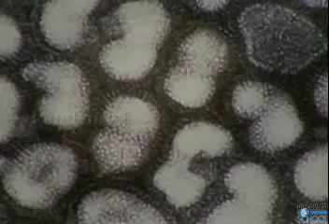
History And Motivation

Slide 3
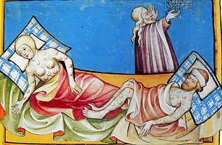
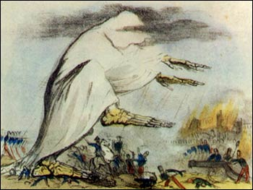
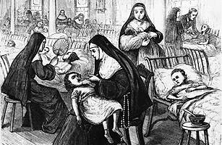
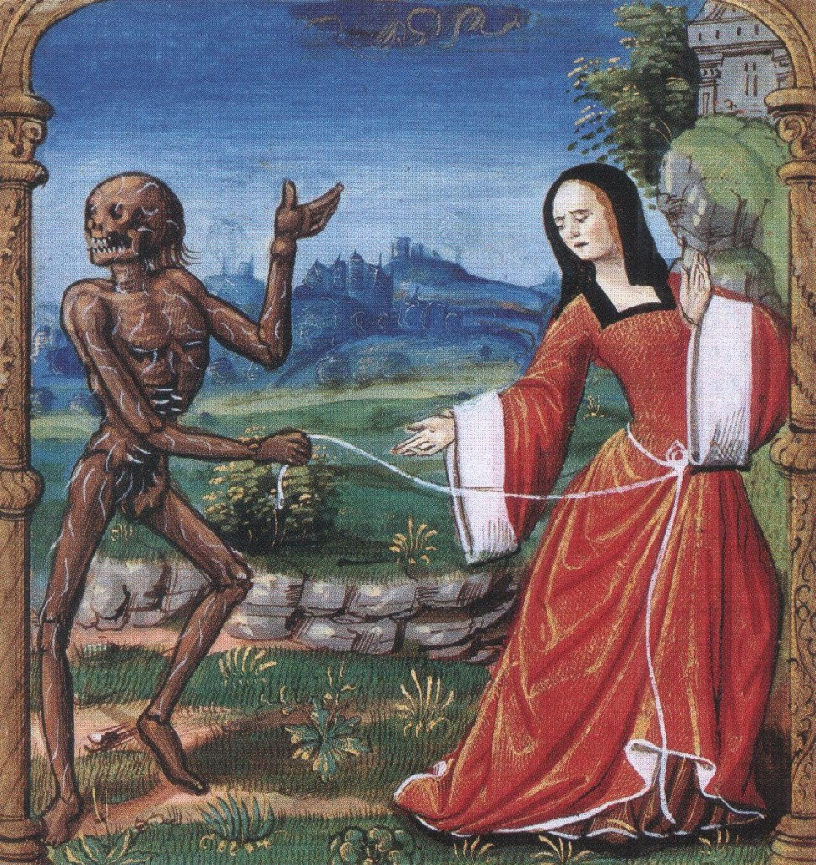
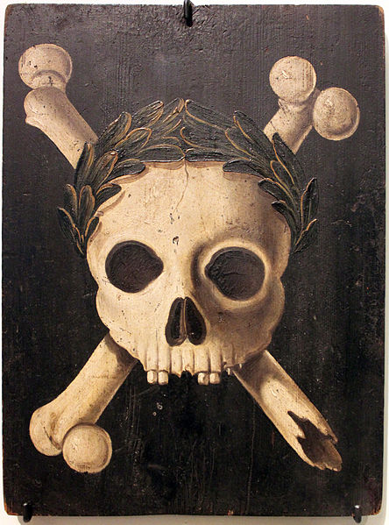
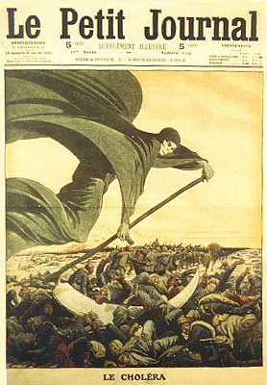
History And Motivation
Diseases and epidemics have been a natural component of our ecological system since the beginning of time.

Slide 4
History And Motivation

Slide 5
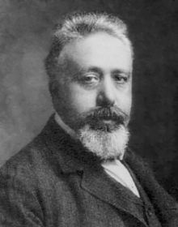
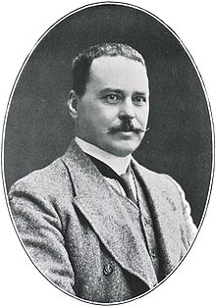
History And Motivation
During the first years of the 20th century, a revolutionary idea has emerged. Pioneers such as Ronald Ross, Lowell Reed, Wade Frost and Vito Volterra have begun to construct mathematical models which qualitatively imitate the natural processes of population dynamics.

Slide 6
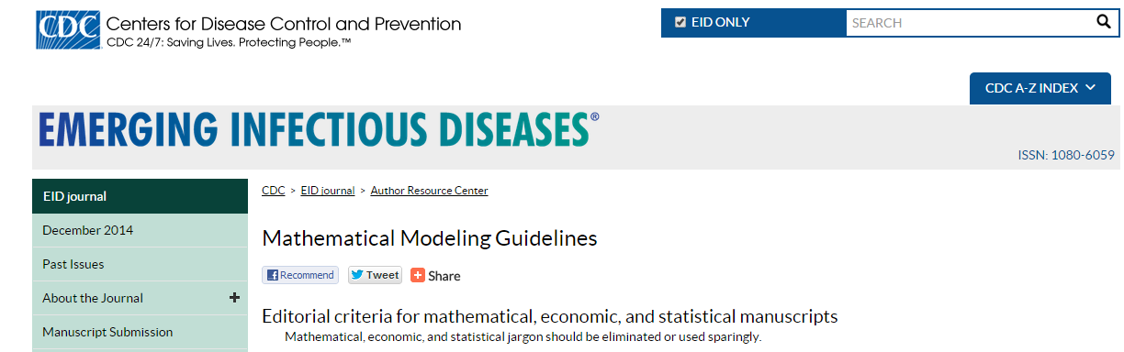
History And Motivation
These new ideas have greatly contributed to the understanding of infectious diseases and provided valuable insights into prevention and containment of epidemics. Mathematical models have become an indispensable tool in determining public health policies – healthcare programs, vaccination campaigns etc.

Slide 7


Slide 8
Assumptions And Notations
Denote by N the size of the population. We will assume that N remains constant. Thus, in models with vital dynamics (births and deaths), the number of births will be equal to the number of deaths.
The population is divided into epidemiological classes, which are denoted by capital letters M,S,E,I and R. The precise classes that are chosen vary from model to model.

Slide 9
Assumptions And Notations
Denote by S(t),I(t),R(t)… the fractions of the population in these classes and assume N to be large enough for the sizes of the classes to be described by a continuous function.
The population is homogenously mixing. Denote by λ the daily contact rate – the average number of adequate contacts per infective, per day. Therefore, the average number of susceptibles infected by the infective class per day is λSNI. We assume the daily contact rate to be fixed.
Individuals move between the classes at a rate proportional to their size with a proportionality constant .This corresponds to an exponentially distributed random variable

Slide 10
Assumptions And Notations
Denote the contact number by σ. It is defined to be the average number of adequate contacts (with both susceptibles and others) of an infective during an average infectious period. The contact number allows us to define the average number of infections produced when one infected individual is introduced into a susceptible population, denoted by Rₒ.

Slide 11
Goal
A basic concept in epidemiology is the existence of thresholds. These critical values for quantities such as the contact number, population size or vector density that must be exceed in order for an epidemic to occur or for a disease to remain endemic.
Since mathematical models of infectious diseases focus on the spread of the disease in the population, they are usually formulated in terms of proportions rather than sizes of the classes.

Slide 12
Classic SIR Model – No Vital Dynamics
Also called the classic epidemic model, since it imitates the spread of a disease which goes through the population in a relatively short period of time (usually up to one year). Therefore, the model does not include vital dynamics.
We consider diseases for which infection confers permanent immunity.
Epidemics are common for diseases such as influenza, measles, rubella and chickenpox.

Slide 13
Classic SIR Model – No Vital Dynamics
The IVP for the SIR model without vital dynamics is given by (the contact rate is, therefore, σ = λ/γ)

Slide 14
Classic SIR Model – No Vital Dynamics
Since the model should imitate reality, a question arises regarding the well-posedness of the model. However, in addition to mathematical well-posedness, we require epidemiological well-posedness.
Thus, we are interested in the epidemiologically reasonable region in the SI plane.
Theorem [Nagumo,1942] : A compact set is invariant if the direction field of the differential equation is tangent or pointing into the set at every boundary point.

Slide 15
Classic SIR Model – No Vital Dynamics

Slide 16
Classic SIR Model – No Vital Dynamics
Is the model compatible with reality?

Slide 17
Classic SIR Model – No Vital Dynamics
Thus, the intuition derived from the model can be summarized in the following theorem
As we have seen, a relatively simplistic model allows us to have compatibility with reality, on the one hand, and to reach some threshold parameters, on the other hand. Let us look at another application derived from the predictions of the model.

Slide 18
Infectivity Estimation
Rapid detection, rapid response. But how rapid?
There is a need for an indicator of infectivity, which allow us to compare various diseases and to estimate a suitable response time. The given theorem allows us to do just that, under a very reasonable assumption.
If we assume Iₒ to be extremely small (an assumption which is supported by available data) we have 1-Rₒ ≈ Sₒ. Substituting this into the equation in the theorem we get

Slide 19

Infectivity Estimation
By using data regarding epidemics in homogenous population without vaccination, we can estimate the contact numbers of various diseases under various circumstances. This is done by estimating Sₒ and S($∞$) via serologic studies.
Evans (1982) reports on sero-surveys conducted on freshman at Yale university. The results were σ = 6.2 for rubella and σ = 1.44 for influenza.

Slide 20
Classic SIR Model – With Vital Dynamics
We introduce births and deaths into the model (the size of the population remains constant). By doing so we obtain a model suitable for describing diseases which persist in the population over a long period of time. Such diseases are called endemic.
Therefor, we introduce into the model a new parameter μ, which denotes the death rate constant. Deaths can occur in every class and their number is proportional to the size of the class.
We also update the contact number to account for the new parameter : σ = λ/(μ+γ) .

Slide 21
Classic SIR Model – With Vital Dynamics
Some diseases which can be described with the help of this model are Polio, HIV and Cholera .

Slide 22
Classic SIR Model – With Vital Dynamics
The IVP for the SIR model with vital dynamics is given by
We use the same epidemiologically reasonable region T.

Slide 23
Classic SIR Model – With Vital Dynamics
We use numerical integration in order to present the phase plane portraits for this model. With vital dynamics there are two options.

Slide 24
Classic SIR Model – With Vital Dynamics
The behaviour of the disease in this model is summarized by the following theorem
As can be seen in the theorem, this model is characterized by a transcritical bifurication at σ = 1. The value of this threshold parameter dictates which of the equilibriums of the model are stable.

Slide 25
Classic SIR Model – With Vital Dynamics
We can observe this phenomenon by looking at the appropriate bifurication diagram. Afterwards let us look at some implications.

Slide 26
Infectivity Estimation
Previously, we presented a way to estimate the contact number from epidemic data. With vital dynamics, it is also possible to do so. If disease is near it’s endemic equilibrium, we can perform a serological survey and use the estimate σ=1/Sᵉ .Thus, we obtain an infectivity parameter for the disease.
By using this method, the following estimates can be obtained:
  Measles - σ = 16
  Polio - σ = 5
  Mumps - σ = 12

Slide 27
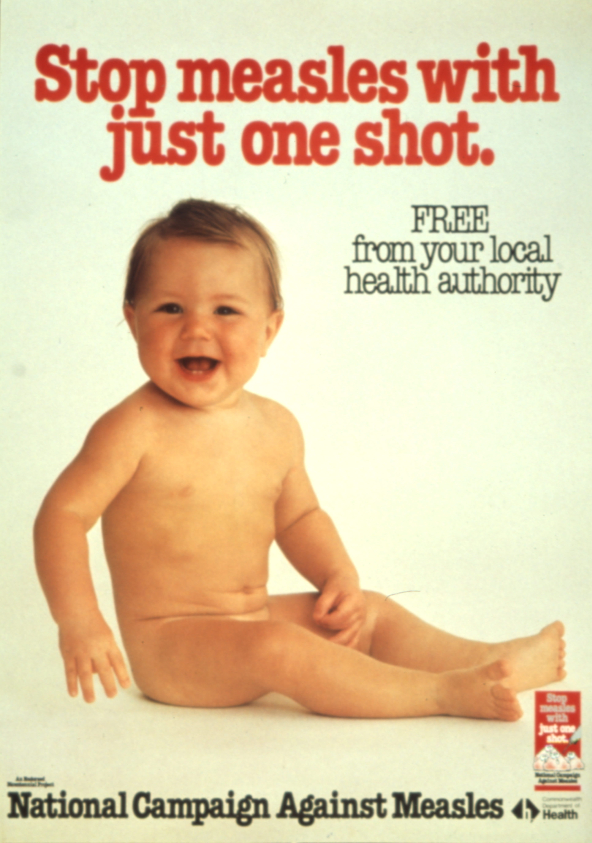


Herd Immunity - Theory
This model provides a mechanism which can (possibly) allow us to eradicate certain diseases. This mechanism is mass vaccinations.
Herd immunity for a disease occurs if enough people have disease-acquired or vaccination-acquired immunity.

Slide 28
Herd Immunity - Theory
Let us remember that the contact number denotes average number of adequate contacts (those which are sufficient for transmission if all contacted people are susceptible). On the other hand, we have seen that the value of σS (replacement number – the number of secondary infectives an infective produces) determines the way the infection spreads.
Therefore, if the population is homogenously mixing and the immune people are distributed uniformly then by vaccinating a sufficient fraction of the population we can cause the replacement number to be smaller than 1. In this case, the disease won’t reach the endemic equilibrium.

Slide 29
Herd Immunity - Theory
Therefore, after estimating the contact number of a disease, vaccinating enough people in order to achieve σS < 1 will result in herd immunity. Under our previous assumption, it is enough to demand σ(1-R) < 1.

Slide 30
Herd Immunity - Practice
Attainment of herd immunity for a disease can be quite difficult
  Vaccinations are not uniformly distributed in a population – fear and mistrust, non-accessible populations, religious reasons etc.
  For various reasons a small fraction of those who are vaccinated do not become immune.
  The models are simplified proxies.
Nevertheless, several serious diseases were eradicated over the course of the 20th century : smallpox was eradicated globally in 1977 and the number of rubella, measles, mumps and polio cases diminished significantly.

Slide 31
Limitations and Extensions
We have seen that the classic models allow us to reach some interesting conclusions regarding Epidemiology. However, these models make some binding assumptions. Let us address some these assumptions
  Constant population size – The classic models do not deal with changes in N and therefore with diseases with high mortality, such as ebola, plague and some strains of flu. The MSEIR model with exponentially changing size is the basic model that takes into account changes in N.
  Age structure – The models do not take into account the division of the population into age groups

Slide 32
Limitations and Extensions
  Gender.
  Immunity of some parts of the population.
  Changing daily contact rate λ – between age groups, climate zones, seasons etc.
  Non homogenous mixing of the population – In reality, the transmission of infection depends strongly on the pattern of contacts between members of the population. This leads to stochastic epidemic models.
  Mutating viruses – For example, HIV and Flu.

Slide 33
Conclusion
  It is a most extraordinary thing, but I never read a patent medicine advertisement without being impelled to the conclusion that I am suffering from the particular disease therein dealt with in its most virulent form. The diagnosis seems in every case to correspond exactly with all the sensations that I have ever felt.
  Three Men In A Boat
  Jerome K. Jerome

Slide 34
SIS Model With Disease Fatalities
In this model with vital dynamics, recovery gives no immunity to the disease.
We expect to see the disease reach the endemic equilibrium.
Assume that the rate of removal of infectives by death due to the disease is proportional to the number of infectives. We denote this removal rate by η.
In this model, denote by NR(t) the number of people who have died due to the disease.

Slide 35
SIS Model With Disease Fatalities
The IVP for this model is given by
We call η – the daily disease related death rate.

Slide 36
SIS Model With Disease Fatalities
Numerical integration provides us with the following SI phase plane portrait

Slide 37
SIS Model With Disease Fatalities
Define ξ to be ξ = η/(γ+δ). We have the following result
Therefore, in a disease with no immunity where the disease causes death, the disease always disappears and the final susceptible fraction is positive.

Slide 38
SIS Model With Disease Fatalities
The fraction R is increasing inasmuch as the disease is fatal to a fixed proportion of the infectives, so that the reproducing population S+I decreases until the birth of new susceptibles is not sufficient to keep the disease endemic.
The model is not realistic in a human population, since for a potentially fatal disease, preventive measures would be taken, which will invalidate one of the model assumptions, such as homogenous mixing.

