Slide 1
CRIS systems in Europe: brief overview
Dr. Luba Gornstein, The Library Authority
July 2016

Slide 2
Questions for discussion
Objectives
Which modules to use?
Which types of materials to include?
Which parts will be public domain?
What and how to measure?
Who manages and maintains the system?
National or institutional?
The Library Authority 07/26/2016
Slide No.

Slide 3
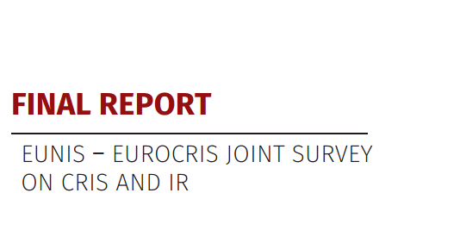
CRIS systems – brief history in Europe
86 respondents
20 countries
The Library Authority 07/26/2016
Slide No.

Slide 4
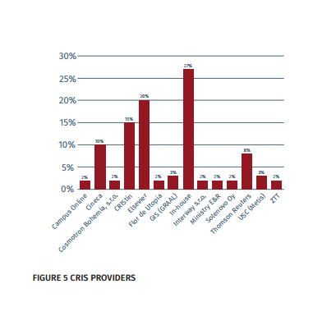
Who is a provider?
The Library Authority 07/26/2016

Slide 5
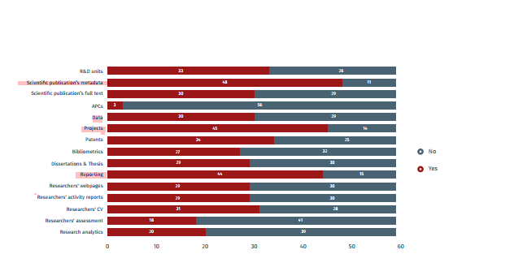
Main functionalities
The Library Authority 07/26/2016
Slide No.

Slide 6
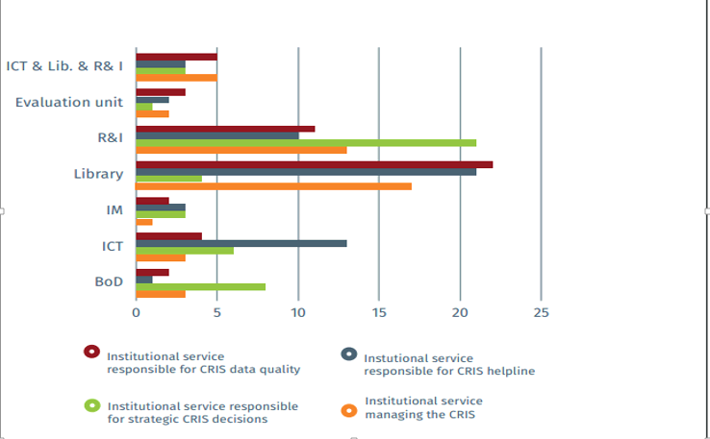
Who manages?
The Library Authority 07/26/2016
Slide No.

Slide 7
How CRIS changes the scope of evaluation of the academic impact
Complements the data existing in the main international databases (WoS, Scopus, etc.)
Includes local publications in local languages
Includes the material types which are not covered by WoS and Scopus
Gives much better coverage to Humanities and Social Sciences
The Library Authority 07/26/2016

Slide 8
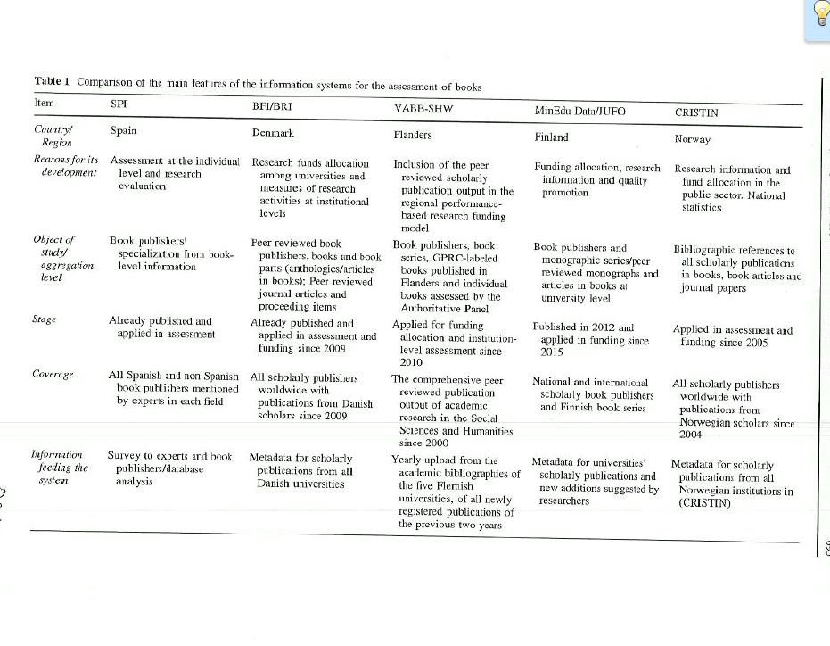
National metrics
“The BRI (Bibliometric research indicator) takes into account published research and review articles from peer-reviewed journals, monographs, anthology and proceedings papers and articles in books published by Danish research institutions”.
The Library Authority 07/26/2016

Slide 9
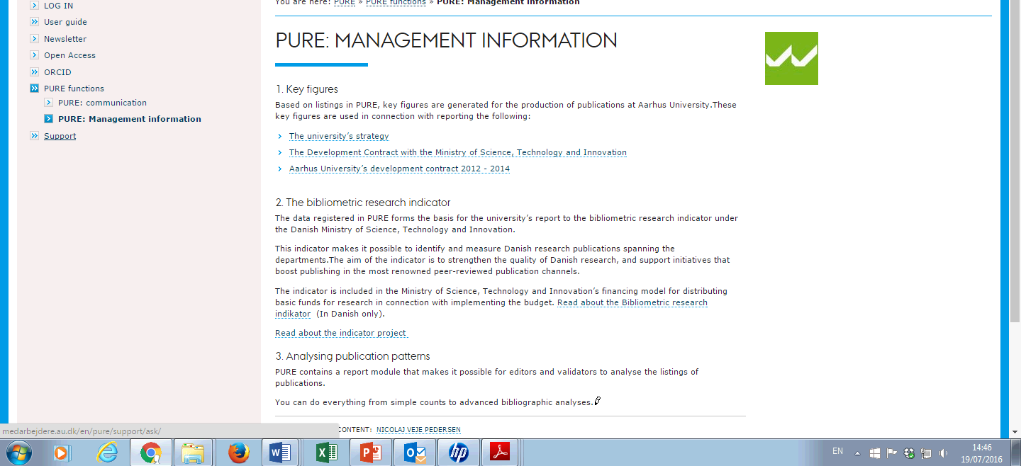
Aarhus University - Denmark
The Library Authority 07/26/2016

Slide 10
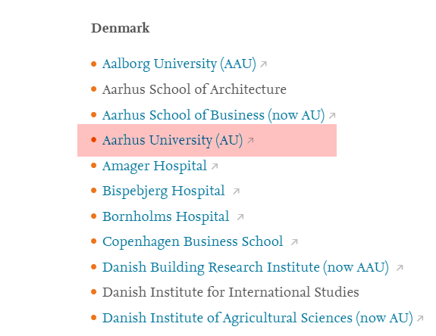
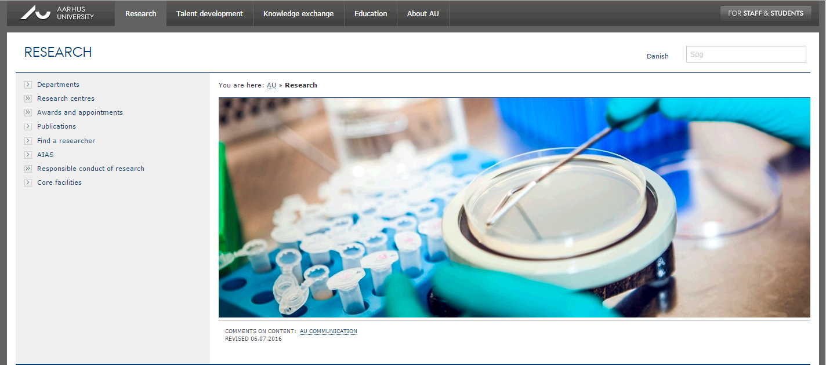
Aarhus University - Denmark
The Library Authority 07/26/2016
Slide No.

Slide 11
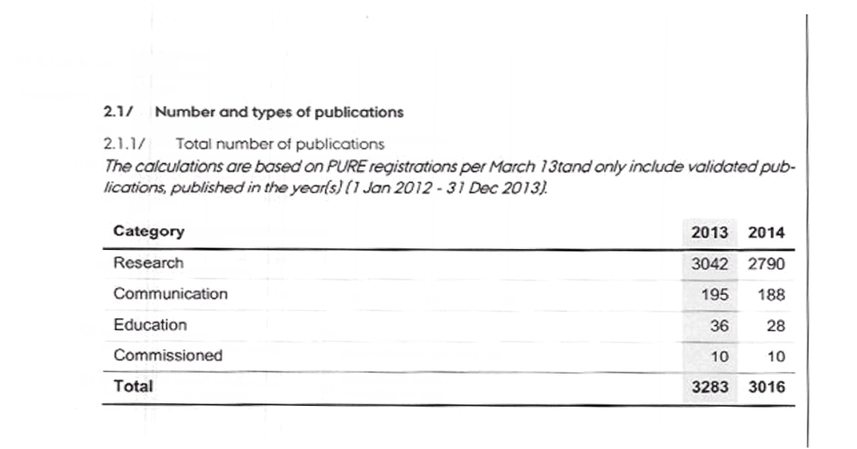
AU – Internal reporting
The Library Authority 07/26/2016

Slide 12
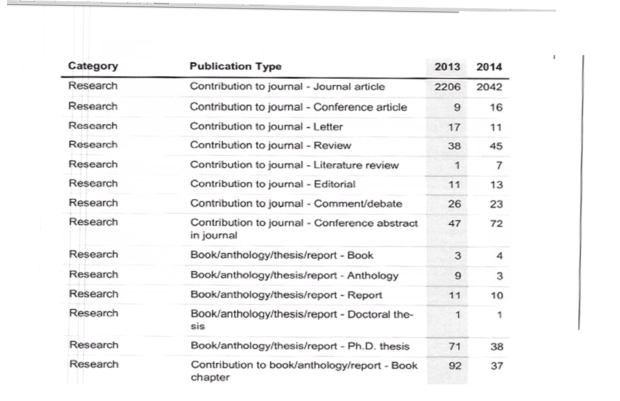
The Library Authority 07/26/2016

Slide 13
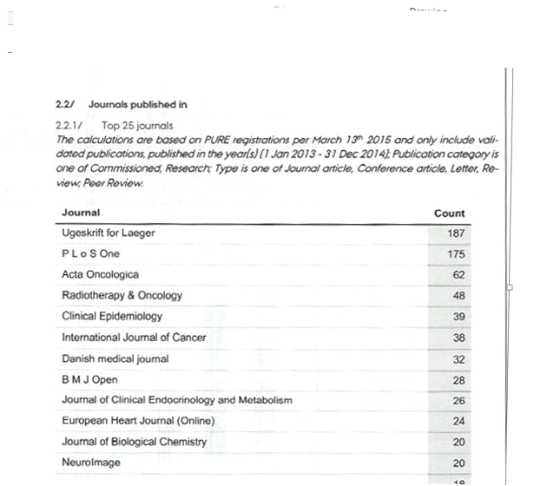
The Library Authority 07/26/2016

Slide 14
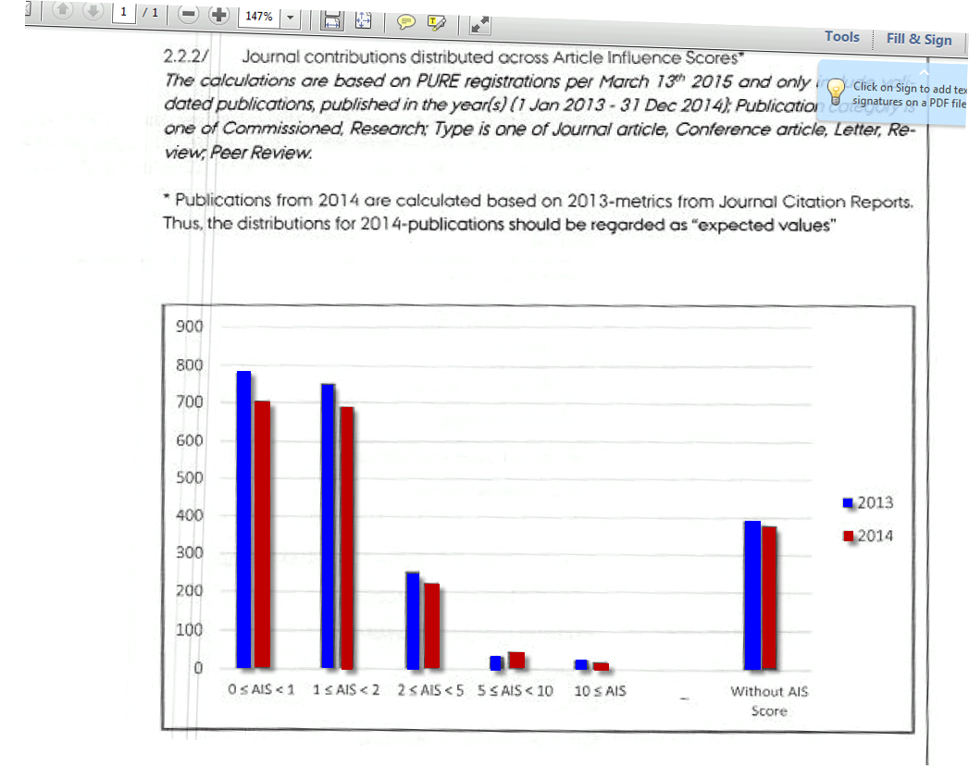
The Library Authority 07/26/2016

Slide 15
The Library Authority 07/26/2016

Slide 16
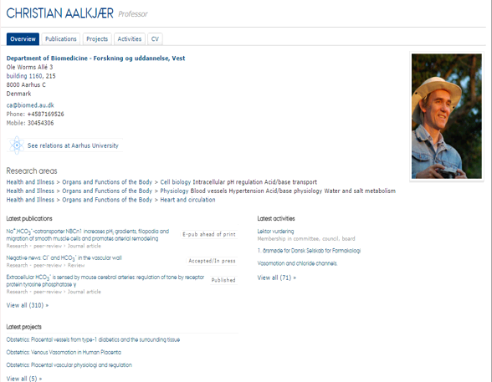
The Library Authority 07/26/2016

Slide 17
Recommendations
Create the indicator for evaluation on the national level
Data quality assessment plan
Standards for reporting
Professional cooperation
The Library Authority 07/26/2016

