Slide 1

New Directions towards 10% Efficient Dye Solar Cells at 3GSolar
Jonathan Goldstein
IFCBC, 26 January 2011

Slide 2
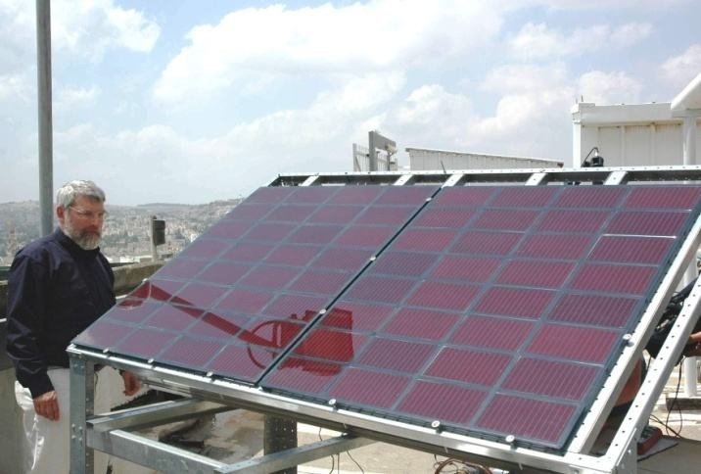
Company Changes
New ownership and direction – from September 2010
Investment by private equity fund (Solar Partnership) advised by Smedvig Capital (UK)
Company located in Jerusalem; Staff of 12
3GSolar has 13 background patents and licensing agreements with partners
Bar Ilan University, Weizmann Institute and Joma International (Norway)

Slide 3
Background to Dye Solar Cell Technology
Dye Solar Cells (DSC) first discovered by Prof. Michael Graetzel, Switzerland
Light conversion mechanism and materials completely different from conventional inorganic semiconductor (Si, CdTe, CuInSe₂) solar cells
  Not based on microelectronics processing
  Low cost materials
  Very low-cost manufacturing
Main barrier for market entry to date is low efficiency
  3GSolar identified a viable and experimentally verified route for higher efficiencies
  Focus is incorporating this new approach into 3GSolar existing technology platform

Slide 4
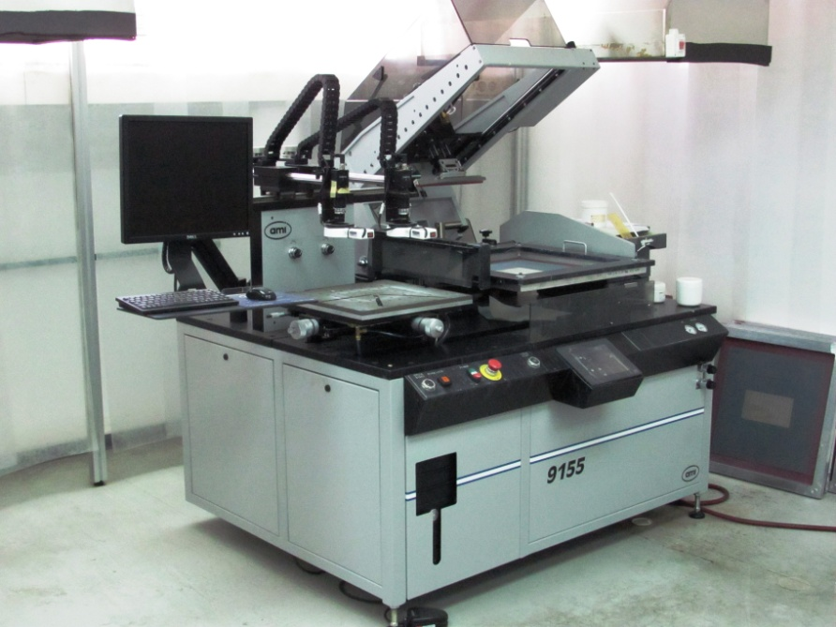
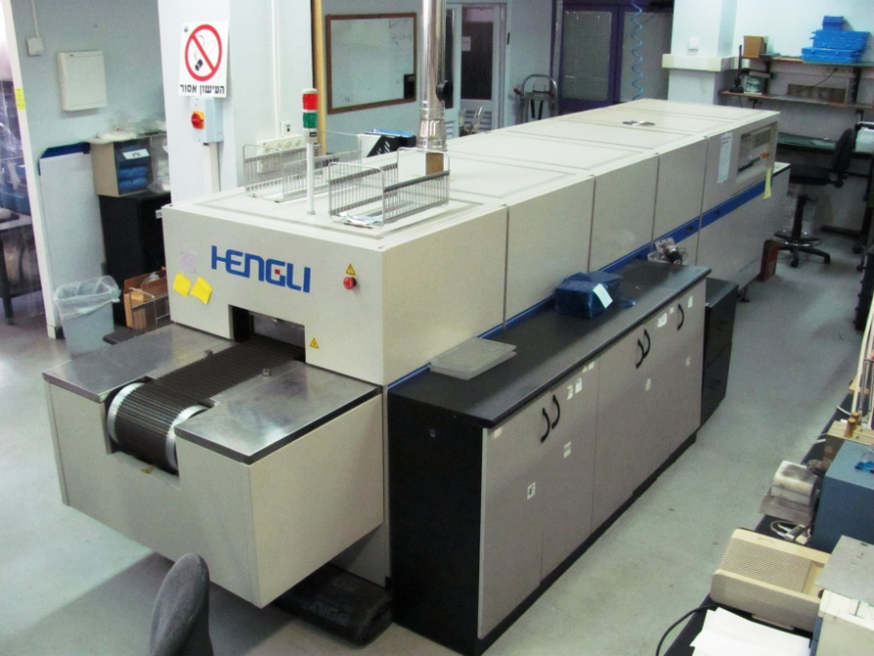
3GSolar Photovoltaics – DSC Advantages
Screen Printer
Low Manufacturing Costs
Main Manufacturing Processes
  Screen Printing
  Sintering
  Advantages
  No high vacuum processing
  No severe clean room conditions
  No toxic chemicals
Pilot Production
at 3GSolar
Belt Furnace

Slide 5
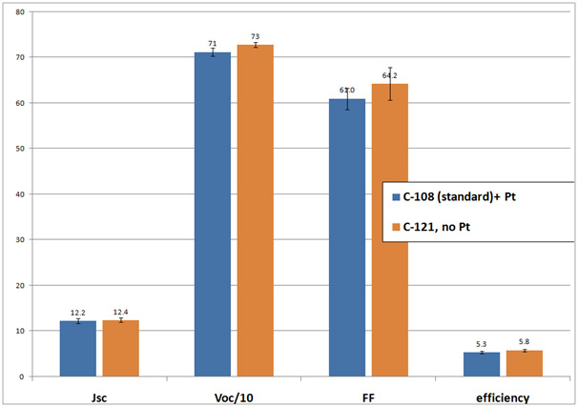
We are eliminating platinum in the carbon cathode
Notes:
5

Slide 6
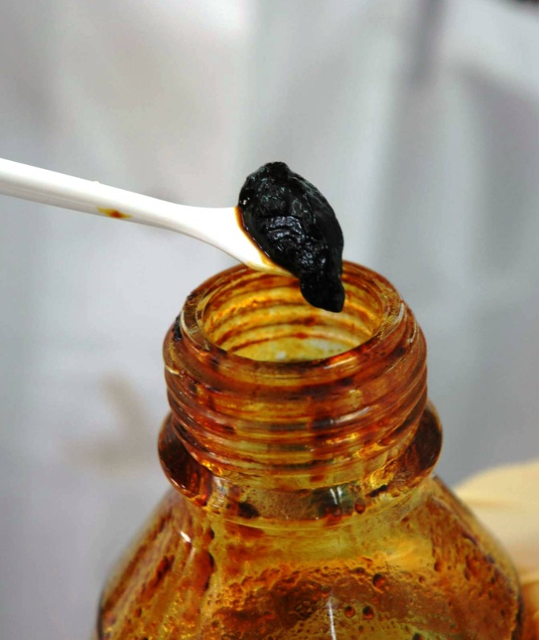
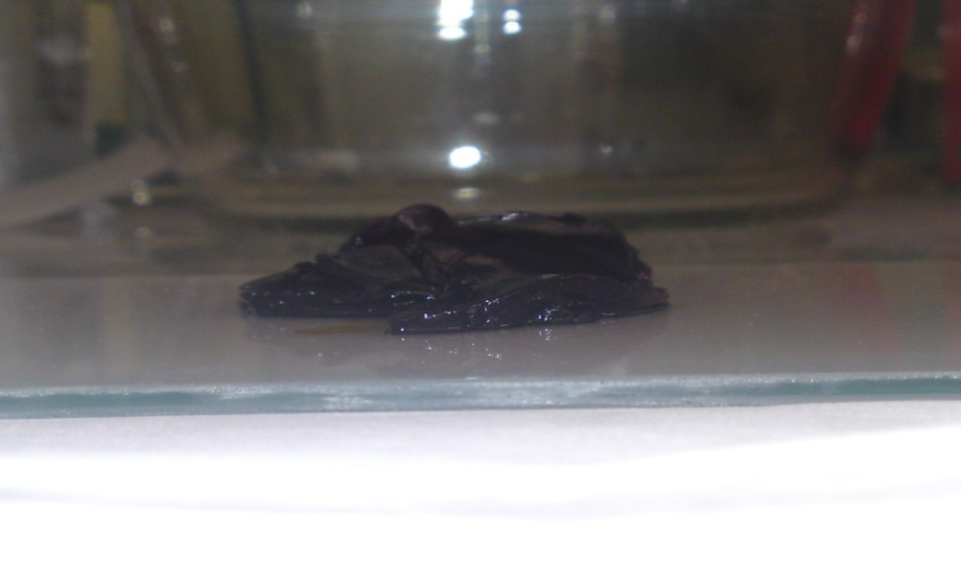
We have developed an in-house immobilized electrolyte
Notes:
6

Slide 7
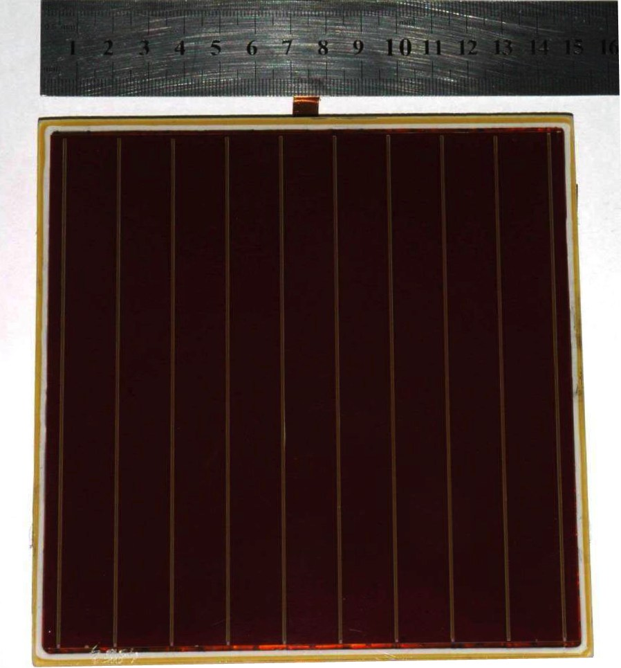
Our square cell design (external area 225 sq cm, aperture 202 sq cm) for pilot production
Notes:
7

Slide 8
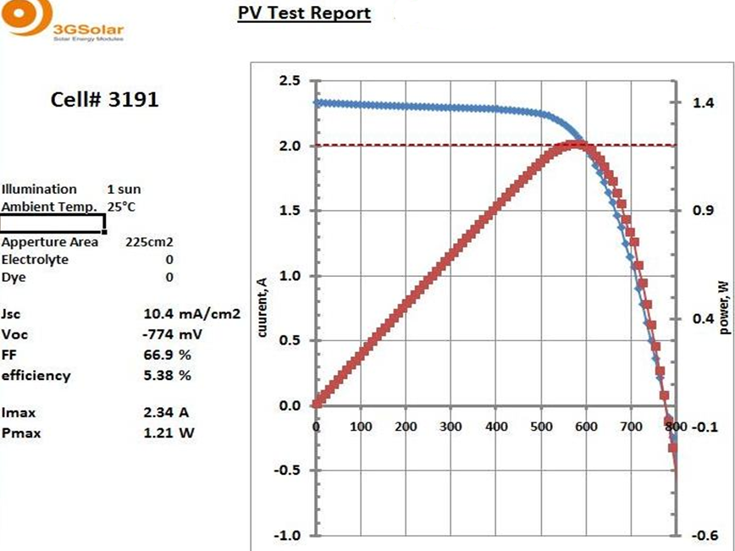
Large Area 3GSolar DSC (area 225 sq cm) with 5.4% efficiency at one sun-Confirmed by ECN, Holland
Notes:
8

Slide 9
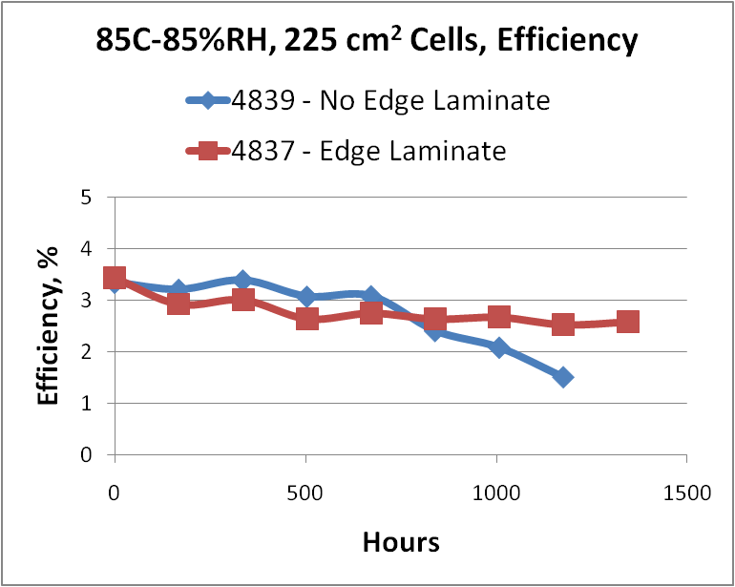
3GSolar Cell Endurance Tests
Notes:
9

Slide 10
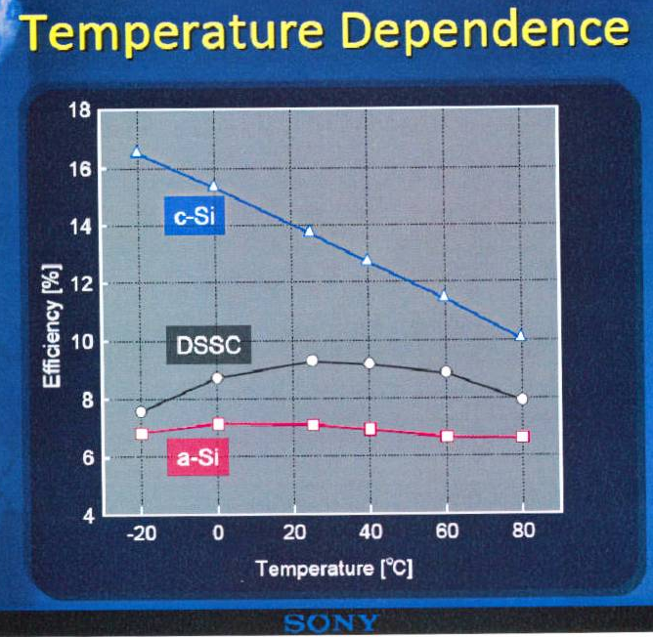
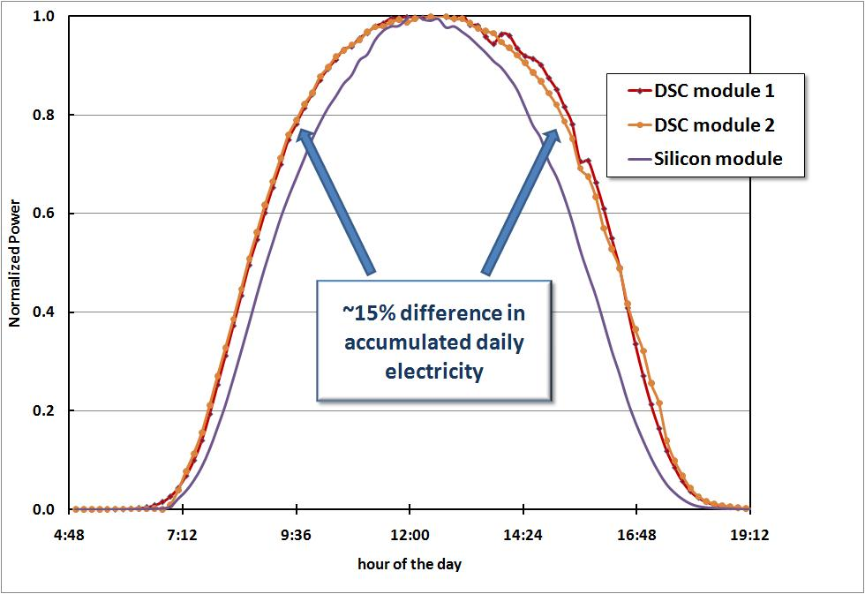
3GSolar Photovoltaics – DSC Advantages
Captures more total light than Si
  Sunny and cloudy days
  Less sensitive to temperature than Si
  Less sensitive to orientation than Si
  Not sensitive to shading
Results in lower $/kW-hr
3GSolar Results
May 2009

Slide 11
3GSolar Photovoltaics – Program
Goal
To achieve 10+% module efficiency
in a printed solar cell
Methodology
Incorporating Foerster Resonance Energy Transfer (FRET) technology into the existing 3GSolar printed DSC platform
Expected results
Printed DSC – Low cost, high efficiency, long lifetime!
Will result in 3GSolar entry into commercial, on-grid PV market

Slide 12
3GSolar Project Partners
FP7
Prof. Graetzel Prof. Torres
Merck ECIC (Taiwan)
Solaronix (Swiss) Torrey Hills (USA)
Direct R&D Partners
Collaboration
Arie Zaban, BIU
Dan Oron, Weizmann
David Cahen, Weizmann
Joma International, Norway
3GSolar

Slide 13
3GSolar Photovoltaics – problem and solution
Current barrier
  Efficiency of 3GSolar commercial-size cell currently 5.4%
The 3GSolar solution to boost efficiency –
  FRET allows us to capture more of the solar spectrum
    Current 3GSolar current density is 12 mA/cm² vs. 24 mA/cm² expected for light capture to 900 nm
    Doubling light capture and increasing voltage leads to X2.5 previous efficiency
    Current best dye cell research lab results at 12% efficiency without FRET
  FRET physics completely compatible with current 3GSolar module design (Plug and Play)

Slide 14
What is FRET?
FRET process is nonradiative Energy transfer from excited fluorophore (donor) to another chromophore (acceptor).
D
A
Energy transfer
Advantage of FRET is light absorption and electron injection roles are separated. Antenna molecules collect photons to feed to dye molecules.

Slide 15
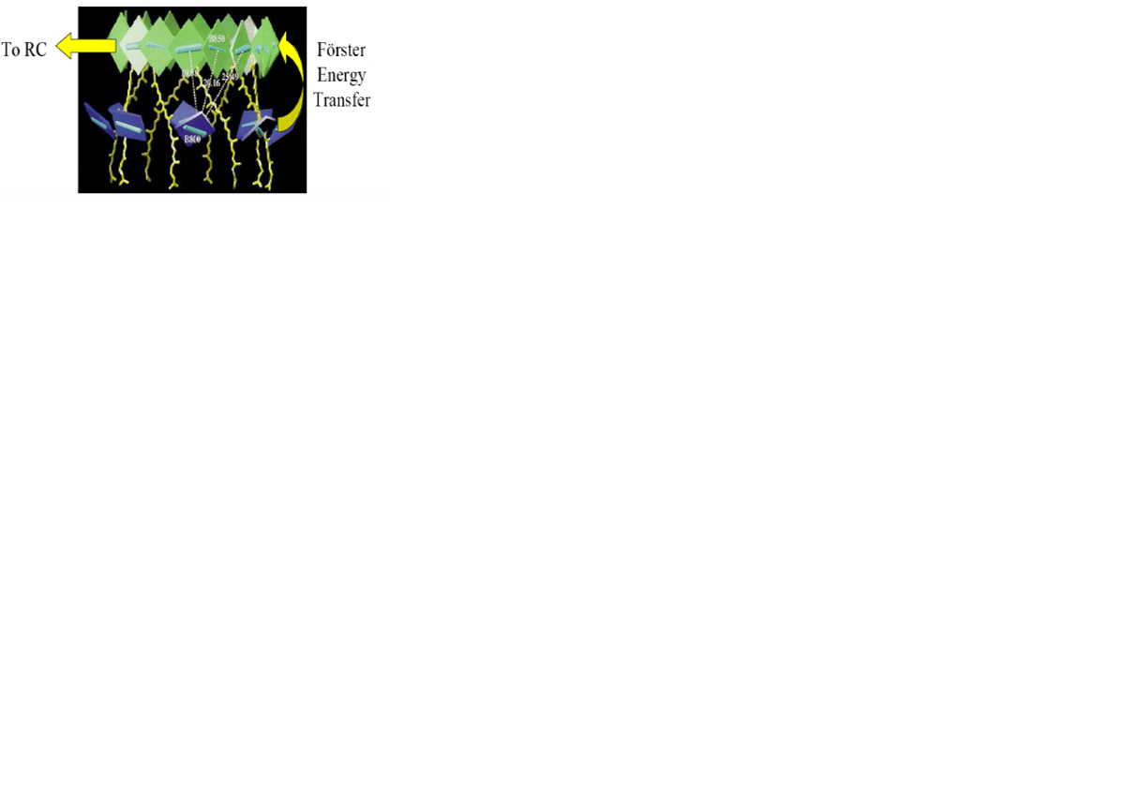
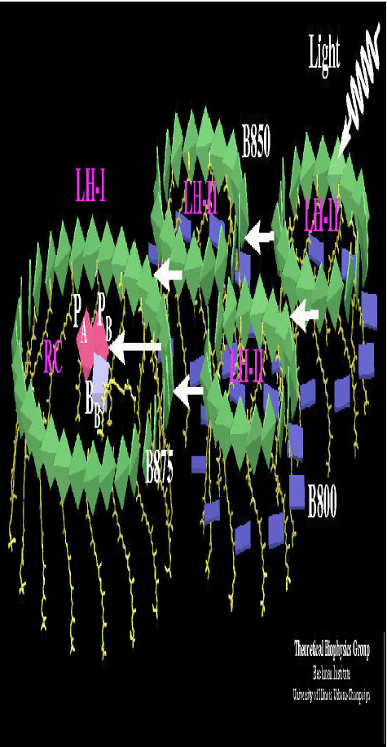
FRET and Photosynthesis
1
Light in
3
e⁻ Injection
Reactive
Center
3
2
QD
e⁻ Injection
TiO₂ e⁻ Acceptor
Light
in
dye
1
Chlorophyll
Antenna
2
FRET Process
COMPONENT | FRET-DSC | PHOTOSYNTHESIS
Antenna – FRET Donor | Quantum Dots | Chlorophylls
FRET Acceptor & e⁻ Donor | Dye | LH-II and LH-I
Electron Acceptor | TiO₂ | Chemical Reaction Center
Electron Donor | I⁻ | Organic molecules (quinones)
1
2
3
Photosynthesis achieves FRET efficiencies as high as 90%!

Slide 16
FRET – the performance potential
Typical 3GSolar
IPCE Curve
 | Standard 3GSolar 650 nm | FRET cell with I⁻ electrolyte, 900 nm | FRET cell with solid electrolyte, 900 nm
Potential Current, mA/cm² | 17 | 34 | 34
Current @ 70% IPCE, mA/cm² | 12 | 24 | 24
Voltage, V | 0.7 | 0.7 | >0.9
Fill Factor | 70% | 70% | 70%
Efficiency | 5.9% | 11.8% | >15.1%

Slide 17
FRET Proof of Concept
Work from lab of Prof. A. Zaban, BIU
Incident photon conversion spectra on three different electrode structures:
  nc-TiO₂/QD/a-TiO₂
  nc-TiO₂/a-TiO₂/dye
  nc-TiO₂/QD/a-TiO₂/dye
Combining QDs and dyes in FRET process dramatically increases photon conversion over whole visible spectrum
Shifting dye absorption to longer wavelengths will further increase conversion

Slide 18
3GSolar Photovoltaics – DSC Advantages
Low manufacturing costs
  Screen printing vs high vacuum for Si and thin film
  Under $0.40/W_{peak} module production costs
  Lowest PV plant capital costs

Slide 19
Summary
3GSolar is the leading developer of DSC technology
The project will focus on incorporating FRET approach into 3GSolar’s DSC technology platform
Will achieve 10+% efficiency in commercial scale printed modules
DSC has very strong cost and technical advantages over existing Si and thin-film technologies
3GSolar will be a game-changer for the on-grid PV market
Low capex and simple manufacturing lines allow installing plant sites anywhere in Israel or elsewhere on the globe

