Slide 1
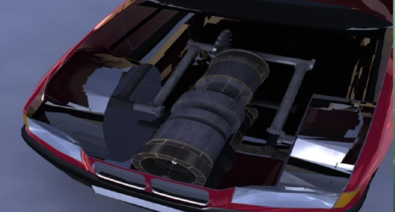
A national R&D Policy toward AN Oil-free world
Ministry of National Infrastructures
Office of the Chief Scientist
Dr. Shlomo Wald, Chief Scientist
Dr. Avraham Arbib, Deputy Chief Scientist
Israel Ministry of National Infrastructures

Slide 2
Overview of the MNI R&D objectives (1)
MNI is promoting four “vertical”, system- oriented, R&D efforts:
Renewable Energy and Energy Efficiency:
“Green and smart“ cities, homes and industries
Local renewables
Smart grids:
Natural integration of distributed electricity suppliers and customers
Better security of supply
Efficient usage of resources
…
Alternatives to oil for transportation and for the chemical industry
Future nuclear power

Slide 3
overview of the MNI R&D objectives (2)
All relevant “horizontal’, technology-oriented, R&D efforts:
Renewable Energy –
solar, wind, geothermal, energy from waste, biomass…,
RE for heating and cooling,
RE for fuel production,
etc…
Clean coal technologies
Transportation technologies
Basic research in supporting areas:
Materials science,
High-Temperature Superconductivity
etc…

Slide 4
The world’s addiction to oil (1)
The demand
Oil is NOT any more a key factor in electricity production (only ~5%)
~10% for heat (steam, etc.) production
But, transportation (ground, marine and air) is heavily dependent on oil (~60%)
The chemical industry consumes ~25% of the oil market
These two sectors are oil-captive markets
The oil demand increases exponentially, especially in developing countries

Slide 5
The world’s addiction to oil (2)
The supply
Cartel ➔ unstable and unpredictable prices
Most of the oil providers are have radical regimes that support terrorism
OIL-ALTERNATIVES WILL REDUCE THE UNDESIRED GLOBAL DEPENDENCE ON THE OIL CARTEL
Terrorism
Larger defense expenses
Increase in oil demand
Larger income to the oil suppliers
More resources to terrorism

Slide 6
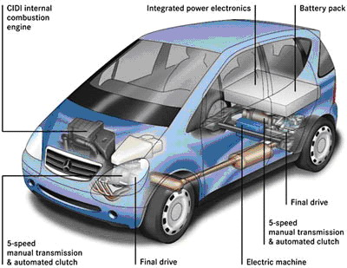
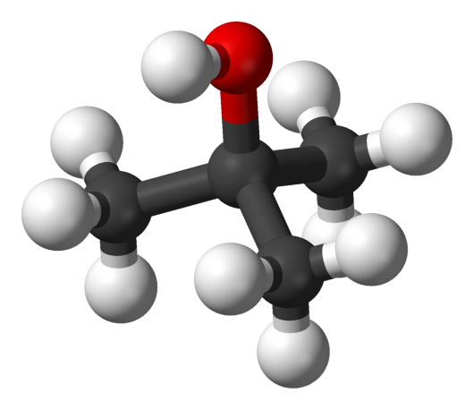
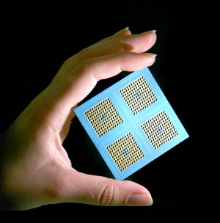
Alternatives to oil in the transportation sector
Biofuels
Propulsion technologies
Chemical fuels
Batteries, Fuel cells
Alternatives to oil in the transportation sector
Notes:
כיוונים במחקר והפיתוח הטכנולוגי

Slide 7
The prime minister’s initiative for alternatives to oil (1)
The target - To relax the GLOBAL addiction to oil – not limited to the Israeli market
The program -
Focus on the transportation sector only
Explore all alternatives: biofuels, electric cars, hydrogen, synthetic fuels (Fisher-Tropsch)…, efficient engines,…
Support the whole life-cycle of technology development
Support all the systems’ components – from technologies to implementation aspects: infrastructures, regulations, etc.
Long-term (10 years) commitment of funds, ~ 200 MNIS/year
Strong emphasis on international collaboration and international private and public financial contribution

Slide 8
The prime minister’s initiative for alternatives to oil (2)
The method –
Steering committee
Project manager (under the PM office)
One-stop center for all the activities
Use of existing governmental R&D tools: MOITAL Chief Scientist Office, MNI, MOST, ISF, BSF, BIRD, BARD, GIF,…
Establishment of up to four centers of excellence in the academe
Special venture-capital funds based on 1:3 governmental to private participation
International collaboration

Slide 9
Expected yearly budget distribution
 | The program budget (PMO) | MOITAL | MNI | MOST | Planning and Budgeting Committee | Total
Project management | 9 |  |  |  |  | 9
Cutting-Edge Experiments (MNI) | 20 |  |  |  |  | 20
One-Stop Center | 2 |  |  |  |  | 2
Investment Funds (MOITAL) | 40 | 20 |  |  |  | 60
R&D Grants (*) | 34 | 6 |  | 2 | 6 | 48
Centers of Excellence (2011-2015) (PBC) | 9 |  |  |  | 6 | 15
International Collaboration R&D(*) | 24 | 6 | 2 |  | 2 | 34
International implementation efforts (MOITAL) | 4 |  |  |  |  | 4
PM’s Prize (MOST) | 4 |  |  |  |  | 4
TOTAL | 146 | 32 | 2 | 2 | 14 | 196
(*) All of the participating organizations

Slide 10
The estimated implementation Roadmap
Time Range | Implementation Objectives
Short Range | Biofuels – Scaling up thermal process using fossil resources (coal, NG) and organic wastes ➔ biofuels and biocoal Limited implementation of biofuels – regulatory acts, etc. Electric vehicles – HEV, PHV, EV Other – CNG, H₂, etc. Shale oil
Intermediate Range | Demonstrating cutting-edge, scaled-up technologies such as Algae,… Thermal and/or chemical cellulose decomposition Agricultural energy plantation for export markets Hydrocarbon production in advanced FT processes Novel batteries and fuel-cells Hydrogen technologies: H₂ on-board, advanced storage, solar H₂ production,…
Long Range | Implementation of successful technologies

Slide 11
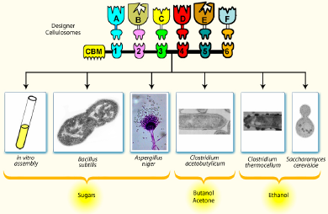
Some Opportunities for local researchers
Solar production of hydrogen
Solar production of synthetic fuels
Advanced Fisher-Tropsch processes (coal, wastes,…)
Artificial photosynthesis
Etc.

Slide 12
Energy efficiency
Efficiency and innovation
in the automotive industry
Agam's car engine should allow to achieve 100 miles per gallon, emitting 1/10 of the CO₂ and pollution of a standard car
 | Agam’s Engine

Slide 13
Electric cars
Fuel cells and batteries development
BetterPlace – Pioneering deployment of electric cars

Slide 14
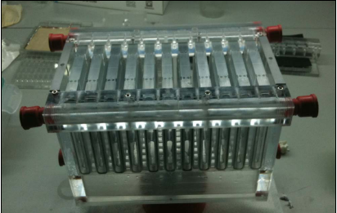
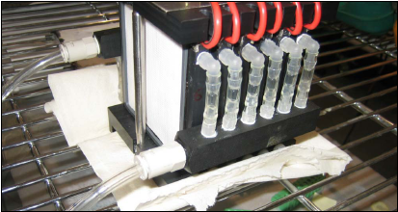
Batteries – Bar Ilan University

Slide 15
Summary and Conclusions
There is no doubt that alternatives to oil will attract a lot of interest and funds in this decade
There will be opportunities for large-scale pilot and demonstration projects
Collaboration within the Israeli academe and R&D institutes, as well as academe-industry, and international cooperation will be strongly encouraged
We expect stronger motivation to enter this field by researchers that are not presently active in it
There should be opportunities for top scientists from abroad to join Israeli centers of excellence

Slide 16
Thank You

