Slide 1

Large Area Glass-Based PV Dye Cells and Modules at 3GSolar
Dr. Jonathan Goldstein (President) 3GSolar Ltd., Israel
IFCBC, Tel Aviv University, Feb 2010

Slide 2
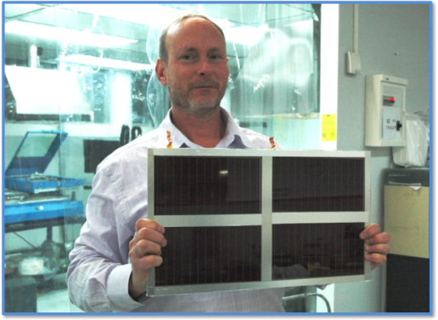
Background on 3GSolar Ltd.
Founded in 2004 (originally named Orionsolar)
Start-up company, located in Jerusalem, Israel
Team with broad experience in solar energy, batteries, fuel cells, capacitors and materials
Management headed by Barry Breen (CEO), Dr. Jonathan Goldstein (President) and Dr. Ilya Yakupov (CTO)
Initial funding from US-based 21Ventures and the Office of the Chief Scientist (Israel)

Slide 3
Overview
3GSolar - Pioneer in Commercializing 3rd generation PV – Dye Solar Cells (DSC)
DSC- low cost alternative to silicon and thin film PV technologies
Disruptive technology: printed PV instead of vacuum processing
1st market is off-grid (3rd world) - then solar fields/rooftops
Our first projected 8MW line (2011) will cost <$10M (a fraction of the capex for silicon or thin film) giving a low entry cost of US$1.4 per peak watt for 7% efficient modules, life 7 years
By 2014, we predict our efficiency will reach 10% and life 15 years, reducing cost to US$0.7 per peak watt - based on multiple plant manufacturing scenarios, improved performance critical components (e.g. dye) and optimized cell design, with plants in Israel & abroad

Slide 4
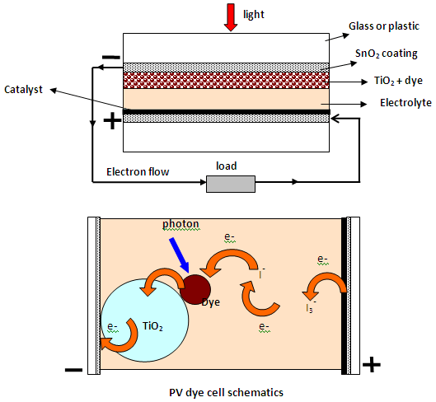
Technology
Dye cells (DSC) & artificial photosynthesis compared
Our cell comprises a photoanode of nano-titania coated with a self-assembling monolayer of dye, a redox electrolyte and a carbon-based counter electrode
Layers printed in air onto glass
Previously-no efficient current collection for practically sized cells. The unique 3GSolar robust current collector increases cell current, active area, efficiency & durability. Cheap, benign materials
Notes:
4

Slide 5
Strategic Partners
Academic/Industry Collaboration
  - Prof. Arie Zaban (Bar Ilan Univ.) - DSC lab and Nano Center
- Member of Israel MAGNET programs in solar and nanomaterials
Technology & manufacturing scale-up
  - Solaronix, Dyesol, Everlight & others for materials, equipment
  - We are part of the EU-Funded Robust DSC FP7 Multinational Consortium (includes Michael Graetzel, ECN, G24i, Fraunhofer)
Commercial
  Discussions to set up DSC plants in Israel and abroad (India)
  Initial emphasis on SHS and ultimately on solar fields/rooftops

Slide 6
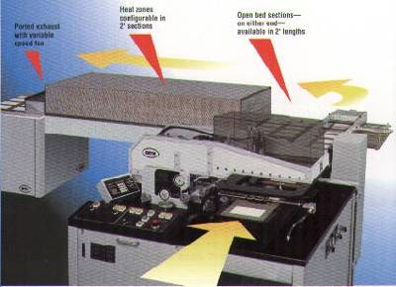
Production: silicon and DSC compared
Typical Silicon Cell Equipment (PECVD)
Typical Dye Cell Equipment (Screen Printer and Furnace)

Slide 7
The 3GSolar approach to large cell design
Photoanode comprises titania printed in multiple layers
Photoanade support is commercially available FTO glass fitted with silver-free, inert robust conductors for current takeoff
Cathode is carbon-based with low or no platinum catalyst
In-house pastes for conductors, titania and carbon layers
Dye and electrolyte are commercially available materials
Only one FTO glass is needed per cell
Glass sandwich with edge sealing-large area cell size 225 sq cm
Cells are connected in series in a support structure to
form modules

Slide 8
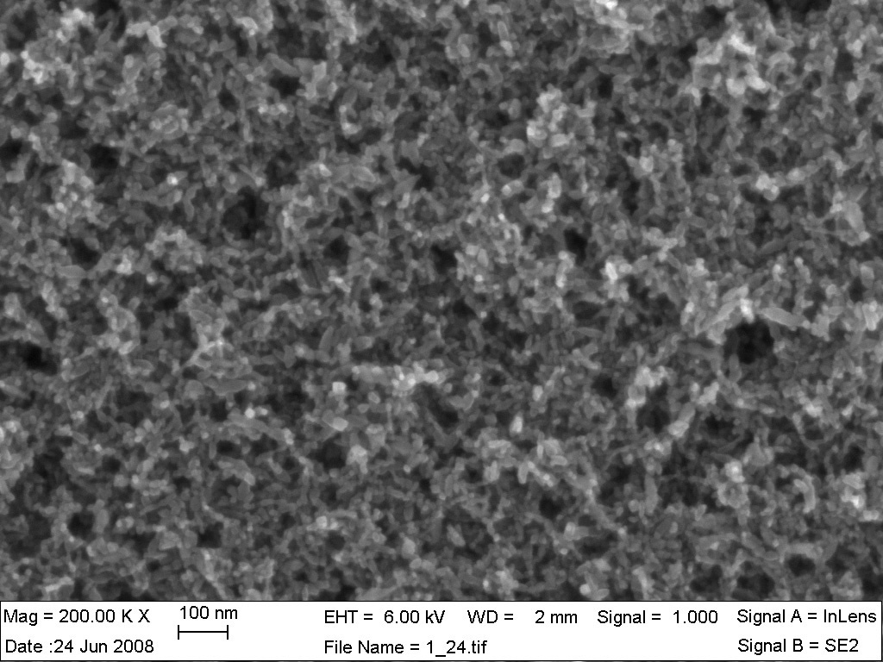
Use of commercially available and in-house titania pastes in multilayer strategy
Notes:
8

Slide 9
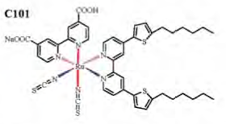
3GSolar is screening dyes based on performance, robustness and commerciability
workhorse dye has been N719, new dyes are C101 and Z991
These new dyes are hydrophobic and show good stability
Graetzel reported 12.2% efficiency in a champion cell (Z991)
Need to optimize application method & reduce staining time

Slide 10
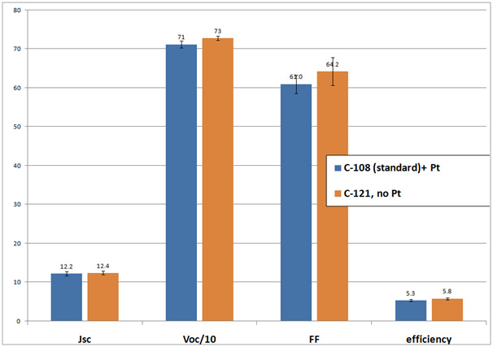
Elimination of platinum in the carbon cathode
Notes:
10

Slide 11
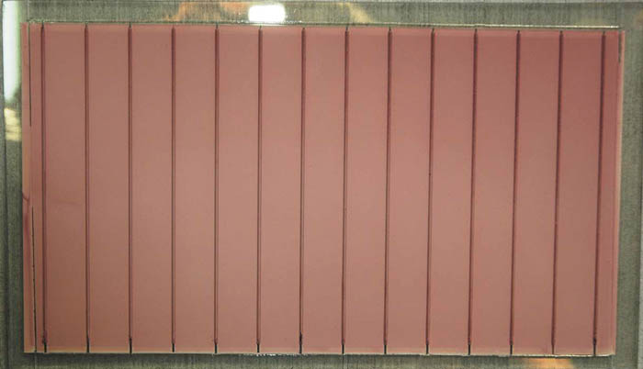
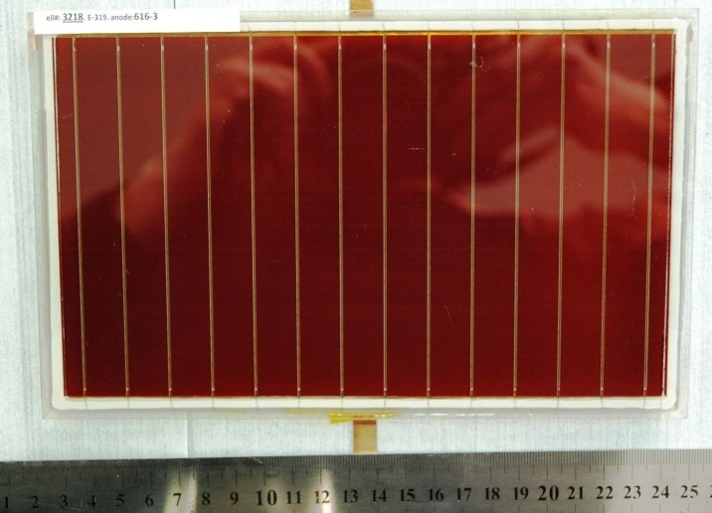
Large cell builds (area 225 sq cm)
Notes:
11

Slide 12
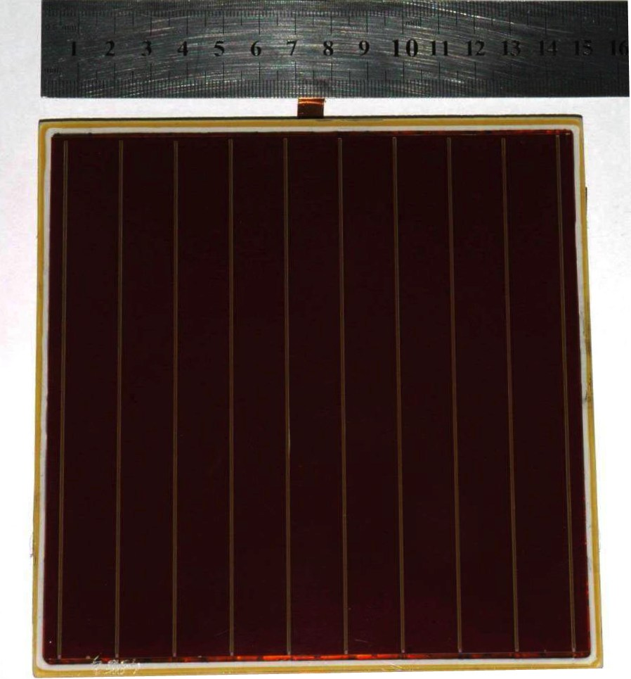
New square cell design (area 225 sq cm) for pilot production
Notes:
12

Slide 13
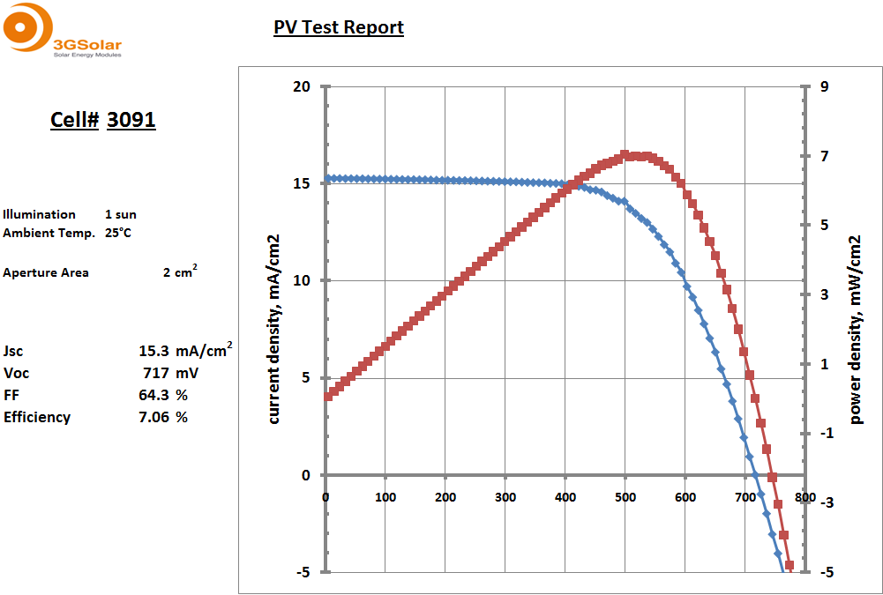
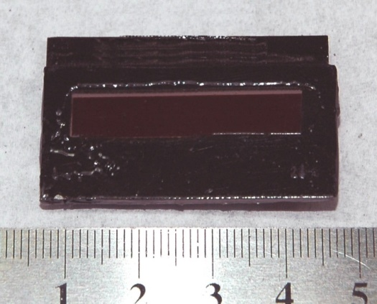
Small shaded test cell (2 sq cm) with 7.1% efficiency under one sun
Notes:
13

Slide 14
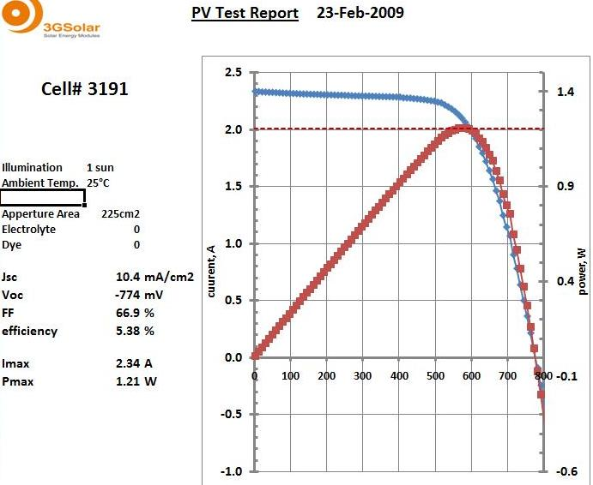
Confirmed World Record 3GSolar DSC (area 225 sq cm) with 5.4% efficiency at one sun
Notes:
14

Slide 15
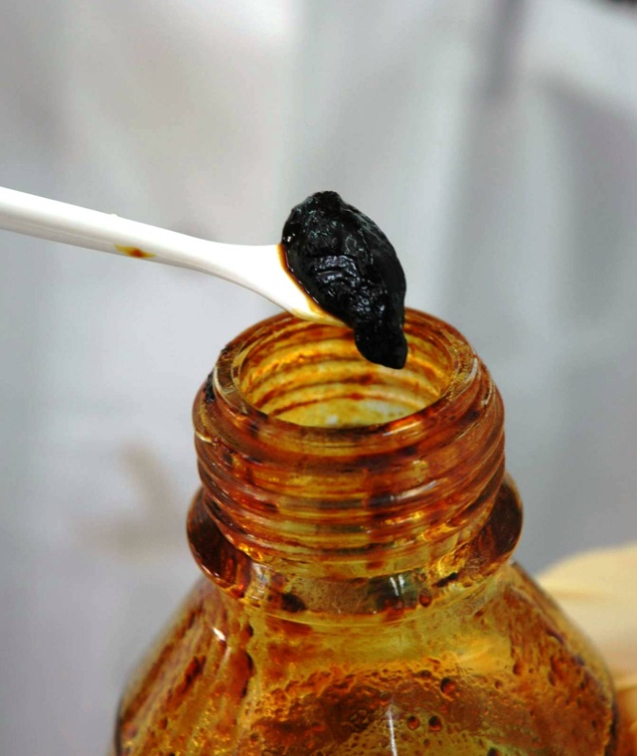
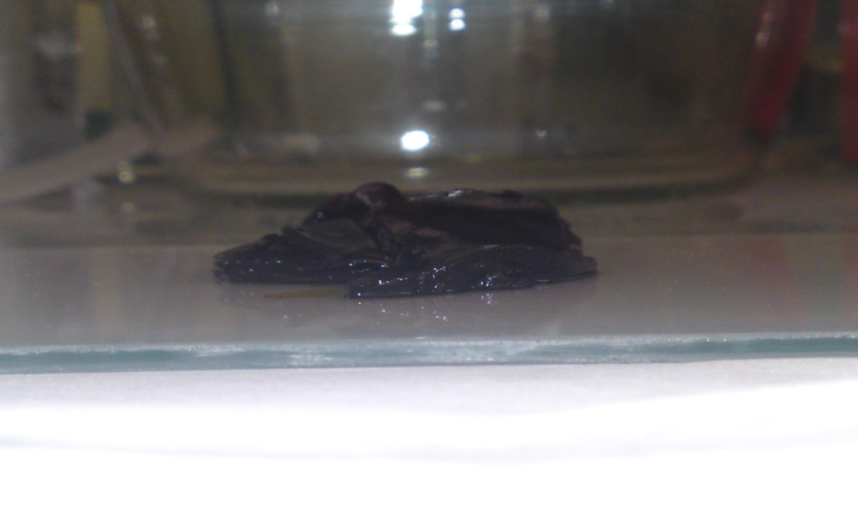
In-house immobilized electrolyte
Notes:
15

Slide 16
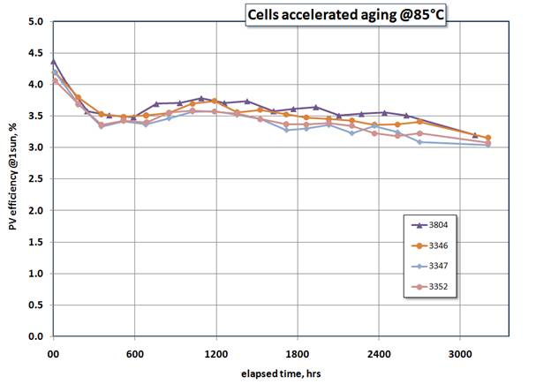
Large cell-seal endurance (225 sq cm cell):
>3,000 hr stability at 85 C, ongoing
Notes:
16

Slide 17
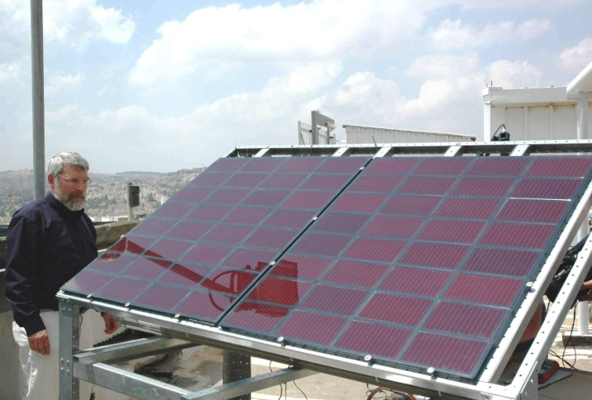
Twin module DSC prototype - each module has
32 series-connected cells of size 225 sq cm
Notes:
17

Slide 18
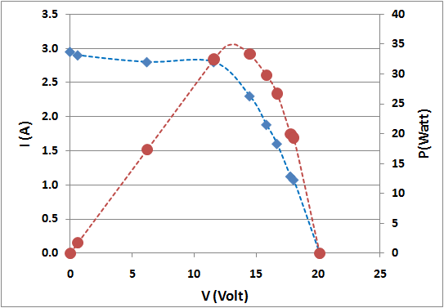
32-cell full size module prototype: I-V curve under one sun illumination
Notes:
18

Slide 19
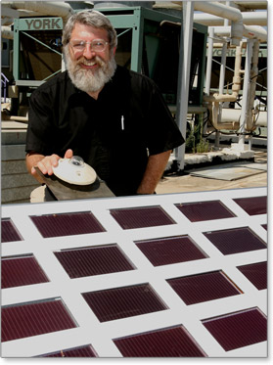
Roadmap
2010:
New round of funding
Achieve cell/module efficiency/life targets
Pilot-scale manufacturing line installation
2011:
First commercial module (7% efficiency, 7-year life)
Testing and Approval
Plant Design and Ramp up to manufacturing
Notes:
19

Slide 20
Thank you!
Dr. Jonathan Goldstein, President
3GSolar Ltd.
jg@3gsolar.com
www.3gsolar.com

