Slide 1
A geometrical representation for bootstrap and jackknife
Based on “An Introduction to the Bootstrap”,
B. Efron and R. J. Tibshirani,
chapter 20
Aviv Navon

Slide 2
Intro
Suppose we are in the simple one-sample situation, having observed a random sample $x=\left(x_{1},…,x_{n}\right)$ from a population $F$. Consider a functional statistic $\hat{θ}=t\left(\hat{F}\right)$, where $\hat{F}$ denotes the empirical distribution.
Let $P^{∗}={\left(P_{1}^{∗},…,P_{n}^{∗}\right)}^{T}$ be a vector of probabilities, and let ${\hat{F}}^{∗}={\hat{F}}^{∗}\left(P^{∗}\right)$ be the distribution function putting mass $P_{i}^{∗}$ on $x_{i}$.
We define
$${\hat{θ}}^{∗}=T\left(P^{∗}\right)≡t\left({\hat{F}}^{∗}\left(P^{∗}\right) \right)$$
Denote $P^{0}={\left(\frac{1}{n},…,\frac{1}{n}\right)}^{T}$, we have
$\hat{θ}=T\left(P^{0}\right)$
From now on, we will work with $T\left(P^{∗}\right)$.

Slide 3
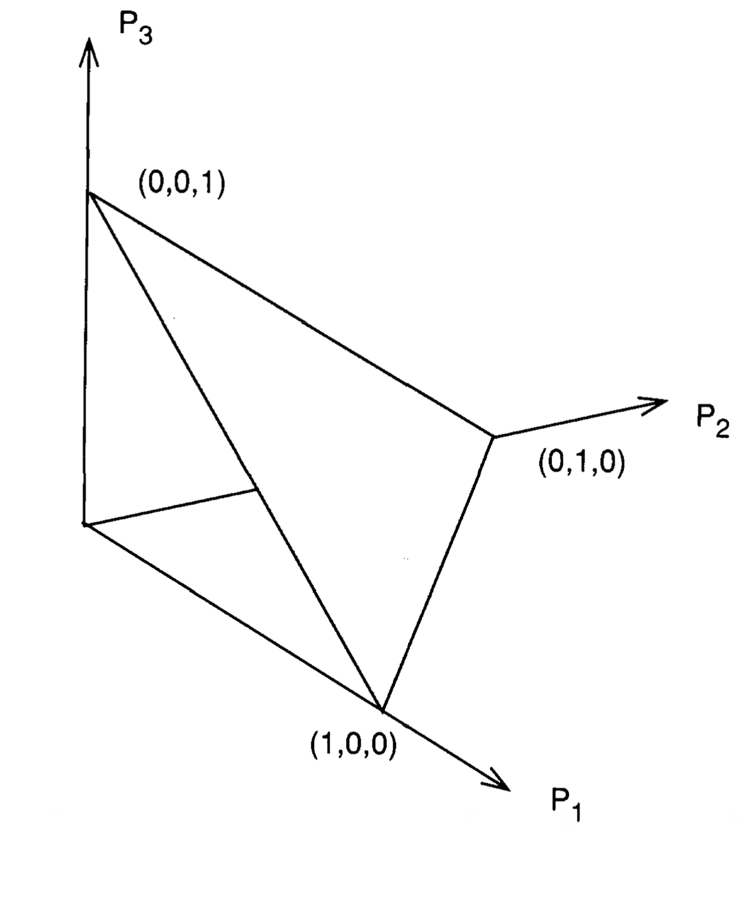
Intro
This defines our statistics as a function whose domain is the set of all vectors $P^{∗}$ satisfying $0≤P_{i}^{∗}≤1$ and $\sum_{i}{P_{i}^{∗}}=1$ – the ($n−$dimensional) simplex – denoted $S_{n}$.
For the jackknife vectors we denote
$$P_{\left(i\right)}=\left(\frac{1}{n−1},..,0,\frac{1}{n−1},…,\frac{1}{n−1}\right)$$
with the corresponding values
${\hat{θ}}_{\left(i\right)}=T\left(P_{\left(i\right)}\right)$
for the statistic.
The simplex for $n=3$.

Slide 4
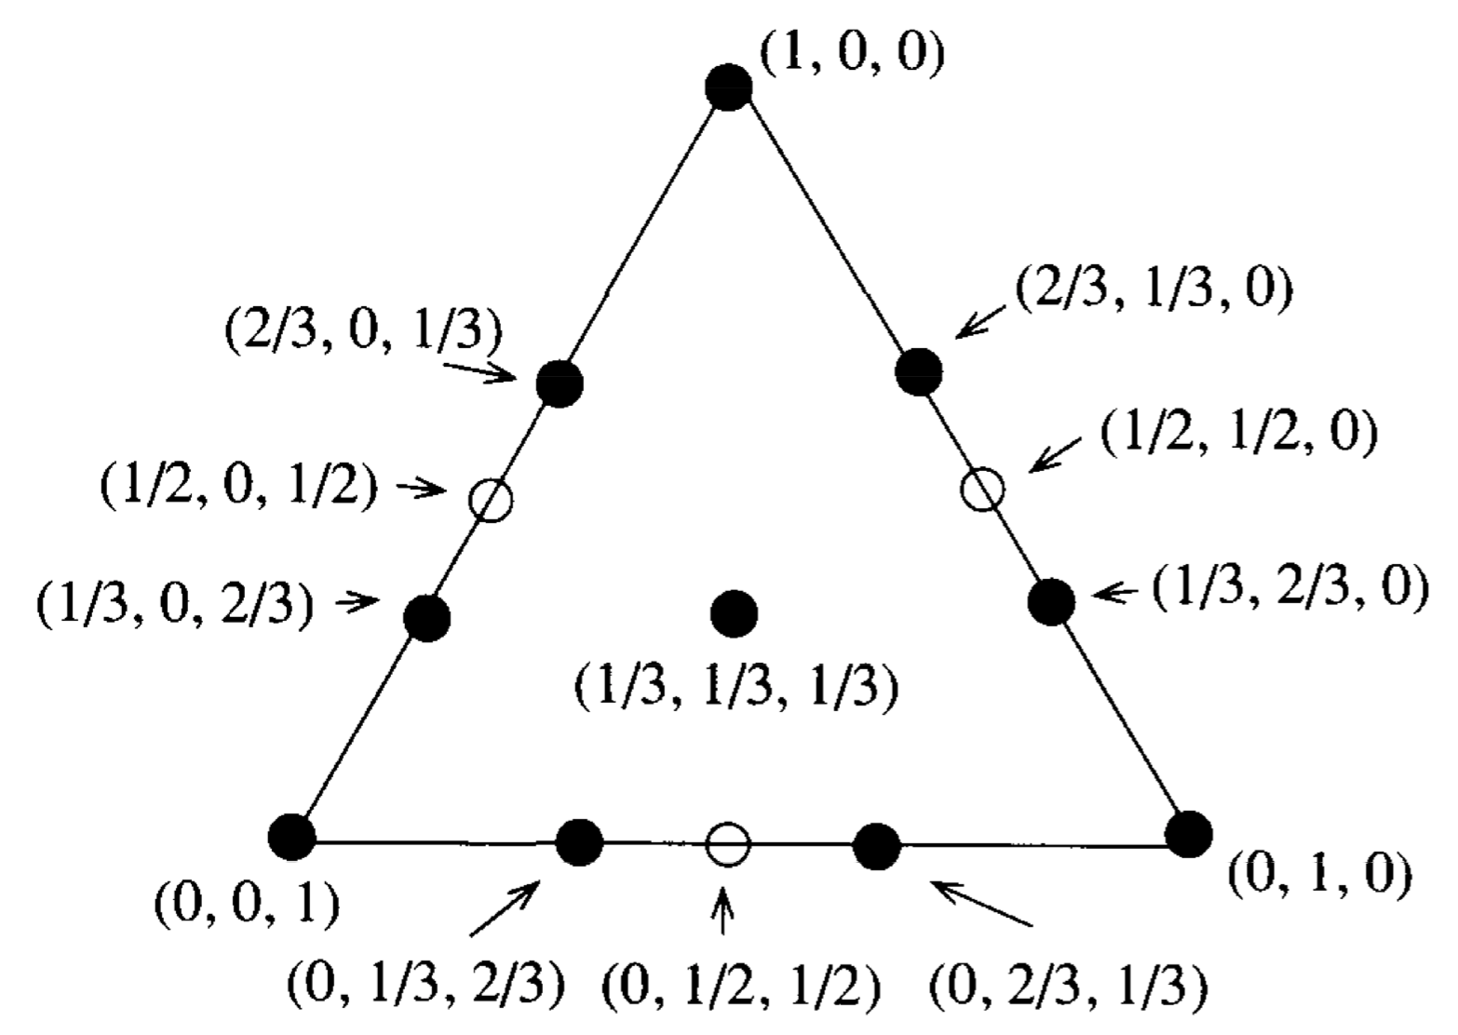
Intro
Simplex for $n=3$. The solid points indicates the support points of the bootstrap distribution, while the open circles are the jackknife points.

Slide 5
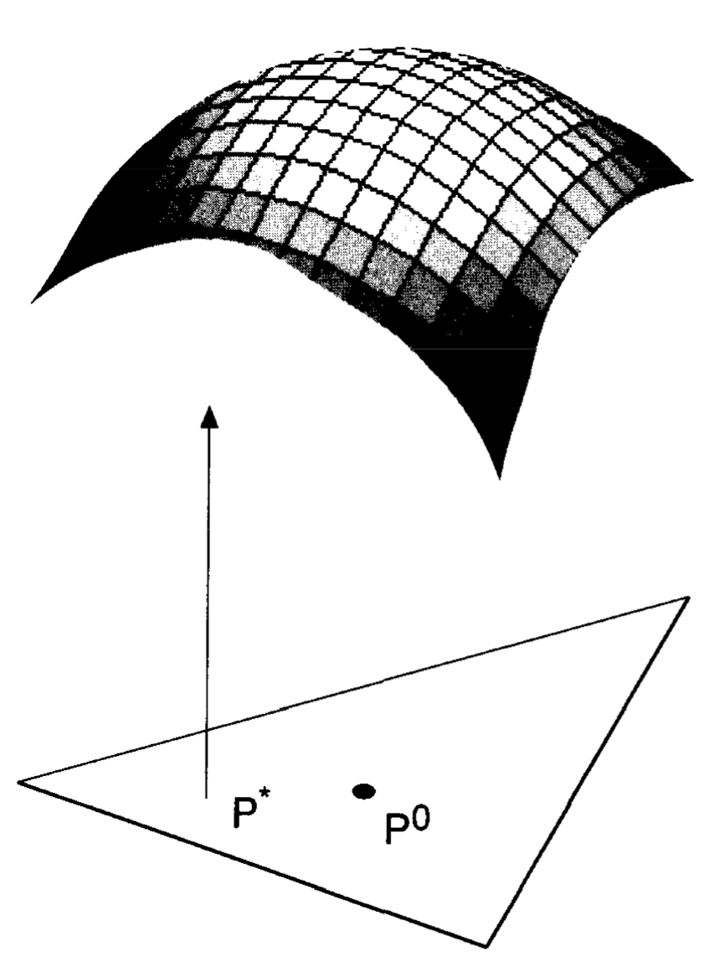
Intro
The statistics $T\left(P^{∗}\right)$ can be thought of as a surface over it’s domain $S_{n}$.

Slide 6
Bootstrap Sampling
We can describe bootstrap sampling in the framework presented:
Sampling with replacement from $x_{1},…,x_{n}$ is equivalent to sampling,
$$P^{∗}\sim \frac{1}{n}Mult\left(n,P^{0}\right)$$
We have $𝔼\left[P^{∗}\right]=P^{0}, var\left(P^{∗}\right)=\frac{1}{n^{2}}\left[I_{n×n}−nP^{0}{P^{0}}^{T}\right]$.
The bootstrap estimate of variance for a statistic can be written as,
$$var_{∗}T\left(P^{∗}\right)$$
and will be viewed as the ”gold standard” throughout this presentation.

Slide 7
The jackknife as an approx. to the bootstrap
A linear statistic $T\left(P^{∗}\right)$ has the form,
$$T\left(P^{∗}\right)=c_{0}+{\left(P^{∗}−P^{0}\right)}^{T}U$$
where $c_{0}$ is a constant and $U$ is a vector satisfying $∑U_{i}=0$.
When viewed as a surface, a linear statistic defines a hyperplane over $S_{n}$.
The mean ${\overline{x}}^{∗}=∑P_{i}^{∗}x_{i}$ is a simple example with $c_{0}=\overline{x};U_{i}=x_{i}−\overline{x}$.

Slide 8
The jackknife as an approx. to the bootstrap
Theorem. Let $T^{LIN}$ be the unique hyperplane passing through the jackknife points $\left(P_{\left(i\right)},T\left(P_{\left(i\right)}\right)\right)$ for $i=1,…,n$. Then,
$$var_{∗}T^{LIN}=\frac{n−1}{n}⋅var_{jack}\hat{θ}$$
where $var_{jack}\hat{θ}$ is the jackknife estimate of variance for $\hat{θ}$,
$$var_{jack}\hat{θ}=\frac{n−1}{n}∑{\left({\hat{θ}}_{\left(i\right)}−{\hat{θ}}_{\left(⋅\right)}\right)}^{2}$$

Slide 9
The jackknife as an approx. to the bootstrap
Proof.
lemma - Let $T^{LIN}\left(P^{∗}\right)=c_{0}+{\left(P^{∗}−P^{0}\right)}^{T}U$ be the unique hyperplane passing through the points $\left(P_{\left(i\right)},T\left(P_{\left(i\right)}\right)\right)$, then we have,
$c_{0}=\hat{θ}, { U}_{i}=\left(n−1\right)\left({\hat{θ}}_{\left(i\right)}−{\hat{θ}}_{\left(⋅\right)}\right)$.
The proof is simply solving the set of $n+1$ linear equations ${\hat{θ}}_{\left(i\right)}=T^{LIN}\left(P_{\left(i\right)}\right)$ and $∑U_{i}=0$.
Now,
$$\begin{matrix}var_{∗}T^{LIN}\left(P^{∗}\right)=var_{∗}\left(c_{0}+{\left(P^{∗}−P^{0}\right)}^{T}U\right)=U^{T}var_{∗}\left(P^{∗}\right)U=U^{T}\left[\frac{1}{n^{2}}\left(I_{n×n}−n{P^{0}}^{T}P^{0}\right)\right]U \\ =\frac{1}{n^{2}}\left[U^{T}U−\frac{1}{n}\underset{=0}{\underbrace{U^{T}J_{n×n}U}}\right]=\frac{1}{n^{2}}U^{T}U=\frac{1}{n^{2}}{\left(n−1\right)}^{2}\sum_{i}{{\left({\hat{θ}}_{\left(i\right)}−{\hat{θ}}_{\left(⋅\right)}\right)}^{2}} \\ =\frac{n−1}{n}\left\{\frac{n−1}{n}\sum_{i}{{\left({\hat{θ}}_{\left(i\right)}−{\hat{θ}}_{\left(⋅\right)}\right)}^{2}}\right\}\end{matrix}$$

Slide 10
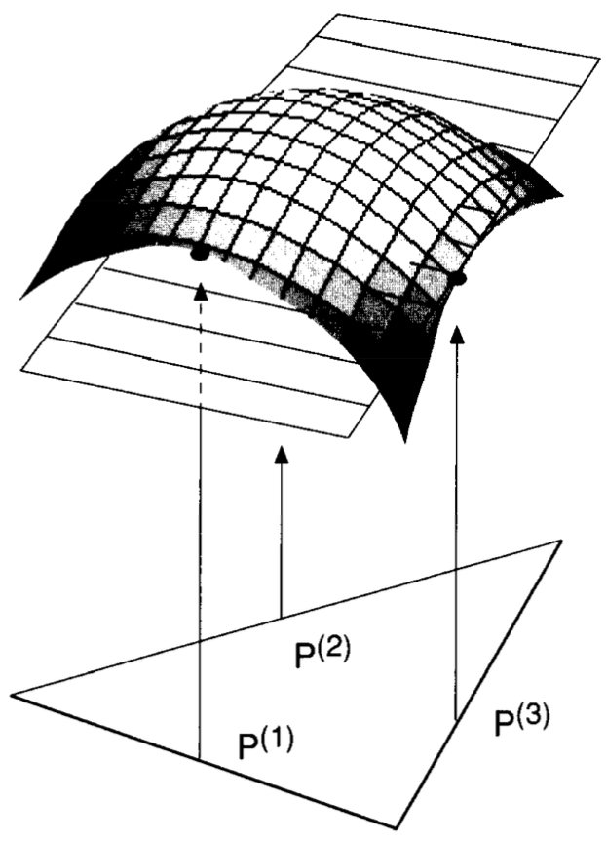
The jackknife as an approx. to the bootstrap
From this result, we see that the jackknife’s accuracy as an approximation to the bootstrap, depends on how well $T^{LIN}$ approximate $T$.
The plot shows the hyperplane $T^{LIN}$ as an approximation to $T$, over $S_{n}$.
$$var_{∗}T^{LIN}=\frac{n−1}{n}⋅var_{jack}\hat{θ}$$

Slide 11
Other jackknife approximations
The previous results show that the bootstrap variance estimate arising from any linear approximation is $\frac{1}{n^{2}}∑U_{i}^{2}$.
We now use another linear approximation of $T$, $T^{TAN}$ (the tangent plane approximation at $T\left(P^{0}\right)$, defined by,
$T^{TAN}\left(P^{∗}\right)=T\left(P^{0}\right)+{\left(P^{∗}−P^{0}\right)}^{T}U$
where $U_{i}=\lim_{ε→0}{\frac{T\left(P^{0}+ε\left(e_{i}−P^{0}\right)\right)−T\left(P^{0}\right)}{ε}}, i=1,…,n$, the empirical influence values.

Slide 12
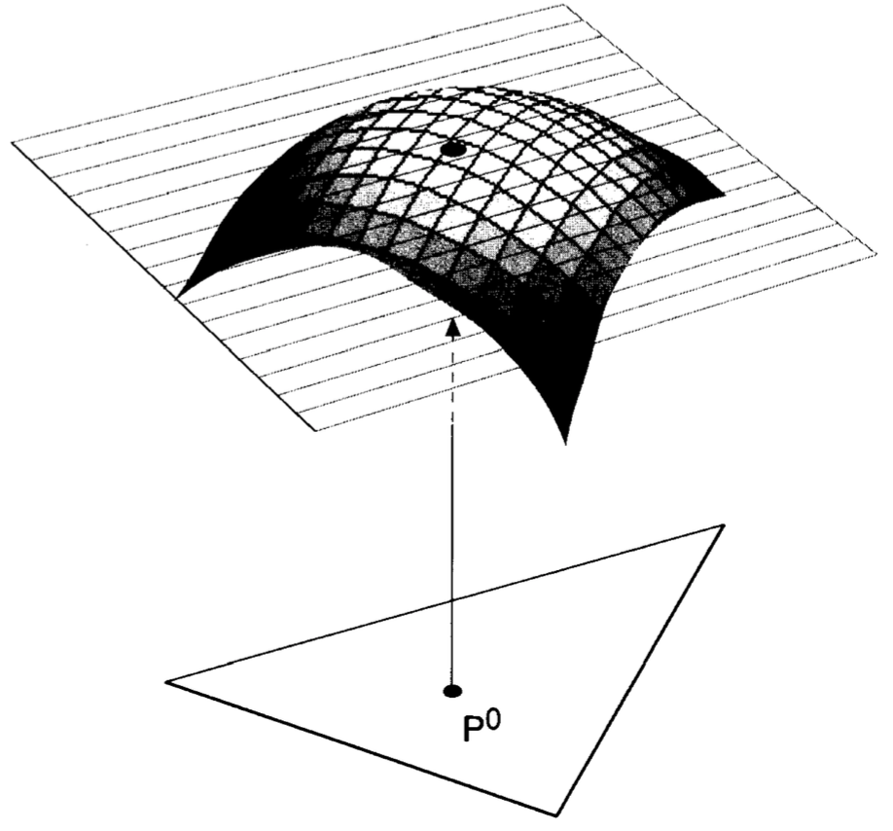
Other jackknife approximations
This gives the bootstrap estimate of variance, which is also called the $infinitisimal jackknife$ estimate of variance,
$$var_{∗}T^{TAN}=var^{IJ}\hat{θ}=\frac{1}{n^{2}}∑U_{i}^{2}$$

Slide 13
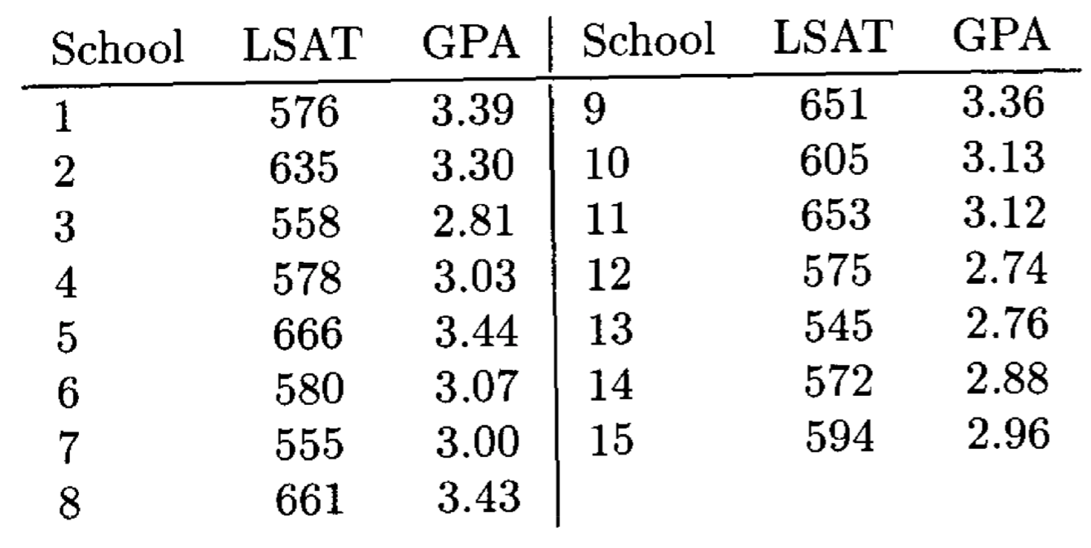
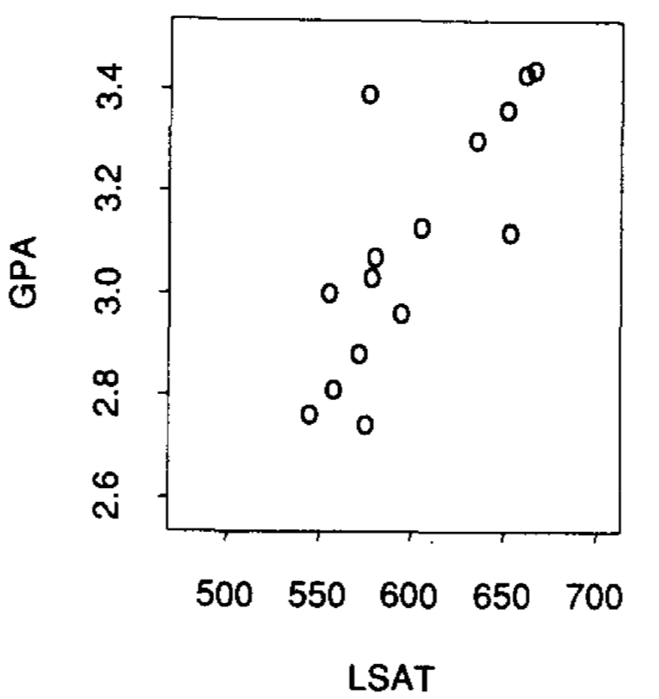
Example
The bootstrap surface is difficult to view if $n>3$, but is possible to view “slices” of the surface.
Consider for example the correlation coefficient applied to the law school data.
Here the bootstrap and jackknife estimate of standard error are $0.127$ and $0.142$ respectively.

Slide 14
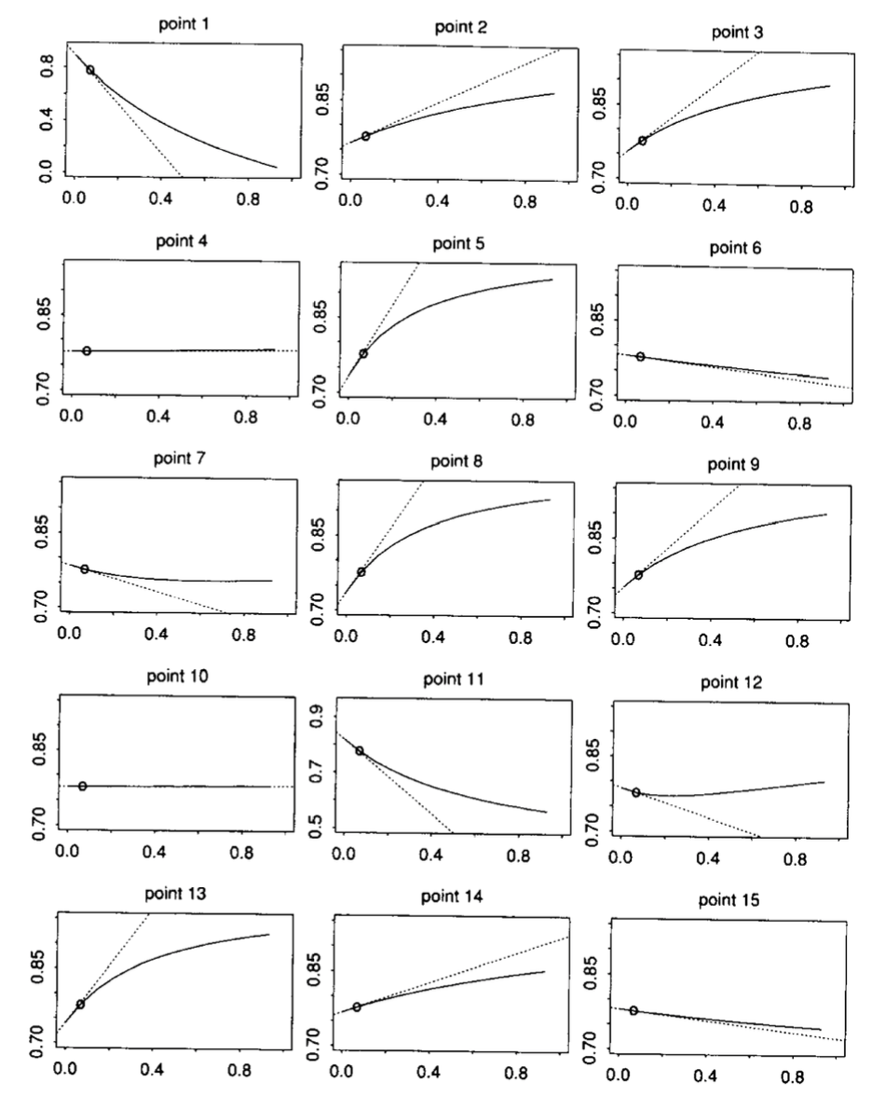
Example
The figure shows how the value of the corr. coefficient changes as the probability mass on of the 15 data points is varied from 0 to 1 (solid curve).
The broken line are the jackknife approximation to the surface, and the dot is the point $\left(P^{∗},T\left(P^{∗}\right)\right)$.

Slide 15
Bootstrap bioequivalence and power calculations
Based on “An Introduction to the Bootstrap”,
B. Efron and R. J. Tibshirani,
chapter 25
Aviv Navon

Slide 16
Intro
This chapter concerns a bioequivalence study involving only 8 patients.
The bioequivalence problem is a good one for understanding the advantages and limitations of bootstrap confidence intervals.
Bioequivalence problem
Power calculation - Simple solution
Power calculation - A more advanced solution

Slide 17
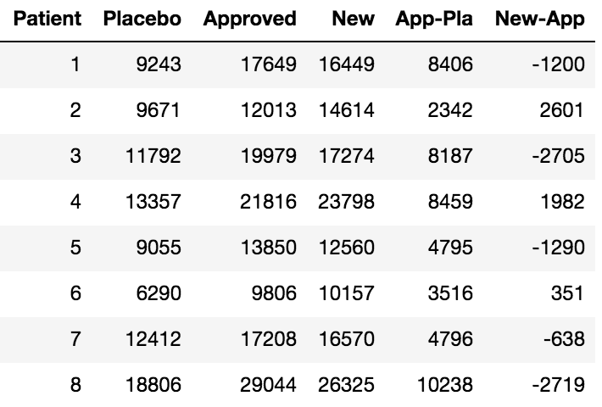
A bioequivalence problem
A drug company has separately applied each of the following three hormone supplement medical patches to eight patients who suffer from a hormone deficiency:
Approved – A patch that has been approved by the FDA.
New – Manufactured at a new facility but is otherwise intended to be identical to the approved patch.
Placebo – Contains no hormone.
The FDA requires proof of bioequivalence before it will approve the new patch for sale.
Each patient’s blood level of the hormone was measured after each patch wearing (the three wearing occur in a random order).

Slide 18
A bioequivalence problem
Bioequivalence definition (FDA)
Denote,
$$x=Approved−Plecebo y=New−Approved$$
let,
$$μ=E\left(x\right) η=E\left(y\right)$$
and define $ρ=η/μ$. The FDA bioequivalence requirement is that a 90% CI for $ρ$ lie within the range $(−.2,.2)$.
In other words, the FDA requires the new patches to have the same efficacy as the approved patches, within an error tolerance of 20%.

Slide 19
A bioequivalence problem
In the presented data, we have $\hat{ρ}=−.071$.
The drug company wishes to answer two related questions:
Are the FDA bioequivalence criteria satisfied by the presented data?
If not, how many patients should be measured in a future experiment so that the FDA requirements will have a good chance of being satisfied? (that is, high power).

Slide 20
Bootstrap confidence intervals
We will use nonparametric and parametric bootstrap in order to calculate a 90% CI interval for $ρ$. For the parametric bootstrap we assume
$${\left(x,y\right)}^{T}\sim N\left(λ,Σ\right)$$
And estimate the parameters using MLE.
We set $B=4000$ in both cases, and use the $BC_{a}$ method in order to calculate the CI.
Nonparametric: $(−.204,.146)$
Parametric: $(−.221,.112)$

Slide 21
Bootstrap power calculations
The drug company decided on run a larger study in order to definitively verify bioequivalence. How many patients should be enrolled in the new study to give it “good” power?
We can imagine drawing a future sample of size $N$:
$$F→data_{N}=\left\{\left(X_{j},Y_{j}\right), j=1,…,N\right\}$$
and calculating a CI for $ρ$,
$$\left({\hat{ρ}}_{N}\left[.05\right], {\hat{ρ}}_{N}\left[.95\right]\right)$$
We are interested in,
$π_{N}\left(lo\right)=Prob_{F}\left({\hat{ρ}}_{N}\left[.05\right]<−.2\right), π_{N}\left(up\right)=Prob_{F}\left({\hat{ρ}}_{N}\left[.95\right]>.2\right)$

Slide 22
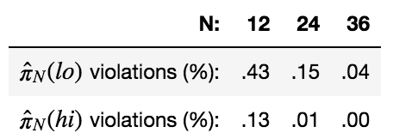
Bootstrap power calculations
We can estimate $π_{N}$ by the plug-in principle:
$${\hat{π}}_{N}\left(lo\right)=Prob_{\hat{F}}\left({{\hat{ρ}}^{ }}_{N}{\left[.05\right]}^{∗}<−.2\right)$$
$${\hat{π}}_{N}\left(up\right)=Prob_{\hat{F}}\left({{\hat{ρ}}^{ }}_{N}{\left[.95\right]}^{∗}>.2\right)$$
For $b=1,…,B$ we take a bootstrap sample of size $N$, $data_{N}^{∗}=\left\{\left(X_{j}^{∗},Y_{j}^{∗}\right),j=1,…,N\right\}$, from the original data (the 8 samples).
Calculate confidence limits for $ρ$ based on $data_{N}^{∗}$.
Check if the bioequivalence criteria is violated.
The proportion of violation in a large number of bootstrap samples gives estimates of $π_{N}\left(⋅\right)$.
Estimated probabilities of violating the bioequivalence criteria for future sample size $N$, based on $B=100$ bootstrap replications for each sample size. Confidence limits obtained from the non-parametric ABC algorithm.

Slide 23
Bootstrap power calculations
It can be shown that as $N$ gets large, the bootstrap confidence limits $({\hat{ρ}}_{N}{\left[.05\right]}^{∗},{\hat{ρ}}_{N}{\left[.95\right]}^{∗})$ will approach the standard limits
$$\left(\hat{ρ}−1.645⋅{\hat{σ}}_{N},\hat{ρ}+1.645⋅{\hat{σ}}_{N}\right)$$
where ${\hat{σ}}_{N}={\left[\frac{{\hat{ρ}}^{2}{\hat{Σ}}_{11}−2{\hat{ρ}}_{ }{\hat{Σ}}_{12}+{\hat{Σ}}_{22}}{N{\overline{x}}^{2}}\right]}^{1/2}$, the delta-method estimate of SE for ${\hat{ρ}}_{N}^{∗}$.
Since ${\hat{σ}}_{N}→0$ as $N→∞$, and $\hat{ρ}∈\left(−.2,.2\right)$, both ${\hat{π}}_{N}\left(lo\right),$ and ${\hat{π}}_{N}\left(up\right)$ go to zero as $N→∞$.

Slide 24
A more careful power calculation
The previous slide implies that the drug company would certainly satisfy the bioequivalence criteria if the future sample size $N$ is large enough, but this can only be the case if the true value of $ρ$ lies in the range $\left(−.2,.2\right)$.
The trouble comes from the straightforward use of the plug-in principle.
It is possible to use the plug-in principle more carefully.

Slide 25
A more careful power calculation
Define,
$$T=\frac{{\hat{ρ}}_{n}−{\hat{ρ}}_{N}\left[.05\right]}{{\hat{σ}}_{n}}$$
Where ${\hat{ρ}}_{n}$ is the estimate based on ${data}_{n}$ (the original data), ${\hat{ρ}}_{n}=\hat{ρ}=−.071$, and ${\hat{σ}}_{n}$ is the delta-method estimate of standard error for ${\hat{ρ}}_{n}$,
$${\hat{σ}}_{n}={\left[\frac{{\hat{ρ}}^{2}{\hat{Σ}}_{11}−2\hat{ρ}{\hat{Σ}}_{12}+{\hat{Σ}}_{22}}{n{\overline{x}}^{2}}\right]}^{1/2}=.097$$
The statistic $T$ measures how many standard error units it is from ${\hat{ρ}}_{n}$ to ${\hat{ρ}}_{N}{\left[.05\right]}^{ }$, based on a future sample $data_{N}$. We have,
$$\frac{{\hat{ρ}}_{n}−\left(.−2\right)}{{\hat{σ}}_{n}}=1.33$$
Thus the statement “${\hat{ρ}}_{N}[.05]<−.2$” is equivalent to “$T>1.33$”, given ${\hat{ρ}}_{n},{\hat{σ}}_{n}$.

Slide 26
A more careful power calculation
We can estimate $π_{N}\left(lo\right)$ by using bootstrap to estimate the probability that $T$ exceed $1.33$:
$${\hat{π}}_{N}\left(lo\right)=Prob_{\hat{F}}\left\{T^{∗}>1.33\right\}$$
where $T^{∗}= {\left({\hat{ρ}}_{n}^{∗}−{\hat{ρ}}_{N}^{ }{\left[.05\right]}^{∗}\right)}/{{\hat{σ}}_{n}^{∗}}$.
Here ${\hat{ρ}}_{n}^{∗},{\hat{σ}}_{n}^{∗}$ are estimates based on a bootstrap sample of size $n=8$, while ${\hat{ρ}}_{N}{\left[.05\right]}^{∗}$ is the lower CI limit based on a separate bootstrap sample of size $N$.

Slide 27
A more careful power calculation
It is possible to study more closely the merits of the two power calculations.
The observed value of $\hat{ρ}$ was $−.071$. What would happened if we had observed $\hat{ρ}$ to be one standard deviation higher\lower?
We perturbed our original data by adding a value $Δ$ to each $y_{i}$, and subtracting the same $Δ$ from each $x_{i}$, choosing $Δ$ so that $\hat{ρ}$ for the perturbed data is one standard deviation larger/smaller.

Slide 28
A more careful power calculation

Slide 29
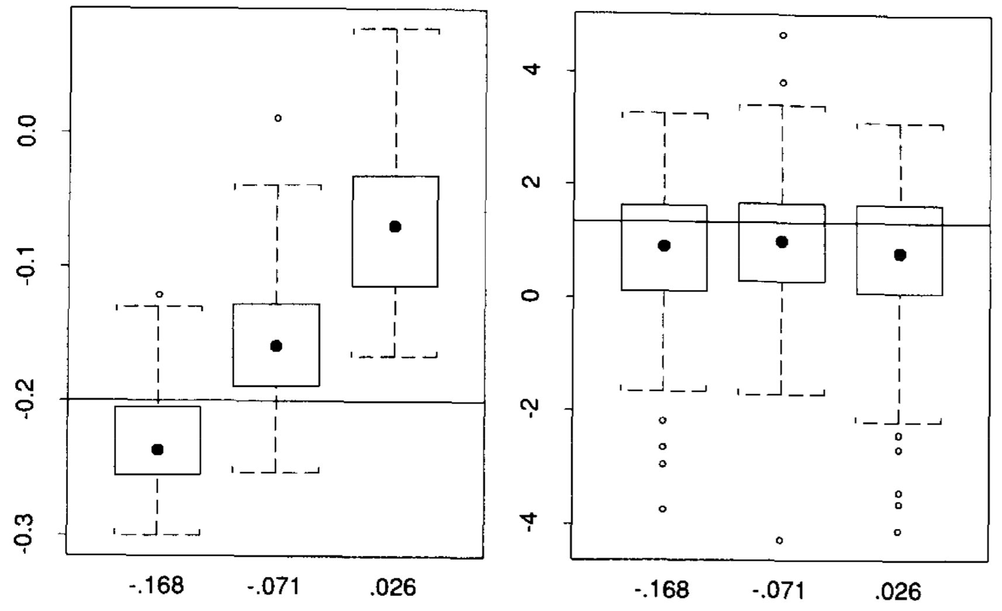
A more careful power calculation
Left: boxplots for ${\hat{ρ}}_{N}^{∗}\left[.05\right]$ with $N=24$, for data sets with $\hat{ρ}=−.071−{\hat{σ}}_{n}, −.071, −.071+{\hat{σ}}_{n}$, respectively. Each boxplot corresponds to 100 simulations. Horizontal line is drawn at $−.2$.
Right: boxplots for the quantity ${({\hat{ρ}}_{n}^{∗}−{\hat{ρ}}_{N}^{∗}[.05])}/{{\hat{σ}}_{n}^{∗} }$ for the same 3 cases. Horizontal line is drawn at $1.33$.
Notice how the distributions shifted dramatically in the left panel, but are quite stable in the right panel.
This illustrate that the power calculations based on the second method is more relabel.

