Slide 1
Matan Schlesinger
Statistics M.Sc seminar
Estimating standard error using bootstrap

Slide 2
Table of contents
The bootstrap estimator of standard error- chapter 6
Estimating the standard error
The number of bootstrap replications
Parametric bootstrap and textbook formulas
Bootstrap standard error examples – chapter 7
Eigenvalues
Curve fitting
Example of bootstrap sampling failure

Slide 3
The bootstrap estimator of standard error – chapter 6

Slide 4
The problem
Suppose that we have a random sample $X$ $=(x_{1},$ $x_{2},…$, $x_{n})$ from an unknown distribution and we wish to estimate some parameter of interest $θ=t(F)$.
For this purpose, we calculate an estimate $\hat{θ}=s\left(x\right)$
Now, we want to ask how accurate is $\hat{θ}$ ?
The bootstrap is computer based method for estimating the standard error of $\hat{θ}$, regardless of how mathematically complicated $\hat{θ}$ is.

Slide 5
Estimating the standard error

Slide 6
Non parametric Bootstrap- sample and estimate
Let $\hat{F}$ be the empirical distribution, putting probability $\frac{1}{n}$ on each of the observed values $x_{i}$, $i=1,2,…,n$.
A bootstrap sample is defined to be a random sample of size n drawn from $\hat{F}$, ${\underline{X}}^{∗}=(x_{1}^{∗}, x_{2}^{∗}…,x_{n}^{∗})$
Corresponding to ${\underline{X}}^{∗}$ we have a replication of $\hat{θ}$, ${\hat{θ}}^{∗}=s(X^{∗})$ (for example if $s\left(x\right)$ is the sample mean $\overline{x}$, then $s\left(X^{∗}\right)={\overline{x}}^{∗}=\sum_{i=1}^{n}{\frac{x_{i}^{∗}}{n}}$
The bootstrap plugin estimate of ${se}_{F}\left(\hat{θ}\right)$ is ${ se}_{\hat{F}}\left({\hat{θ}}^{∗}\right)$ - a plugin estimate that uses $\hat{F}$ instead of $F$

Slide 7
Parametric bootstrap - sample and estimate
Now, Let $\hat{F}$ be a distribution from some parametric model, where the parameters of $\hat{F}$ are estimated from our sample ($X)$
Now we sample a random sample in the size of n drawn from $\hat{F}$, ${\underline{X}}^{∗}=(x_{1}^{∗}, x_{2}^{∗}…,x_{n}^{∗})$
Corresponding to ${\underline{X}}^{∗}$ we have a replication of $\hat{θ}$, ${\hat{θ}}^{∗}=s(X^{∗})$ (for example if $s\left(x\right)$ is the sample mean $\overline{x}$, then $s\left(X^{∗}\right)={\overline{x}}^{∗}=\sum_{i=1}^{n}{\frac{x_{i}^{∗}}{n}}$
The bootstrap plugin estimate of ${se}_{F}\left(\hat{θ}\right)$ is ${ se}_{\hat{F}}\left({\hat{θ}}^{∗}\right)$ - a plugin estimate that uses $\hat{F}$ instead of $F$

Slide 8
The bootstrap algorithm for estimating standard errors
Select B independent bootstrap samples $X^{∗1},X^{∗2},…,X^{∗B}$, each consisting of n data values drawn from $\hat{F}$
Evaluate the bootstrap replication for each bootstrap sample ${\hat{θ}}^{∗}\left(b\right)=s(X^{∗b})$ $b=1…B$
Estimate the standard error ${se}_{F}\left(\hat{θ}\right)$ by the sample standard deviation of the B replications:${\hat{se}}_{B}=\sqrt{\left\{\sum_{b=1}^{B}{{\left[{\hat{θ}}^{∗}\left(b\right)−\overline{{\hat{θ}}^{∗}}\right]}^{2}/(B−1)}\right\}}$
where: $\overline{{\hat{θ}}^{∗}}=\frac{\sum_{b=1}^{B}{{\hat{θ}}^{∗}(b)}}{B}$

Slide 9
The number of bootstrap replications

Slide 10
What happens when $B→∞$
Question: does the bootstrap estimator for the standard error equals the standard error when $B→∞$ ? $\lim_{B→∞}{{\hat{se}}_{B}({\hat{θ}}^{∗})=}$ ${se}_{F}\left(\hat{θ}\right)$ ?

Slide 11
What happens when $B→∞$
Question: does the bootstrap estimator for the standard error equals the standard error when $B→∞$ ? $\lim_{B→∞}{{\hat{se}}_{B}({\hat{θ}}^{∗})=}$ ${se}_{F}\left(\hat{θ}\right)$ ?
${se}_{\hat{F}}\left({\hat{θ}}^{∗}\right)$ is the ideal bootstrap estimator (the plugin estimate)
NO
$\lim_{B→∞}{{\hat{se}}_{B}({\hat{θ}}^{∗})=}$ ${se}_{\hat{F}}\left({\hat{θ}}^{∗}\right)$

Slide 12
The number of bootstrap replications B
Depends mainly on how much long it takes to evaluate the bootstrap replications, for any $s(X)$ increases linearly in B.
We would like to know how “close” is ${\hat{se}}_{B}({\hat{θ}}^{∗})$ to ${\hat{se}}_{∞}({\hat{θ}}^{∗})={se}_{\hat{F}}\left({\hat{θ}}^{∗}\right)$ and to ${se}_{F}\left(\hat{θ}\right)$
For nonparametric bootstrap, n approximate, can be phrased in terms of the coefficient of variation of ${\hat{se}}_{B}({\hat{θ}}^{∗})$

Slide 13
Coefficient of variation
Coefficient of variation of a random variable X $[X\sim (μ_{F},{σ^{2}}_{F}]$ is defined to be the ratio of its standard deviation to the absolute value of it’s mean:
$${CV}_{F}\left(X\right)=\frac{σ_{F}}{\left|μ_{F}\right|}$$
In other words, ${CV}_{F}$ measures the randomness in X relative to it’s size.
For our needs, ${CV}_{F}\left({\hat{se}}_{B}\right)=\frac{\sqrt{V_{F}({\hat{se}}_{B})}}{E_{F}\left({\hat{se}}_{B}\right)}$

Slide 14
How much does B affect the coefficient of variation
An approximation for $CV\left({\hat{se}}_{B}\right)$ is:
$$CV\left({\hat{se}}_{B}\right)={\left\{{CV({\hat{se}}_{∞})}^{2}+\frac{E\left(∆\right)+2}{4B}\right\}}^{1/2}$$
$∆$- stands for kurtosis
$$B→$$
$$CV\left({\hat{se}}_{∞}\right)$$
$$↓$$
$$∞$$ | 200 | 100 | 50 | 25
0.25 | 0.25 | 0.26 | 0.27 | 0.29 | 0.25
0.20 | 0.21 | 0.21 | 0.22 | 0.24 | 0.20
0.15 | 0.16 | 0.17 | 0.18 | 0.21 | 0.15
0.10 | 0.11 | 0.12 | 0.14 | 0.17 | 0.10
0.05 | 0.07 | 0.09 | 0.11 | 0.15 | 0.05
0.00 | 0.05 | 0.07 | 0.10 | 0.14 | 0.00
table assumes $∆=0$

Slide 15
A more robust way to estimate the standard deviation
A biased but more robust estimate of the bootstrap standard error is:
${\tilde{se}}_{B,α}=\frac{{\hat{θ}}_{(α)}^{∗}−{\hat{θ}}_{(1−α)}^{∗}}{2Z_{(α)}}$
Where ${\hat{θ}}_{(α)}^{∗}$ is 100$α^{th}$ quantile of the bootstrap replications and $Z_{(α)}$is the 100$α^{th}$ percentile of the standard normal distribution

Slide 16
Parametric bootstrap and textbook formulas

Slide 17
Parametric bootstrap in compare to textbook formulas
It might seem strange to use bootstrap to estimate standard error when textbook formula can be used
In fact bootstrap can be carried out parametrically and give results which are closely related to textbook formulas
Most textbook formulas for standard errors are approximations based on normal theory, and will typically gives answers close to the parametric bootstrap that draws samples from a normal distribution

Slide 18
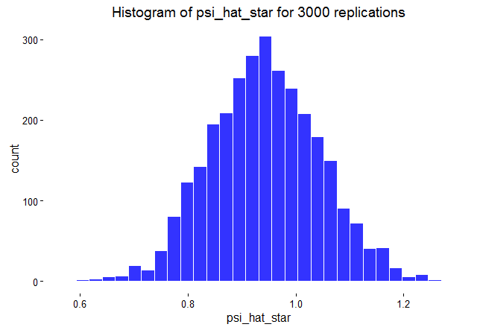
Example- empirical correlation - comparison between textbook formula and parametric (normal) bootstrap
$X\sim U\left(60,100\right) Y=X+ε ε\sim U\left(−20,20\right) θ=cor\left(x,y\right)≈0.707$
It has been shown that for the empirical correlation $\hat{θ}$,
$\hat{ζ}=0.5∙\log\left(\frac{1+\hat{θ}}{1−\hat{θ}}\right)\dot{\sim }N\left(0.5∙\log\left(\frac{1+θ}{1−θ}\right),\frac{1}{n−3} \right)$
So for n=100, we get $se\left(\hat{ζ}\right)≈\frac{1}{\sqrt{97}}=1.1015$
$${\hat{se}}_{3000}\left({\hat{ζ}}^{∗}\right)=0.102$$

Slide 19
Bootstrap advantages in compare to textbook formulas
When used in nonparametric mode, it relieves us from having to make parametric assumptions about the form of population distribution
When used in parametric mode, sometimes it provides more accurate answers than textbook formulas, and can provide answers in problems for which no textbook formulae exist.

Slide 20
Bootstrap standard error - some examples- chapter 7

Slide 21
Eigenvalues

Slide 22
Example- test scores data
Suppose that we have a data for test score of 88 students, each of them took 5 students
For this data we have a 88x5 data matrix X, where the $i^{th}$row of the of the data is $X_{i}=(x_{i1},x_{i2},x_{i3},x_{i4},x_{i5})$
From this matrix we can create an empirical covariance matrix G (size 5x5) where $G_{jk}=\frac{1}{88}\sum_{i=1}^{88}{\left(x_{ij}−{\overline{x}}_{j}\right)\left(x_{ik}−{\overline{x}}_{k}\right) j,k=1…5}$
Now, we can use bootstrap to estimate properties of the eigenvalues and eigenvectors of the covariance matrix

Slide 23
Why should we be interested in the eigenvalues and eigenvectors
Suppose that we think on model for the test results $X_{i}=Q_{i}V+ε_{i}$ , $i=1…88$
If this model is true, we would approximately expect that the first eigenvector of the covariance matrix will be equal to V, and that the eigenvalues ${\hat{λ}}_{1}$ will be positive and ${\hat{λ}}_{2}={\hat{λ}}_{3}={\hat{λ}}_{4}={\hat{λ}}_{5}=0$
Now let $\hat{θ}$ be $\hat{θ}=\frac{{\hat{λ}}_{1}}{\sum_{i=1}^{5}{{\hat{λ}}_{i}}}$
Large value of $\hat{θ}$ is indicating a high degree of explanatory power for the model above
Actually, the eigenvectors are the principal components of the data

Slide 24
Estimating the accuracy of $\hat{θ}$
Create B 88x5 matrixes $X^{∗}$, where the rows of $X^{∗}$ are a random sample from the rows of the actual data matrix X.
For each $X_{b}^{∗}$ create the empirical covariance matrix $G_{b}^{∗}$ and find ${\hat{θ}}_{b}^{∗}$ based on the following: ${\hat{θ}}_{b}^{∗}=\frac{{\hat{λ}}_{1}^{∗}}{\sum_{j=1}^{5}{{\hat{λ}}_{j}^{∗}}}$
Now we can estimate the standard error of $\hat{θ}$ as we saw before
Based on asymptotic theory we can now create a confidence interval for $θ$ $θ ε \hat{θ}±Z_{1−\frac{α}{2}}∗{\hat{se}}_{B}(\hat{θ})$ in an 1-α confidence level

Slide 25
Curve fitting

Slide 26
Regression problem
Suppose that in our population we have two variables Z and Y, by definition the regression of a response variable y on an explanatory variable z is the conditional expectation of y given z: $r\left(z\right)=E(y|z)$
If we had available the entire population (and also let us suppose Z is discrete) then for each value z the regression would be the conditional expectation: $r\left(z\right)=\frac{Sum of Y_{j} values for objects in the population with Z_{j}=Z}{number of objects in the population with Z_{j}=Z}$
So, for a sample an obvious plugin estimate (for non parametric bootstrap) is:
$\hat{r}\left(z\right)=\frac{Sum of y_{j} values for objects in the sample with Z_{j}=Z}{number of objects in the sample with Z_{j}=Z}$ good idea???

Slide 27
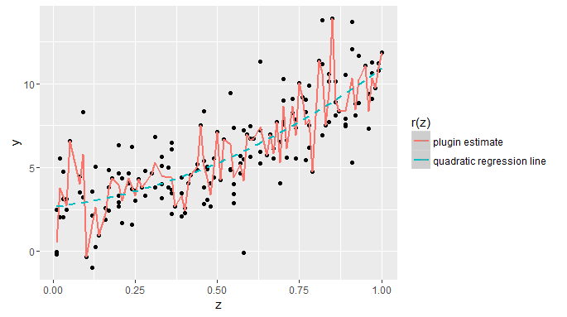
The nonparametric plugin estimate is usually not a good idea for this problem
The model: $Y=3+2∙Z+5∙Z^{2}+Z^{3}−\frac{Z^{4}}{2}+ε$ $ε\sim N\left(0,2^{2}\right)$, $P_{r}\left(Z=\frac{i}{100}\right)=\frac{1}{101}, i=1..100 n=170$

Slide 28
Let us focus on the other solutions to the regression problem - Quadratic least squares linear regression
Let us define $r_{β}\left(z\right)=β_{0}+β_{1}Z+β_{2}Z^{2}$
Now we to minimize $RSE\left(β\right)=\sum_{I=1}^{N}{ {[y_{i}−r_{b}\left(z_{i}\right)]}^{2}}$ by $β$
So $\hat{β}=\min_{β}{RSE(β)}$
We can think on $r_{β}\left(z\right)$ as a smoother version of the plugin estimator
As we considered higher degree polynomials $r_{\hat{β}}(z)$ would more and more resemble to the plugin estimate $\hat{r}(z)$

Slide 29
Let us focus on the other solutions to the regression problem - Weighted least squares linear regression (loess)
we choose a number $α$ that will be the proportion of the n data points used at each point of the curve construction
At each point $z$ we choose the closest $α∙n$ points $"𝒩(z)“$
A weighted least squares linear regression ${\hat{r}}_{z}\left(Z\right)={\hat{β}}_{z,0}+{\hat{β}}_{z,1}Z$
${\hat{β}}_{z,0}$ and ${\hat{β}}_{z,1}$ are different at each point $z$ and are selected to minimize $\sum_{x_{j}∈𝒩\left(z\right)}{w_{z,j}{[y_{j}−\left(β_{0}+β_{1}z_{j}\right)]}^{2}}$ in each $z$
Where $w_{z,j}$ are positive numbers which depend on $|z_{j}−z|$
$u_{j}=\frac{|z_{j}−z| }{\max_{𝒩(z)}{|z_{k}−z|}}$ $w_{j}={(1−{u_{j}}^{3})}^{3}$

Slide 30
Using bootstrap in order to estimate parameters of the two curves - 1
Suppose that we are interested in only a few points (for example $z=0.6$ and $z=1$)
We can expect that $se[{\hat{r}}_{quad}\left(z\right)]$ will be higher then $se[{\hat{r}}_{loess}\left(z\right)]$ since the weighted least squares is based on less data then the quadratic least squares
We can verify it (and see the estimated differences) by estimating each model standard deviation (in a certain point $z$), by using nonparametric bootstrap (by sampling pairs of y and z) to estimate $[{\hat{r}}_{quad}\left(z\right)]$ and $se[{\hat{r}}_{loess}\left(z\right)]$ by the estimators ${\hat{se}}_{B}[{\hat{r}}_{quad}\left(z^{∗}\right)]$ and ${\hat{se}}_{B}[{\hat{r}}_{loess}\left(z^{∗}\right)]$

Slide 31
Using bootstrap in order to estimate parameters of the two curves - 2
Now, let’s Suppose that we are interested in $θ=\frac{r\left(100\right)−r(80)}{20}−\frac{r\left(80\right)−r(60)}{20}$
Since weighted ls much more flexible we expect it to be much less biased then the quadratic ls
Now, if want to know what are reasonable values of $θ$, we can use nonparametric bootstrap to create B bootstrap values ${{\hat{θ}}_{loess}}^{∗}$
Now we can create a histogram of reasonable values for $θ$, and see whether ${\hat{θ}}_{quad}$ is a reasonable estimator
If ${\hat{θ}}_{quad}$ is not reasonable we will might want to fit a more flexible model (cubic, quartic, etc…) and then estimate $θ$

Slide 32
An example of bootstrap sampling failure

Slide 33
Example from uniform distribution
Suppose that we have data $X_{1},…,X_{n}$ from a uniform distribution $(0,θ)$
Let us suppose we want to estimate the standard error of the MLE ${\hat{θ}}_{MLE}=X_{(n)}$
Do you think nonparametric Bootstrap is good way to estimate $\hat{se}\left({\hat{θ}}_{MLE}\right)$?

Slide 34
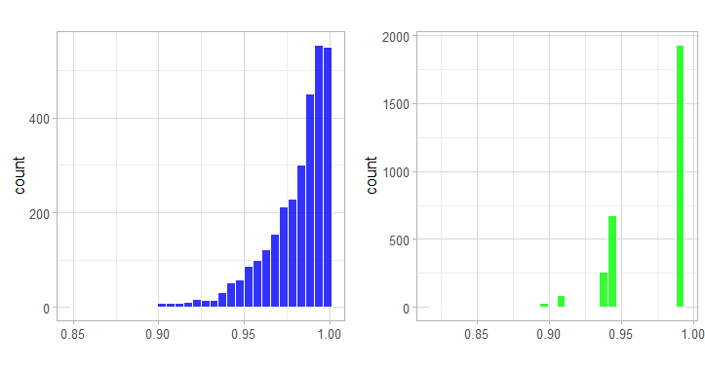
Sometimes the empirical distribution $\hat{F}$ is not a good estimate for F – example from uniform distribution
We computed 50 observations from $U(0,1)$ distribution, and now we want to try and compare the distribution of ${{\hat{θ}}^{∗}}_{MLE}$ to the distribution of ${\hat{θ}}_{MLE}$ and see if ${\hat{se}}_{B}\left({{\hat{θ}}_{MLE}}^{∗}\right)$ is a good estimator for $\hat{se}\left({\hat{θ}}_{MLE}\right)$
$$\hat{se}\left({\hat{θ}}_{MLE}\right)≈ 0.0189$$
$${\hat{se}}_{3000}\left({{\hat{θ}}_{MLE}}^{∗}\right)= 0.0278$$
$${\hat{θ}}_{MLE}$$
$${{\hat{θ}}^{∗}}_{MLE}$$

Slide 35
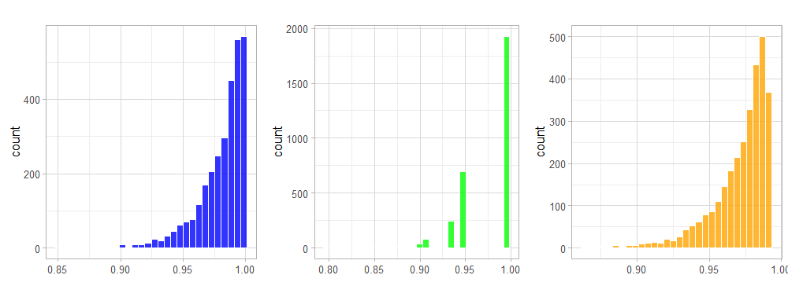
A use of parametric bootstrap can help us built a better $\hat{F}$
Now we will choose a parametric setting where $\hat{F}$ is a uniform $(0,{\hat{θ}}_{MLE}=0.992)$ and will get much better results
An example to how different the parametric and non parametric are can be found in that under nonparametric bootstrap $P_{r}\left({{\hat{θ}}^{∗}}_{MLE}={\hat{θ}}_{MLE}\right)=1−{\left(1−\frac{1}{n}\right)}^{n}≈\frac{1}{e}=0.368$, and under parametric bootstrap $P_{r}\left({{\hat{θ}}^{∗}}_{MLE}={\hat{θ}}_{MLE}\right)=0$
$$\hat{se}\left({\hat{θ}}_{MLE}\right)≈ 0.0189$$
$${\hat{se}}_{3000}\left({{\hat{θ}}_{MLE}}^{∗}\right)= 0.0278$$
$${\hat{se}}_{3000}\left({{\hat{θ}}_{MLE}}^{∗}\right)= 0.0196$$
$${\hat{θ}}_{MLE}$$
${{non parametric \hat{θ}}^{∗}}_{MLE}$
${{parametric \hat{θ}}^{∗}}_{MLE}$

Slide 36
Thank you

