Slide 1
Applying bootstrap methods to time series and regression models
“An Introduction to the Bootstrap” by Efron and Tibshirani, chapters 8-9
M.Sc. Seminar in statistics, TAU, March 2017
By Yotam Haruvi

Slide 2
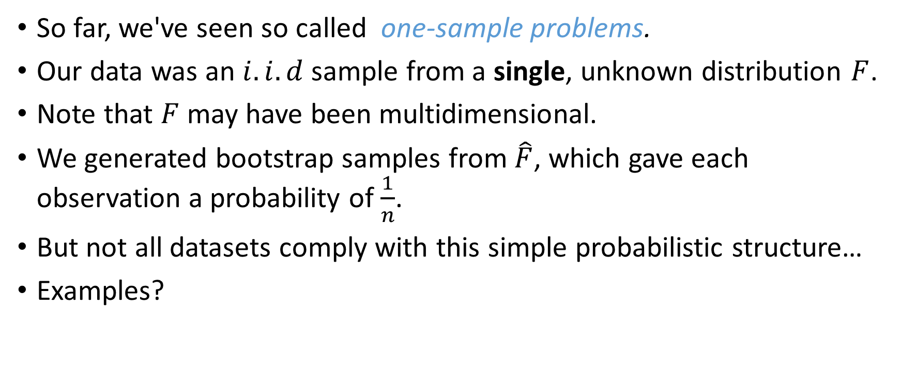
The general problem
So far, we've seen so called one-sample problems.
Our data was an $i.i.d$ sample from a single, unknown distribution $F$.
Note that $F$ may have been multidimensional.
We generated bootstrap samples from $\hat{F}$, which gave each observation a probability of $\frac{1}{n}$.
But not all datasets comply with this simple probabilistic structure…
Examples?

Slide 3
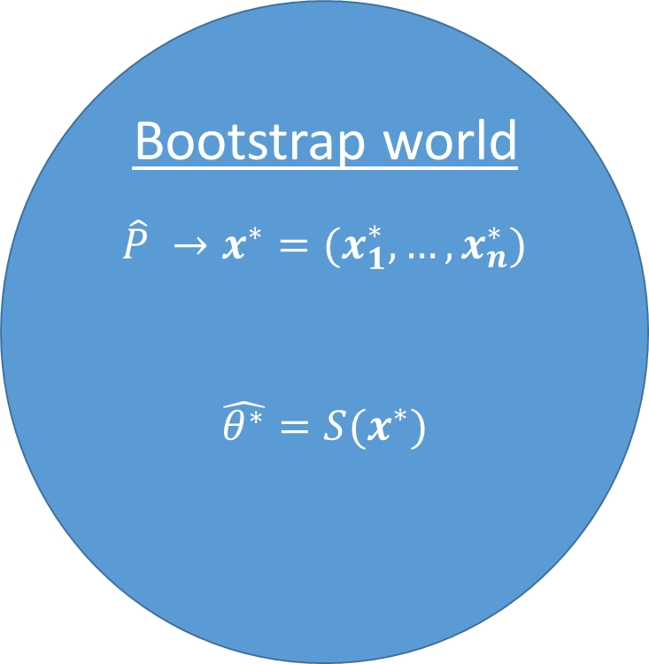
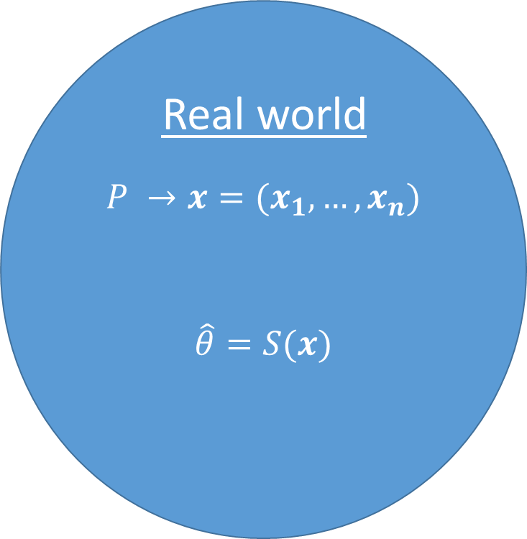
Unknown probabilistic model
Observed data
Estimated probabilistic model
Bootstrap sample
Real world
$$P →x=(x_{1},…, x_{n})$$
$$\hat{θ}=S(x)$$
Bootstrap world
$$\hat{P} →x^{∗}=(x_{1}^{∗},…, x_{n}^{∗})$$
$$\hat{θ^{∗}}=S(x^{∗})$$
We will focus on this part today
Statistic of interest
Bootstrap replication

Slide 4
Agenda
We wish to extend the bootstrap method to other, more complexed data structures:
Time series
Regression
We will review several, ad-hoc bootstrap methods, for each of the structures above.
But we’ll start with a simple example - Two-sample problem.

Slide 5
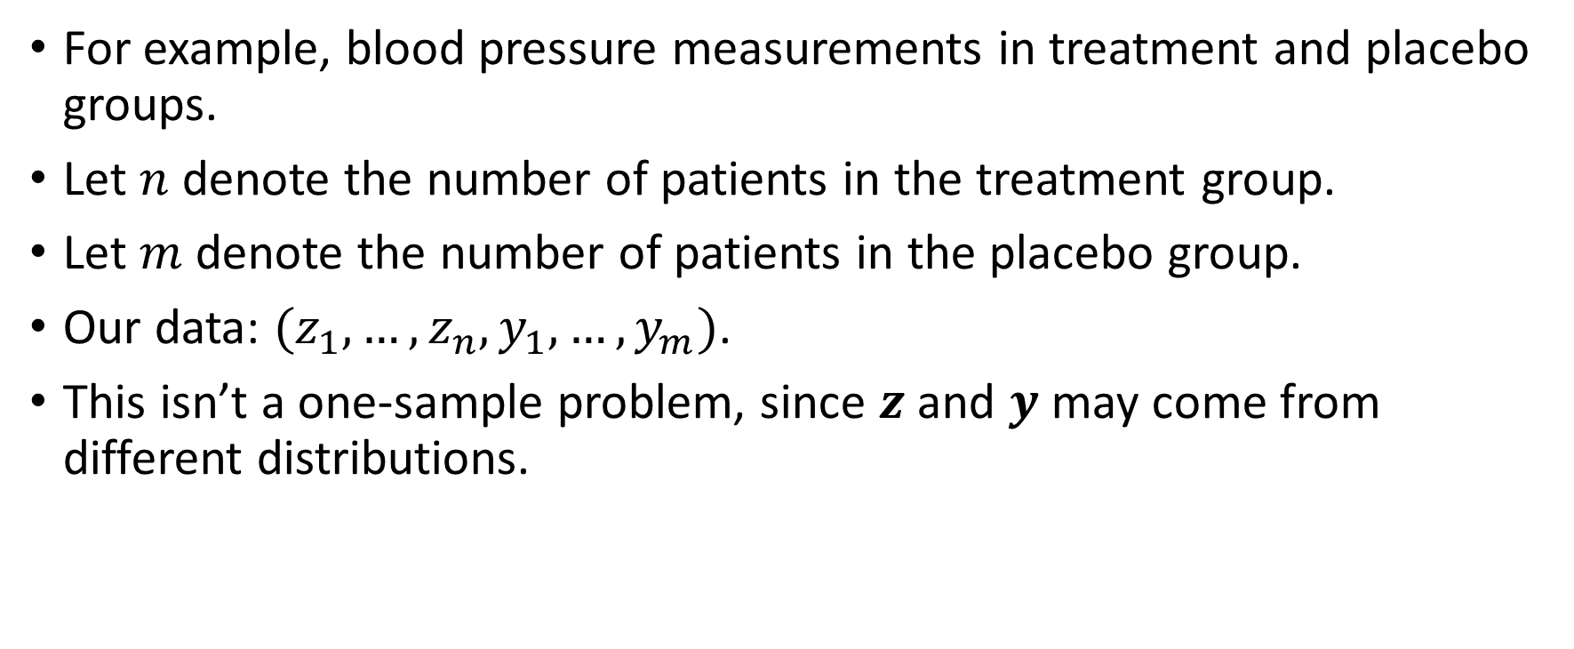
Two-sample problem – the framework
For example, blood pressure measurements in treatment and placebo groups.
Let $n$ denote the number of patients in the treatment group.
Let $m$ denote the number of patients in the placebo group.
Our data: $(z_{1}, …, z_{n}, y_{1}, …, y_{m})$.
This isn’t a one-sample problem, since $z$ and $y$ may come from different distributions.

Slide 6
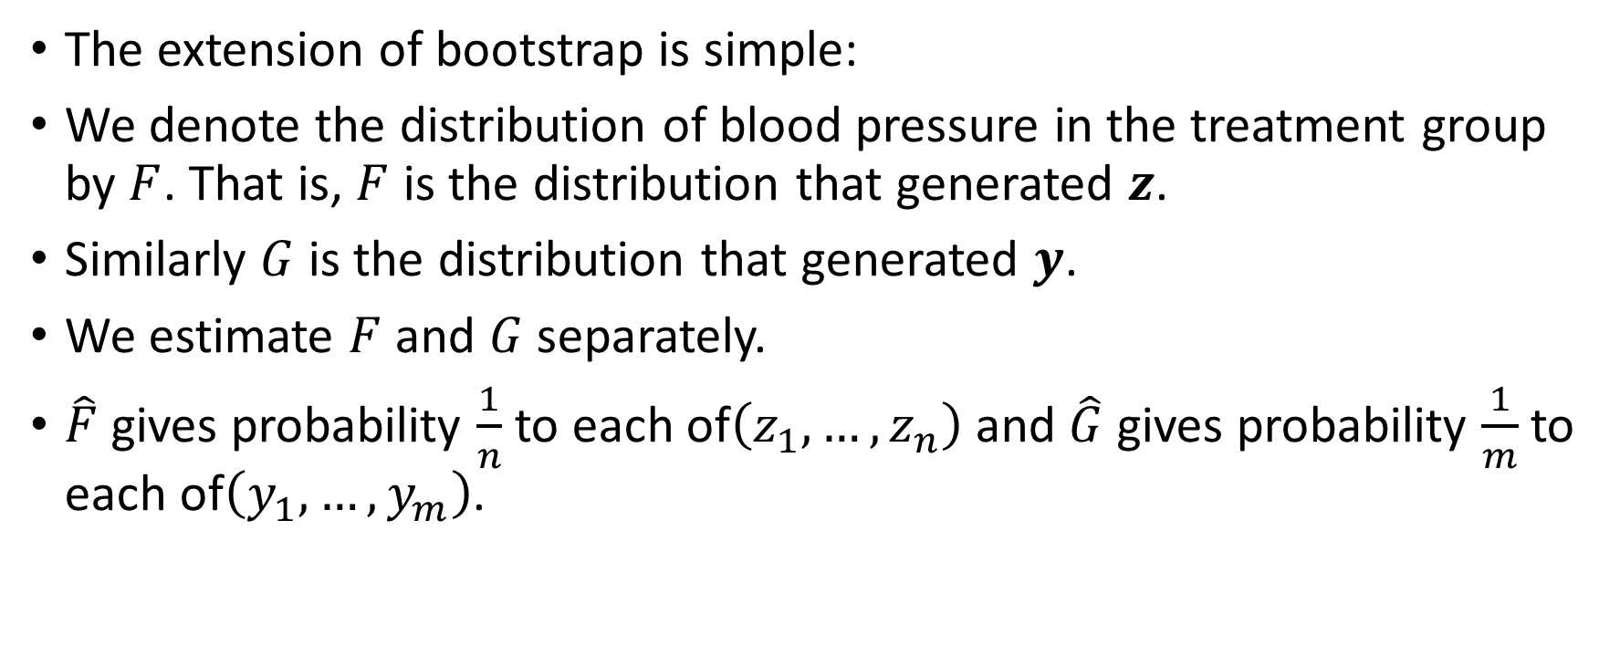
Two-sample problems – a bootstrap solution
The extension of bootstrap is simple:
We denote the distribution of blood pressure in the treatment group by $F$. That is, $F$ is the distribution that generated $z$.
Similarly $G$ is the distribution that generated $y$.
We estimate $F$ and $G$ separately.
$\hat{F}$gives probability $\frac{1}{n}$to each of$\left(z_{1}, …, z_{n}\right)$ and $\hat{G}$ gives probability $\frac{1}{m}$to each of$\left(y_{1}, …, y_{m}\right)$.

Slide 7
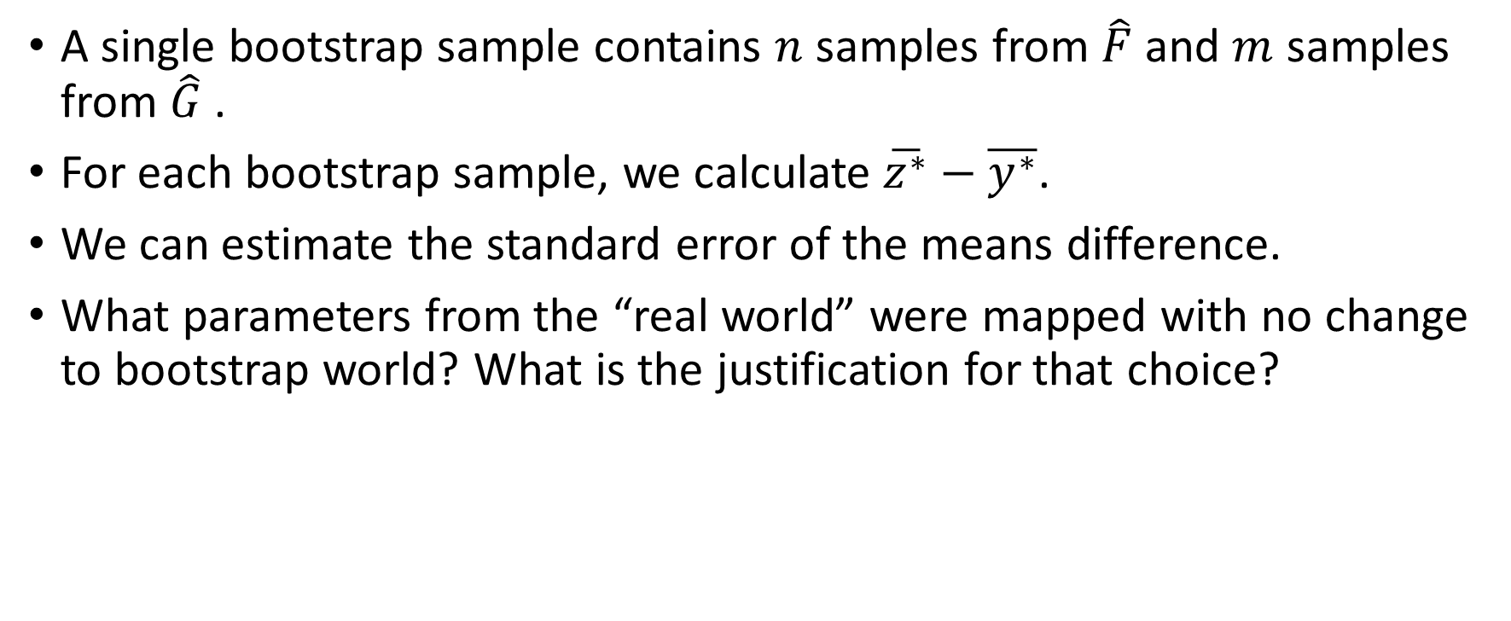
Two-sample problems – a bootstrap solution
A single bootstrap sample contains $n$ samples from $\hat{F}$ and $m$ samples from $\hat{G}$.
For each bootstrap sample, we calculate $\overline{z^{∗}}−\overline{y^{∗}}$.
We can estimate the standard error of the means difference.
What parameters from the “real world” were mapped with no change to bootstrap world? What is the justification for that choice?

Slide 8
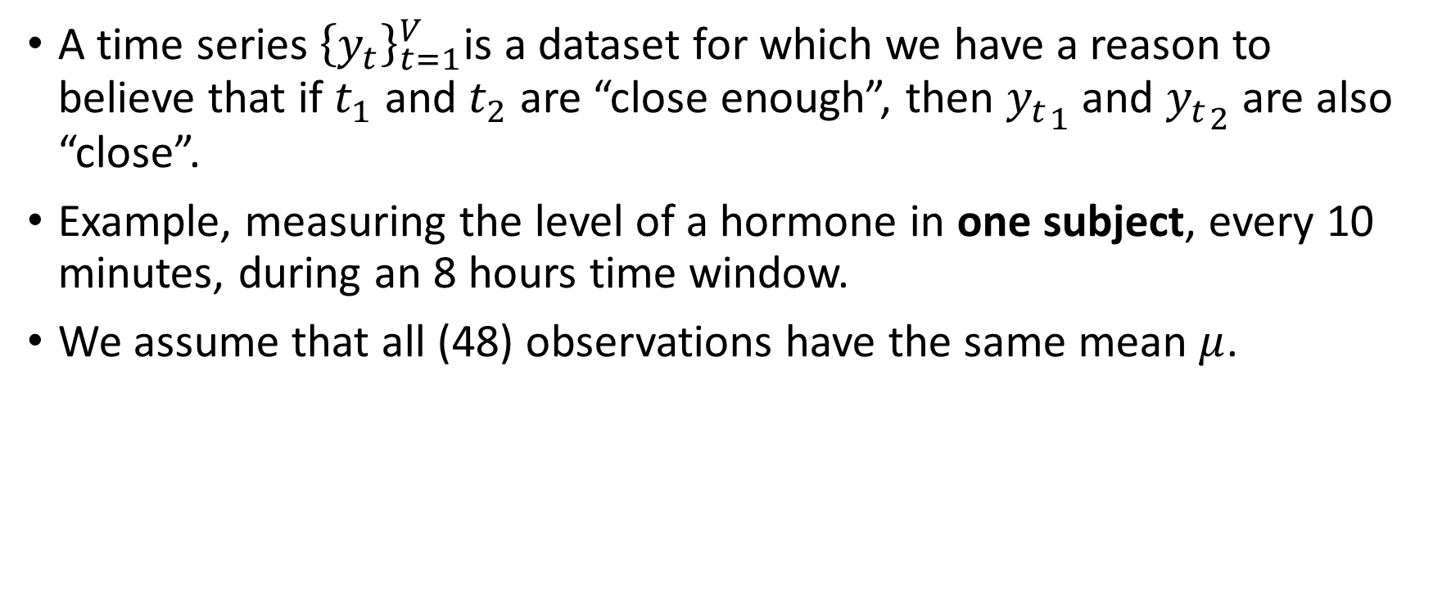
Time series
A time series ${\left\{y_{t}\right\}}_{t=1}^{V}$is a dataset for which we have a reason to believe that if $t_{1}$ and $t_{2}$ are “close enough”, then ${y_{t}}_{1}$ and ${y_{t}}_{2}$ are also “close”.
Example, measuring the level of a hormone in one subject, every 10 minutes, during an 8 hours time window.
We assume that all (48) observations have the same mean $μ$.

Slide 9
Time series - illustration
Diggle, 1990: 48 measurements taken from a healthy woman, every 10 minutes

Slide 10
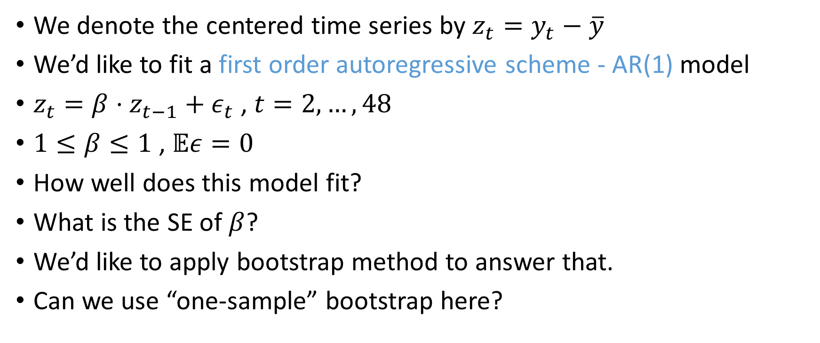
Time series – the problem
We denote the centered time series by $z_{t}=y_{t}−\overline{y}$
We’d like to fit a first order autoregressive scheme - AR(1) model
$z_{t}=β⋅z_{t−1}+ε_{t}$ , $t=2,…, 48$
$1≤β≤1$ , $𝔼ε=0$
How well does this model fit?
What is the SE of $β$?
We’d like to apply bootstrap method to answer that.
Can we use “one-sample” bootstrap here?

Slide 11
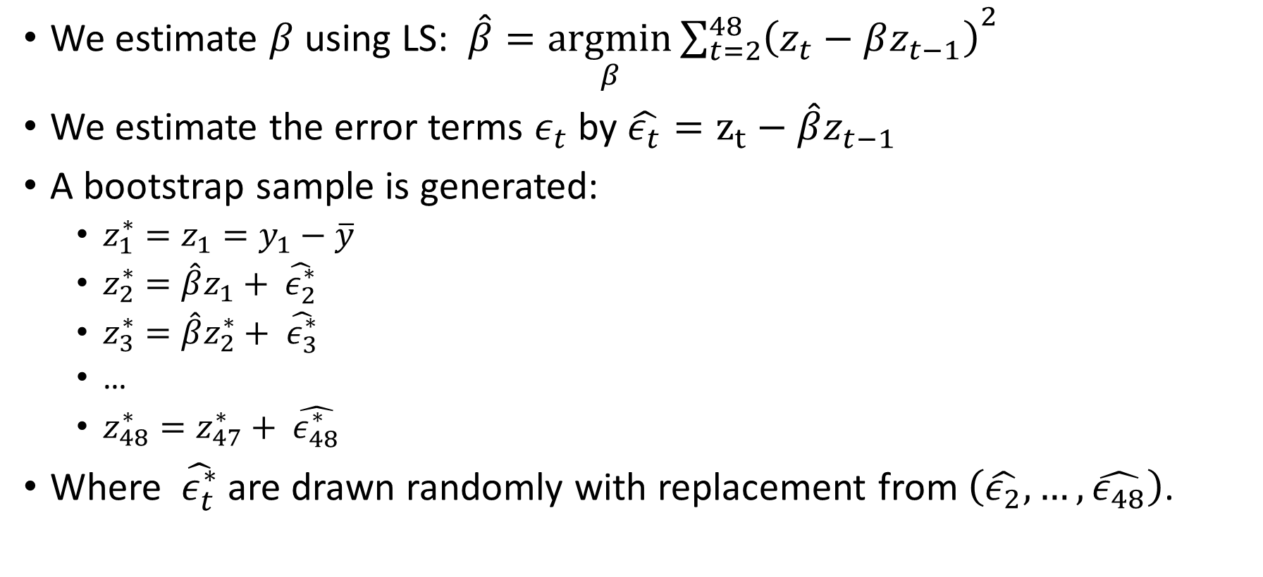
Time series – a bootstrap solution
We estimate $β$ using LS: $\hat{β}=\underset{β}{argmin}{{\sum_{t=2}^{48}{\left(z_{t}−βz_{t−1}\right)}}^{2}}$
We estimate the error terms $ε_{t}$ by $\hat{ε_{t}}=z_{t}−\hat{β}z_{t−1}$
A bootstrap sample is generated:
  $z_{1}^{∗}=z_{1}=y_{1}−\overline{y}$
  $z_{2}^{∗}={\hat{β}z}_{1}+ \hat{ε_{2}^{∗}}$
  $z_{3}^{∗}={\hat{β}z}_{2}^{∗}+ \hat{ε_{3}^{∗}}$
  …
  $z_{48}^{∗}=z_{47}^{∗}+ \hat{ε_{48}^{∗}}$
Where $\hat{ε_{t}^{∗}}$ are drawn randomly with replacement from $\left(\hat{ε_{2}}, …,\hat{ε_{48}}\right)$.

Slide 12

Time series – a bootstrap solution
For each bootstrap sample we calculate LS estimator $\hat{β^{∗}}$
We can now estimate the SE of $β$ by the empirical SE of all $\hat{β^{∗}}$
We can extend easily to second order autoregressive scheme – AR(2)

Slide 13

Time series – moving blocks bootstrap
A different approach to time series – the moving blocks bootstrap.
Choose a block length ( 3 in our illustration)
sample with replacement from all possible contiguous blocks of that length.
Align those blocks until you get a sample of (approximately) size $n$.
Original sample
Bootstrap sample

Slide 14

Time series – moving blocks bootstrap
For each bootstrap sample we calculate LS estimator $\hat{β^{∗}}$
We can now estimate the SE of $β$ by empirical SE of all $\hat{β^{∗}}$
We can extend easily to second order autoregressive scheme – AR(2)

Slide 15
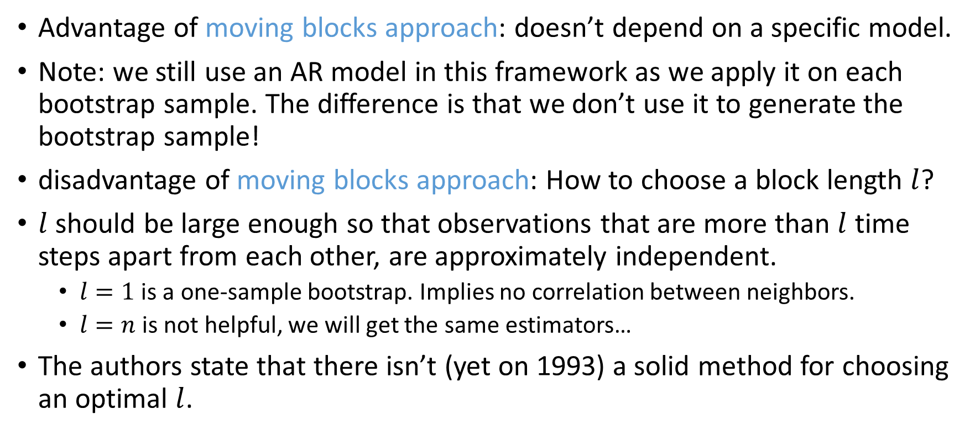
Time series – discussion of two methods
Advantage of moving blocks approach: doesn’t depend on a specific model.
Note: we still use an AR model in this framework as we apply it on each bootstrap sample. The difference is that we don’t use it to generate the bootstrap sample!
disadvantage of moving blocks approach: How to choose a block length $l$?
$l$ should be large enough so that observations that are more than $l$ time steps apart from each other, are approximately independent.
  $l=1$ is a one-sample bootstrap. Implies no correlation between neighbors.
  $l=n$ is not helpful, we will get the same estimators…
The authors state that there isn’t (yet on 1993) a solid method for choosing an optimal $l$.

Slide 16
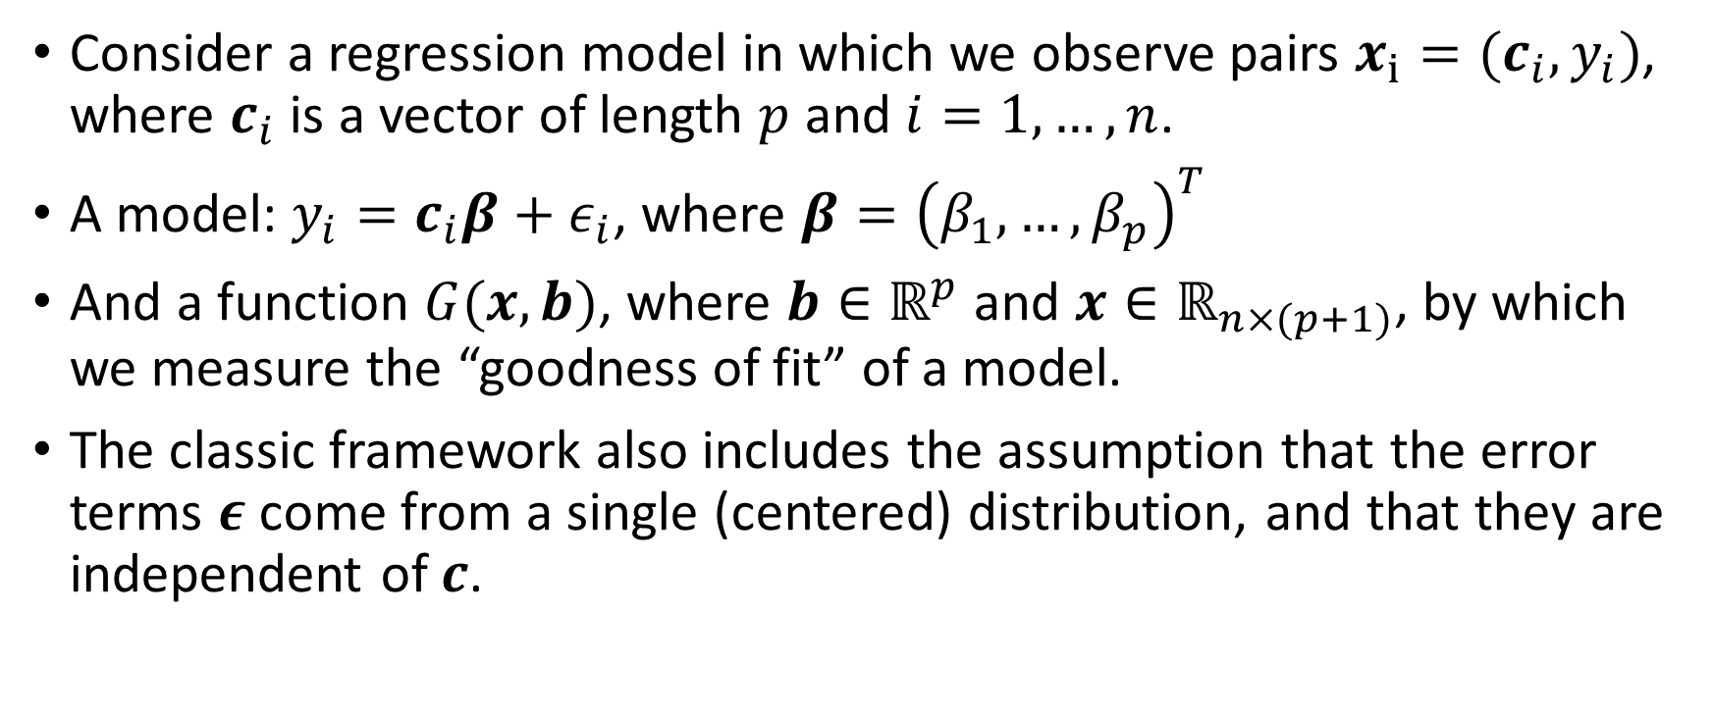
Regression – the framework
Consider a regression model in which we observe pairs $x_{i}=(c_{i}, y_{i})$, where $c_{i}$ is a vector of length $p$ and $i=1,…, n$.
A model: $y_{i}=c_{i}β+ε_{i}$, where $β={\left(β_{1}, …, β_{p}\right)}^{T}$
And a function $G(x,b)$, where $b∈ℝ^{p}$ and $x∈ℝ_{n×(p+1)}$, by which we measure the “goodness of fit” of a model.
The classic framework also includes the assumption that the error terms $ε$ come from a single (centered) distribution, and that they are independent of $c$.

Slide 17
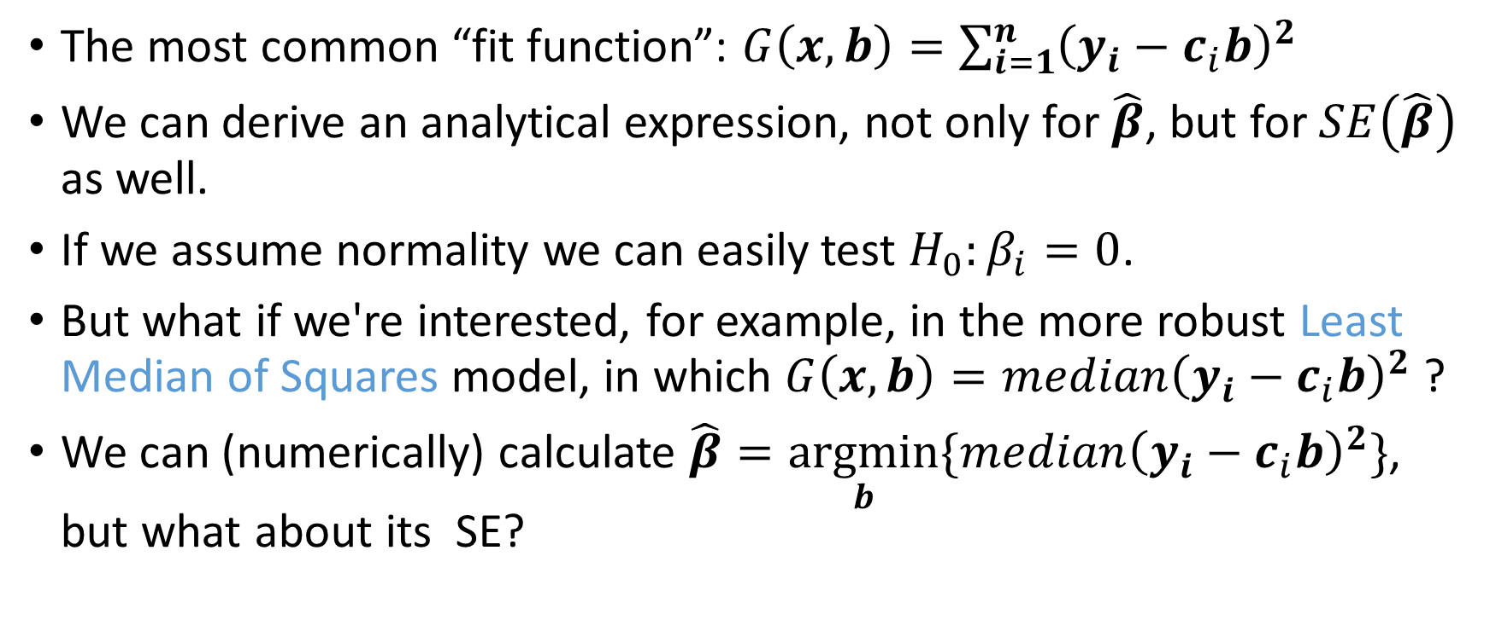
Regression – the problem
The most common “fit function”: $G\left(x, b\right)=\sum_{i=1}^{n}{{\left(y_{i}−c_{i}b\right)}^{2}}$
We can derive an analytical expression, not only for $\hat{β}$, but for $SE\left(\hat{β}\right)$ as well.
If we assume normality we can easily test $H_{0}:β_{i}=0$.
But what if we're interested, for example, in the more robust Least Median of Squares model, in which $G\left(x, b\right)=median{\left(y_{i}−c_{i}b\right)}^{2}$ ?
We can (numerically) calculate $\hat{β}=\underset{b}{argmin}{\{median{\left(y_{i}−c_{i}b\right)}^{2}\}}$, but what about its SE?

Slide 18
Regression – Bootstrap solutions
We will cover two different ways in which we can generate bootstrap samples:
Bootstrapping pairs
Bootstrapping residuals

Slide 19
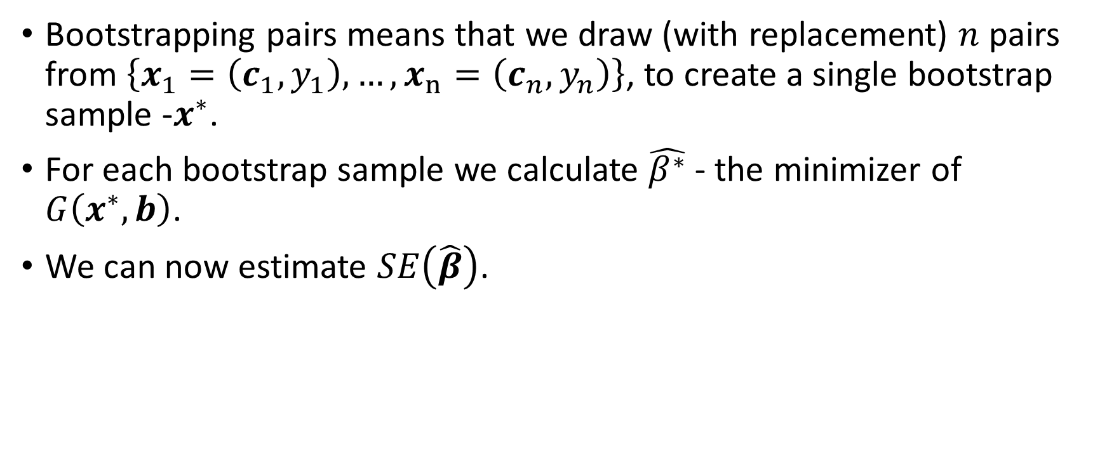
Regression - Bootstrapping pairs
Bootstrapping pairs means that we draw (with replacement) $n$ pairs from $\left\{x_{1}=\left(c_{1}, y_{1}\right), …,x_{n}=\left(c_{n}, y_{n}\right)\right\}$, to create a single bootstrap sample -$x^{∗}$.
For each bootstrap sample we calculate $\hat{β^{∗}}$ - the minimizer of $G\left(x^{∗},b\right)$.
We can now estimate $SE\left(\hat{β}\right)$.

Slide 20
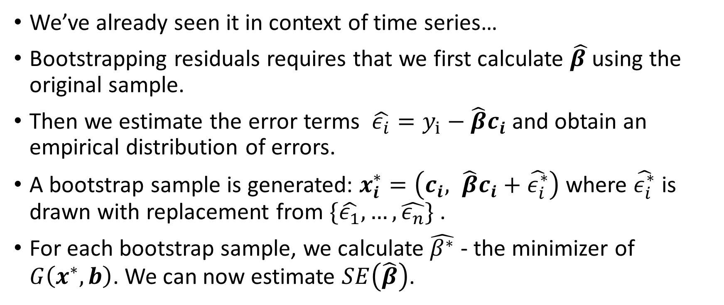
Regression - Bootstrapping residuals
We’ve already seen it in context of time series…
Bootstrapping residuals requires that we first calculate $\hat{β }$using the original sample.
Then we estimate the error terms $\hat{ε_{i}}=y_{i}−\hat{β}c_{i}$and obtain an empirical distribution of errors.
A bootstrap sample is generated: $x_{i}^{∗}=\left(c_{i}, \hat{β}c_{i}+\hat{ε_{i}^{∗}}\right)$ where $\hat{ε_{i}^{∗}}$ is drawn with replacement from $\{\hat{ε_{1}},…,\hat{ε_{n}}\}$ .
For each bootstrap sample, we calculate $\hat{β^{∗}}$ - the minimizer of $G\left(x^{∗},b\right)$. We can now estimate $SE\left(\hat{β}\right)$.

Slide 21
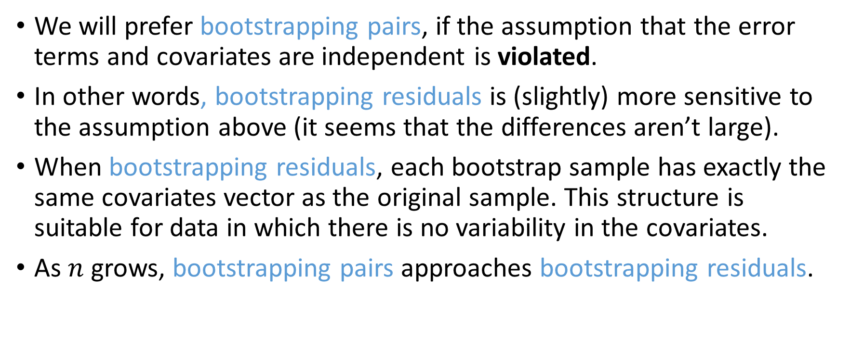
Regression – discussion of two methods
We will prefer bootstrapping pairs, if the assumption that the error terms and covariates are independent is violated.
In other words, bootstrapping residuals is (slightly) more sensitive to the assumption above (it seems that the differences aren’t large).
When bootstrapping residuals, each bootstrap sample has exactly the same covariates vector as the original sample. This structure is suitable for data in which there is no variability in the covariates.
As $n$ grows, bootstrapping pairs approaches bootstrapping residuals.

Slide 22
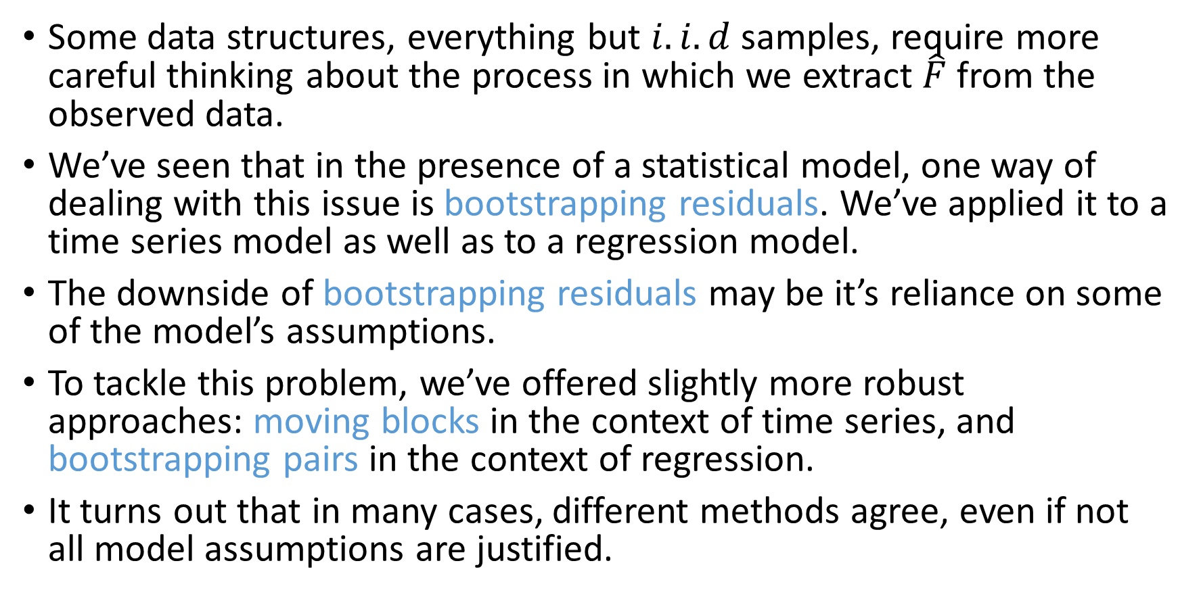
Conclusion
Some data structures, everything but $i.i.d$ samples, require more careful thinking about the process in which we extract $\hat{F}$ from the observed data.
We’ve seen that in the presence of a statistical model, one way of dealing with this issue is bootstrapping residuals. We’ve applied it to a time series model as well as to a regression model.
The downside of bootstrapping residuals may be it’s reliance on some of the model’s assumptions.
To tackle this problem, we’ve offered slightly more robust approaches: moving blocks in the context of time series, and bootstrapping pairs in the context of regression.
It turns out that in many cases, different methods agree, even if not all model assumptions are justified.

Slide 23
Thank you!

