Slide 1
Cross Validation and Other Estimates of Prediction Error
“An Introduction to the Bootstrap” by Efron and Tibshirani, chapter 17
M.Sc. Seminar in statistics, TAU, March 2017
By Aitan Birati

Slide 2
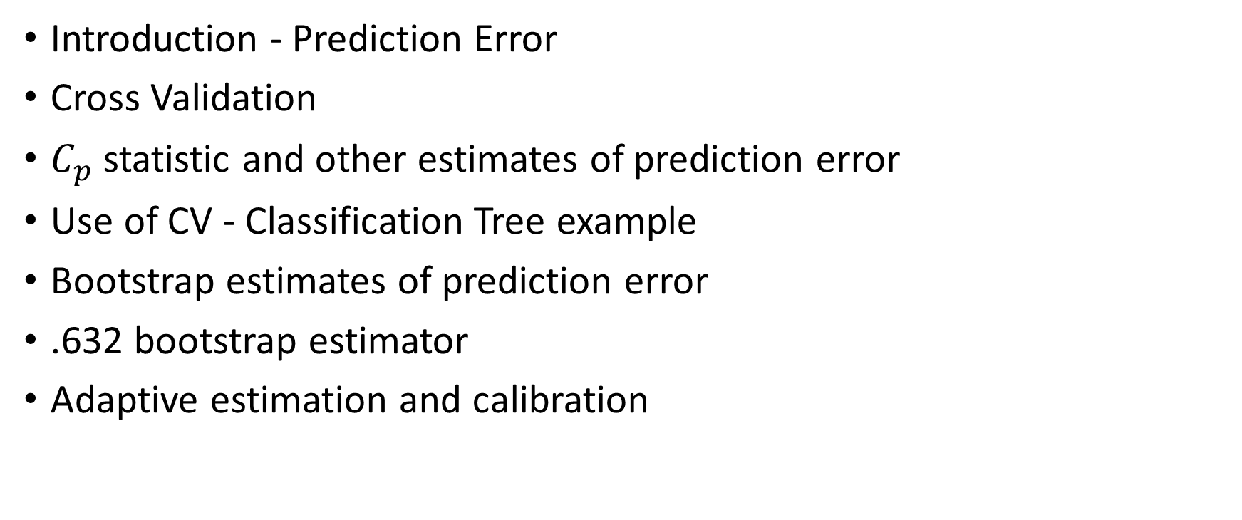
Agenda
Introduction - Prediction Error
Cross Validation
$C_{p}$ statistic and other estimates of prediction error
Use of CV - Classification Tree example
Bootstrap estimates of prediction error
.632 bootstrap estimator
Adaptive estimation and calibration

Slide 3
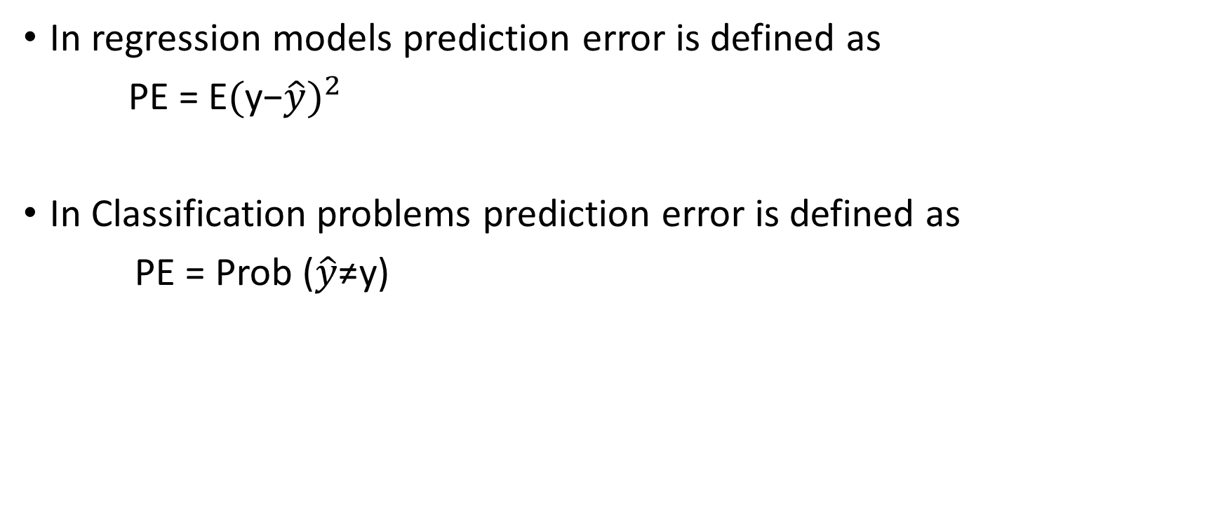
Prediction Error
In regression models prediction error is defined as
PE = E${(\text{y}\text{−}\hat{y})}^{2}$
In Classification problems prediction error is defined as
PE = Prob ($\hat{y}\text{≠}$y)

Slide 4
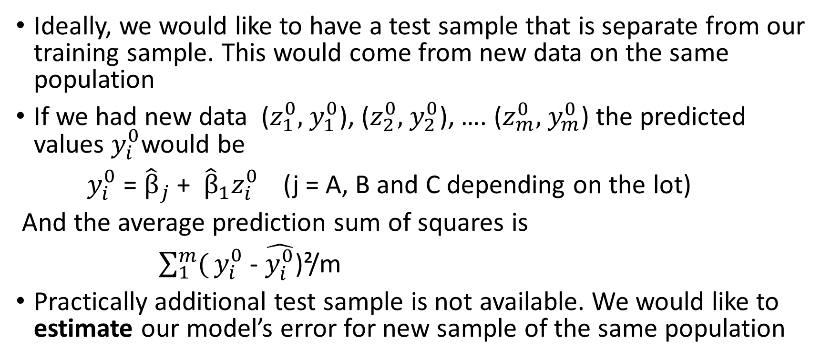
Test Sample versus Training sample
Ideally, we would like to have a test sample that is separate from our training sample. This would come from new data on the same population
If we had new data ($z_{1}^{0},$ $y_{1}^{0}$), ($z_{2}^{0},$ $y_{2}^{0}$), …. ($z_{m}^{0},$ $y_{m}^{0}$) the predicted values $y_{i}^{0}$would be
$y_{i}^{0}$ = ${\hat{β}}_{j}$ + ${\hat{β}}_{1}z_{i}^{0}$(j = A, B and C depending on the lot)
And the average prediction sum of squares is
$\sum_{1}^{m}{(}y_{i}^{0}$ - $\hat{y_{i}^{0}}$)²/m
Practically additional test sample is not available. We would like to estimate our model’s error for new sample of the same population

Slide 5
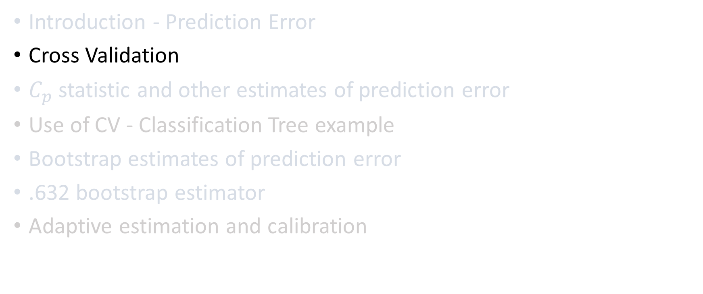
Agenda
Introduction - Prediction Error
Cross Validation
$C_{p}$ statistic and other estimates of prediction error
Use of CV - Classification Tree example
Bootstrap estimates of prediction error
.632 bootstrap estimator
Adaptive estimation and calibration

Slide 6
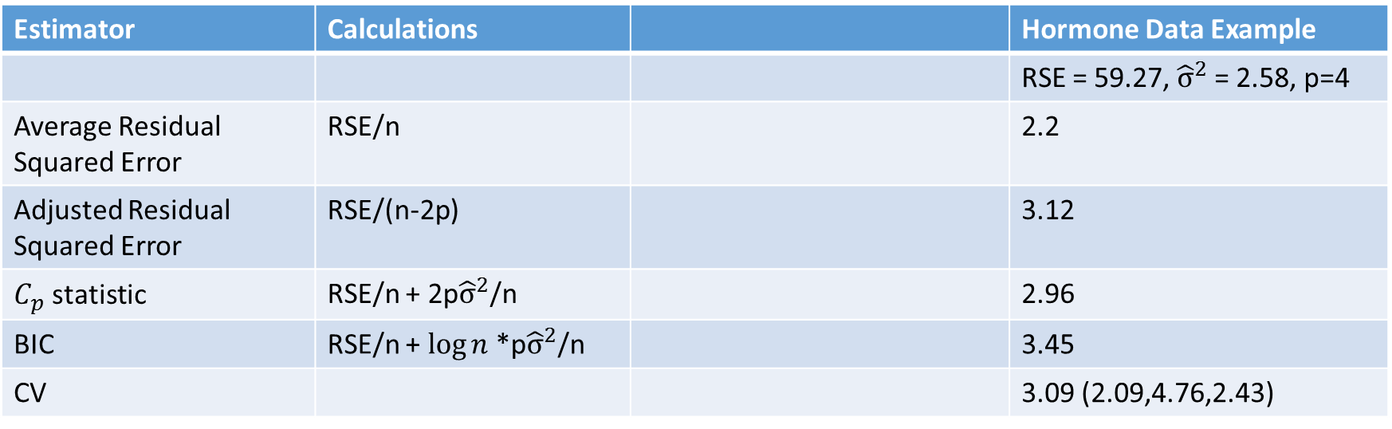

Estimator of prediction errors – first peak
RSE = $\sum_{1}^{n}{(}y_{i}$ - $\hat{y_{i}}$)²
p = number of regressors in the model
${\hat{σ}}^{2}$ = RSE/(n-p) ; p${\hat{σ}}^{2}$/n = (RSE/n) * (p/n-p)
Estimator | Calculations |  | Hormone Data Example
 |  |  | RSE = 59.27, ${\hat{σ}}^{2}$ = 2.58, p=4
Average Residual Squared Error | RSE/n |  | 2.2
Adjusted Residual Squared Error | RSE/(n-2p) |  | 3.12
$C_{p}$ statistic | RSE/n + 2p${\hat{σ}}^{2}$/n |  | 2.96
BIC | RSE/n + $\log{n }$*p${\hat{σ}}^{2}$/n |  | 3.45
CV |  |  | 3.09 (2.09,4.76,2.43)

Slide 7
K- Fold Cross Validation algorithm
Split the data into K roughly equal-sized parts
For the kth part, fit the model to other K-1 parts of the data , and calculate the prediction error of the fitted model when predicting the kth part of the data.
Do the above for k = 1,2,….K and combine K estimates of the prediction error.

Slide 8
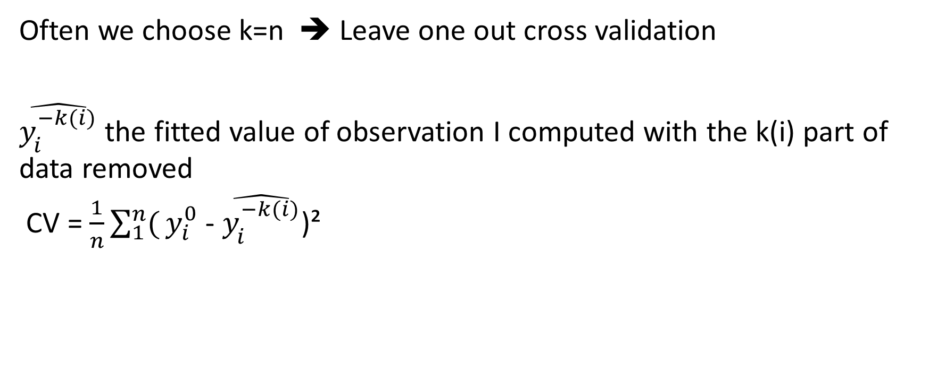
K- Fold Cross Validation algorithm
Often we choose k=n ➔ Leave one out cross validation
$\hat{y_{i}^{−k(i)}}$ the fitted value of observation I computed with the k(i) part of data removed
CV = $\frac{1}{n}\sum_{1}^{n}{(}y_{i}^{0}$ - $\hat{y_{i}^{−k(i)}}$)²

Slide 9
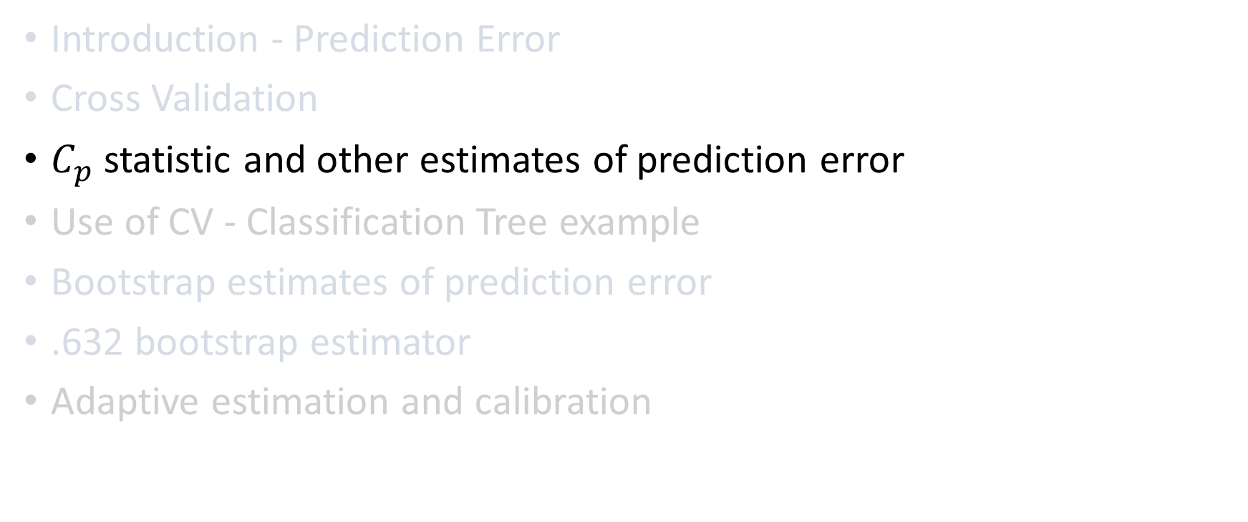
Agenda
Introduction - Prediction Error
Cross Validation
$C_{p}$ statistic and other estimates of prediction error
Use of CV - Classification Tree example
Bootstrap estimates of prediction error
.632 bootstrap estimator
Adaptive estimation and calibration

Slide 10
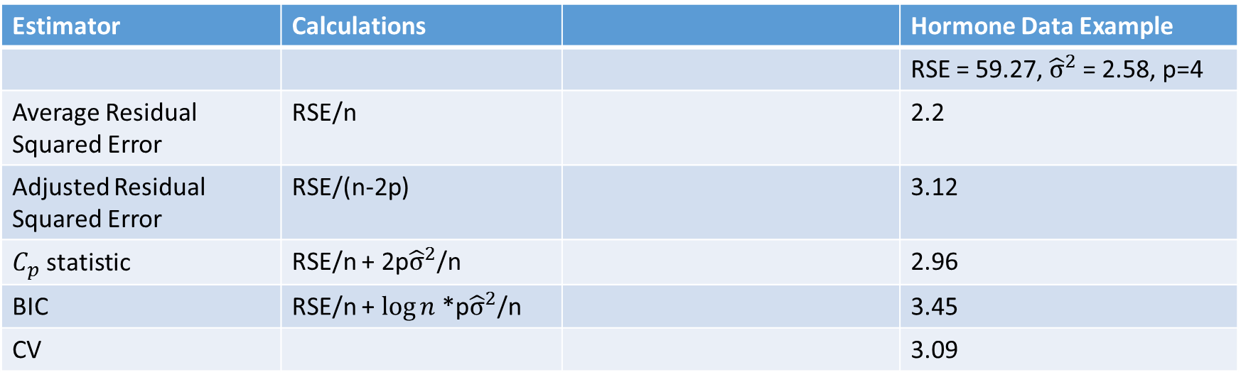
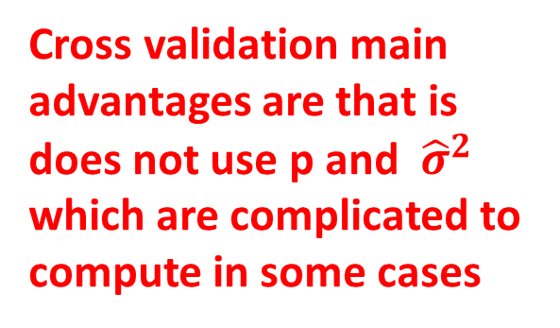
Estimator of prediction errors
Cross validation main advantages are that is does not use p and ${\hat{σ}}^{2}$ which are complicated to compute in some cases
RSE = $\sum_{1}^{n}{(}y_{i}$ - $\hat{y_{i}}$)²
p = number of regressors in the model
${\hat{σ}}^{2}$ = RSE/(n-p) ; p${\hat{σ}}^{2}$/n = (RSE/n) * (p/n-p)
Estimator | Calculations |  | Hormone Data Example
 |  |  | RSE = 59.27, ${\hat{σ}}^{2}$ = 2.58, p=4
Average Residual Squared Error | RSE/n |  | 2.2
Adjusted Residual Squared Error | RSE/(n-2p) |  | 3.12
$C_{p}$ statistic | RSE/n + 2p${\hat{σ}}^{2}$/n |  | 2.96
BIC | RSE/n + $\log{n }$*p${\hat{σ}}^{2}$/n |  | 3.45
CV |  |  | 3.09

Slide 11
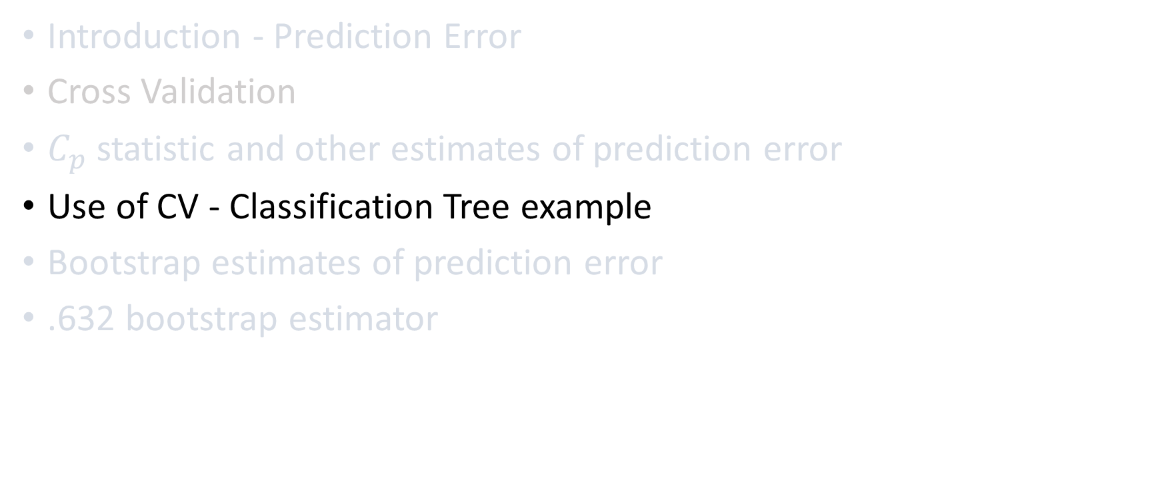
Agenda
Introduction - Prediction Error
Cross Validation
$C_{p}$ statistic and other estimates of prediction error
Use of CV - Classification Tree example
Bootstrap estimates of prediction error
.632 bootstrap estimator

Slide 12
Example of use of Cross Validation - CART
CART = Classification and Regression Tree.
Each node of the tree is a yes / no question assigning to the left/right
The leaves are called terminal nodes.
Each terminal node is a assigned to a class
The Tree is automatically built. It choosing its splitting points that best discriminate the outcome classes
What is the optimized tree size?

Slide 13
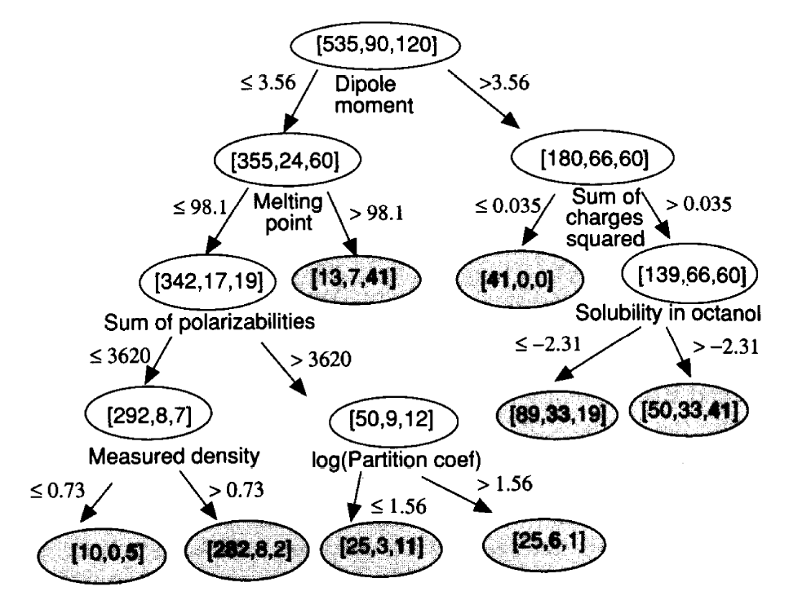
Example from the book

Slide 14
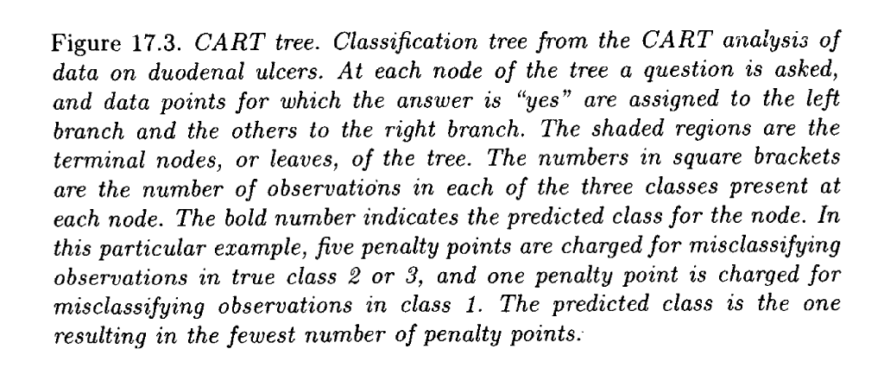
Explanation

Slide 15
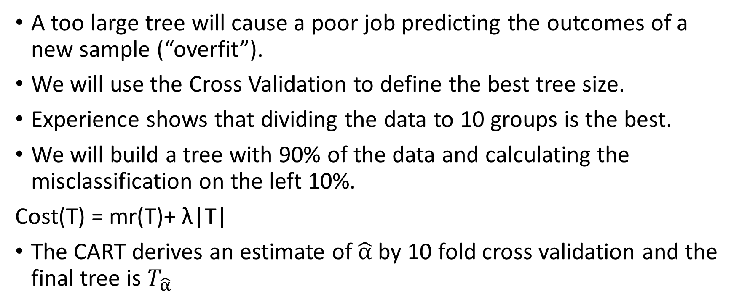
Using CV for optimized tree size
A too large tree will cause a poor job predicting the outcomes of a new sample (“overfit”).
We will use the Cross Validation to define the best tree size.
Experience shows that dividing the data to 10 groups is the best.
We will build a tree with 90% of the data and calculating the misclassification on the left 10%.
Cost(T) = mr(T)+ λ|T|
The CART derives an estimate of $\hat{α}$ by 10 fold cross validation and the final tree is $T_{\hat{α}}$

Slide 16
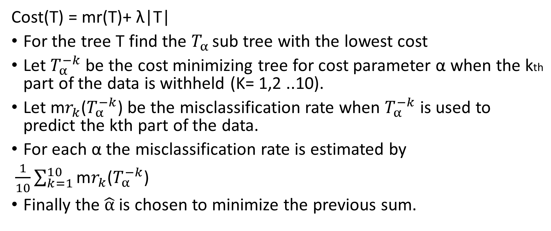
Using CV for optimized tree size
Cost(T) = mr(T)+ λ|T|
For the tree T find the $T_{α }$sub tree with the lowest cost
Let $T_{α}^{−k}$ be the cost minimizing tree for cost parameter α when the kth part of the data is withheld (K= 1,2 ..10).
Let m$r_{k}$($T_{α}^{−k}$) be the misclassification rate when $T_{α}^{−k}$ is used to predict the kth part of the data.
For each α the misclassification rate is estimated by
$\frac{1}{10}\sum_{k=1}^{10}{\text{m}r_{k}\text{(}T_{α}^{−k}\text{)}}$
Finally the $\hat{α}$is chosen to minimize the previous sum.

Slide 17
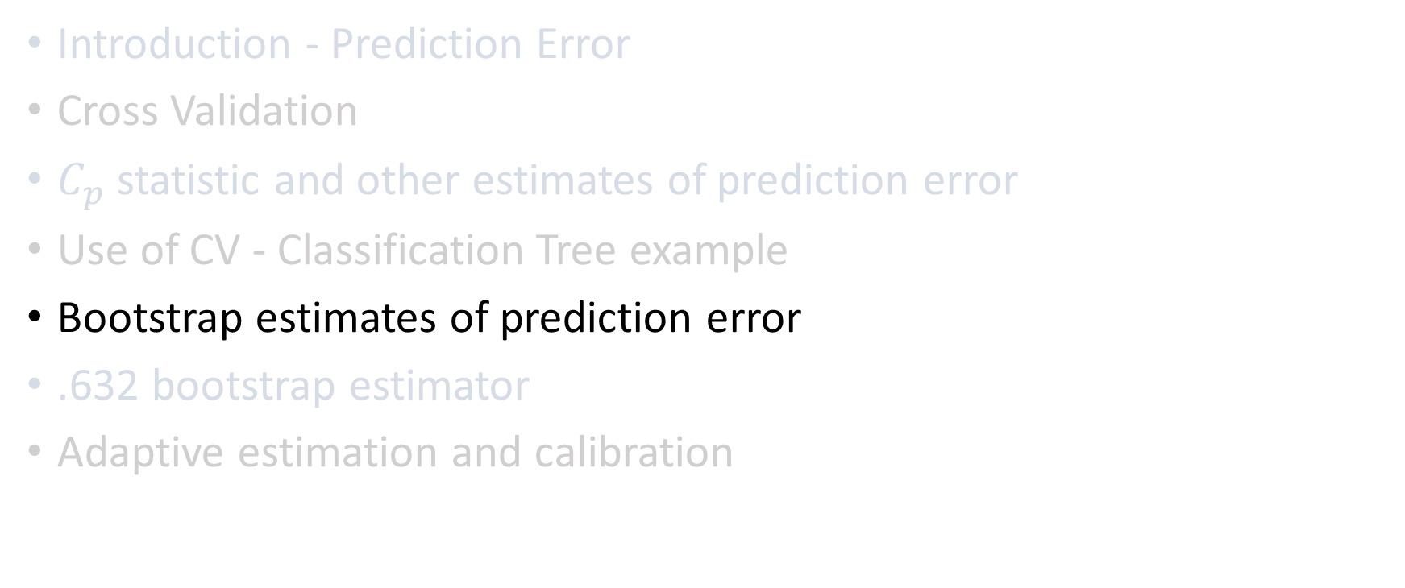
Agenda
Introduction - Prediction Error
Cross Validation
$C_{p}$ statistic and other estimates of prediction error
Use of CV - Classification Tree example
Bootstrap estimates of prediction error
.632 bootstrap estimator
Adaptive estimation and calibration

Slide 18
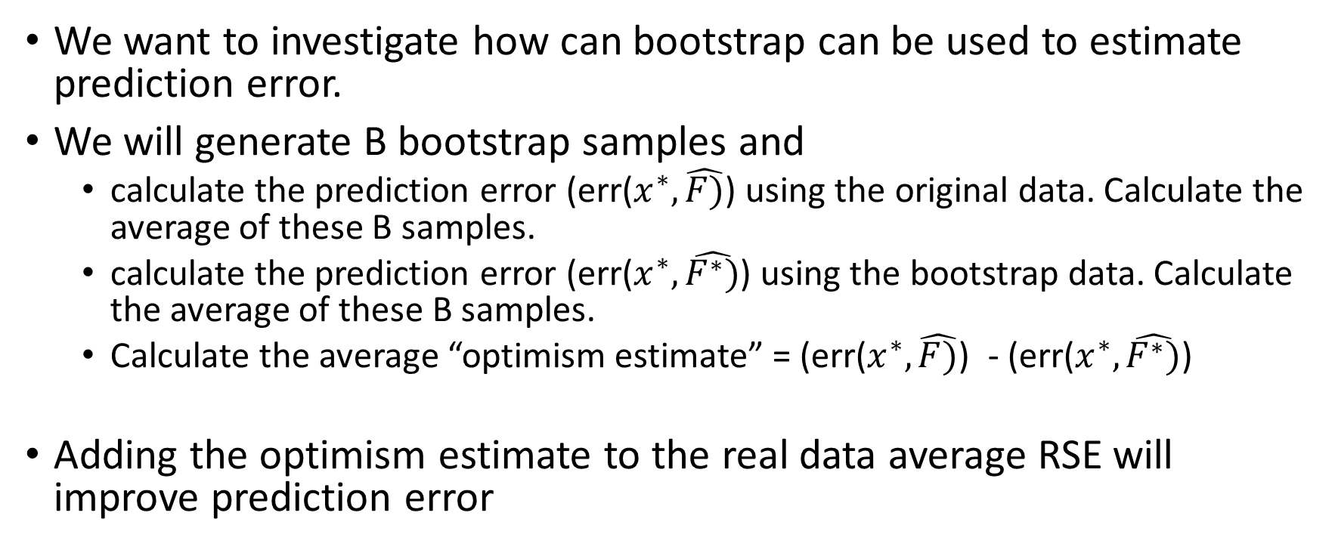
Bootstrap estimates of prediction error
We want to investigate how can bootstrap can be used to estimate prediction error.
We will generate B bootstrap samples and
  calculate the prediction error (err($x^{∗}, \hat{F)}$) using the original data. Calculate the average of these B samples.
  calculate the prediction error (err($x^{∗}, \hat{F^{∗})}$) using the bootstrap data. Calculate the average of these B samples.
  Calculate the average “optimism estimate” = (err($x^{∗}, \hat{F)}$) - (err($x^{∗}, \hat{F^{∗})}$)
Adding the optimism estimate to the real data average RSE will improve prediction error

Slide 19
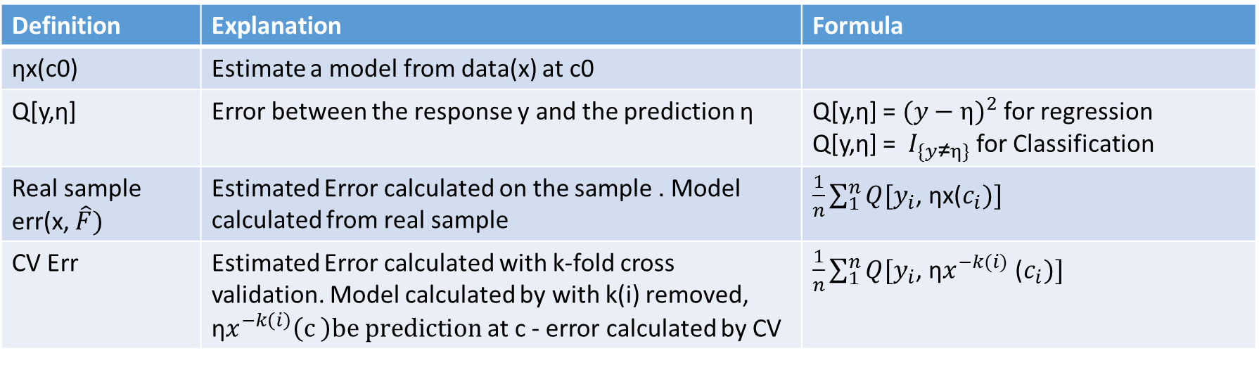
Summary
Definition | Explanation | Formula
ηx(c0) | Estimate a model from data(x) at c0
Q[y,η] | Error between the response y and the prediction η | Q[y,η] = ${(y−η)}^{2}$ for regression Q[y,η] = $I_{\{y\text{≠}η\}}$ for Classification
Real sample err(x, $\hat{F})$ | Estimated Error calculated on the sample . Model calculated from real sample | $\frac{1}{n}\sum_{1}^{n}{Q[y_{i}}$, ηx($c_{i})]$
CV Err | Estimated Error calculated with k-fold cross validation. Model calculated by with k(i) removed, η$x^{−k\left(i\right)}\left(c \right)be prediction$at c - error calculated by CV | $\frac{1}{n}\sum_{1}^{n}{Q[y_{i}}$, η$x^{−k(i)}$ ($c_{i})]$

Slide 20
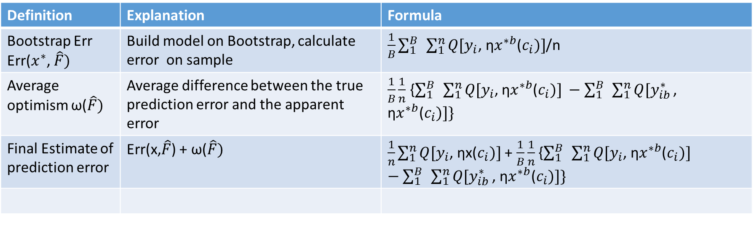
Summary
Definition | Explanation | Formula
Bootstrap Err Err($x^{∗}$, $\hat{F})$ | Build model on Bootstrap, calculate error on sample | $\frac{1}{B}\sum_{1}^{B}{ }\sum_{1}^{n}{Q[y_{i}}$, η$x^{∗b}$($c_{i})]$/n
Average optimism ω($\hat{F})$ | Average difference between the true prediction error and the apparent error | $\frac{1}{B}\frac{1}{n}$ {$\sum_{1}^{B}{ }\sum_{1}^{n}{Q[y_{i}}$, η$x^{∗b}$($c_{i})] −\sum_{1}^{B}{ }\sum_{1}^{n}{Q[y_{ib}^{∗}}\text{, }\text{η}x^{∗b}\text{(}c_{i})]\text{\}}$
Final Estimate of prediction error | Err(x,$\hat{F}$) + ω($\hat{F})$ | $\frac{1}{n}\sum_{1}^{n}{Q[y_{i}}$, ηx($c_{i})]$ + $\frac{1}{B}\frac{1}{n}$ {$\sum_{1}^{B}{ }\sum_{1}^{n}{Q[y_{i}}$, η$x^{∗b}$($c_{i})] −\sum_{1}^{B}{ }\sum_{1}^{n}{Q[y_{ib}^{∗}}\text{, }\text{η}x^{∗b}\text{(}c_{i})]\text{\}}$

Slide 21
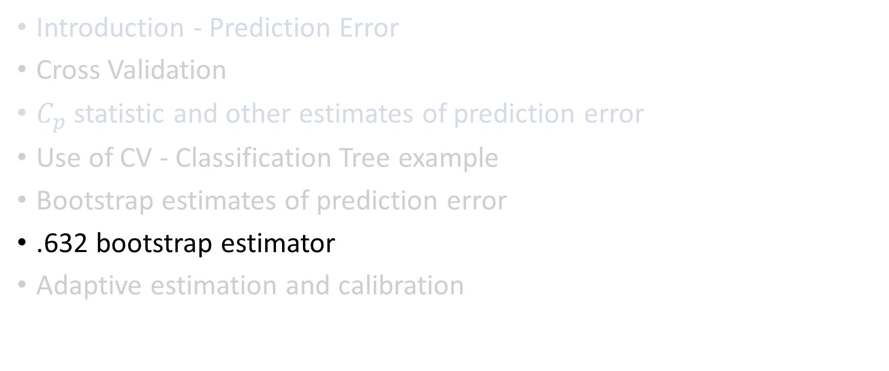
Agenda
Introduction - Prediction Error
Cross Validation
$C_{p}$ statistic and other estimates of prediction error
Use of CV - Classification Tree example
Bootstrap estimates of prediction error
.632 bootstrap estimator
Adaptive estimation and calibration

Slide 22
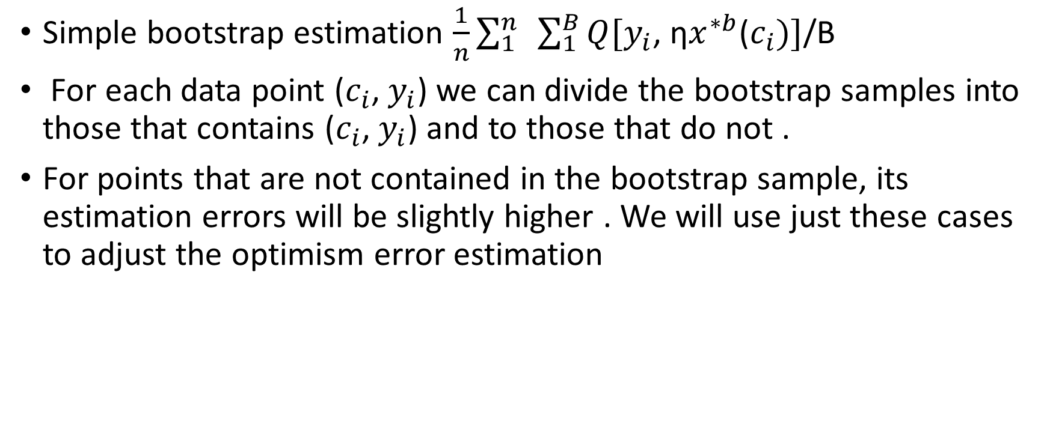
0.632 bootstrap estimator
Simple bootstrap estimation $\frac{1}{n}\sum_{1}^{n}{ }\sum_{1}^{B}{Q[y_{i}}$, η$x^{∗b}$($c_{i})]$/B
For each data point ($c_{i}$, $y_{i}$) we can divide the bootstrap samples into those that contains ($c_{i}$, $y_{i}$) and to those that do not .
For points that are not contained in the bootstrap sample, its estimation errors will be slightly higher . We will use just these cases to adjust the optimism error estimation

Slide 23
Example – n= 27, B=10
1 | 2 | 3 | 4 | 5 | 6 | 7 | 8 | 9 | 10 | 11 | 12 | 13 | 14 | 15 | 16 | 17 | 18 | 19 | 20 | 21 | 22 | 23 | 24 | 25 | 26 | 27
1 | 5 | 23 | 11 | 11 | 24 | 15 | 10 | 27 | 26 | 4 | 2 | 5 | 24 | 1 | 27 | 8 | 17 | 9 | 4 | 14 | 14 | 13 | 22 | 8 | 2 | 3
16 | 5 | 16 | 24 | 11 | 14 | 17 | 26 | 11 | 27 | 20 | 10 | 26 | 26 | 22 | 22 | 21 | 21 | 26 | 16 | 14 | 20 | 14 | 23 | 13 | 13 | 16
25 | 4 | 12 | 16 | 14 | 27 | 24 | 7 | 23 | 18 | 14 | 13 | 2 | 27 | 14 | 8 | 3 | 6 | 17 | 27 | 11 | 25 | 8 | 25 | 19 | 26 | 25
1 | 7 | 12 | 16 | 14 | 27 | 24 | 7 | 23 | 18 | 14 | 13 | 2 | 27 | 14 | 8 | 3 | 6 | 17 | 27 | 11 | 25 | 8 | 25 | 19 | 26 | 25
23 | 17 | 15 | 9 | 6 | 22 | 9 | 22 | 3 | 8 | 7 | 26 | 2 | 17 | 17 | 22 | 27 | 22 | 8 | 15 | 24 | 16 | 3 | 19 | 27 | 23 | 2
6 | 26 | 10 | 9 | 27 | 10 | 23 | 7 | 3 | 7 | 9 | 4 | 18 | 11 | 19 | 20 | 21 | 17 | 3 | 11 | 2 | 12 | 8 | 22 | 8 | 1 | 14
5 | 9 | 3 | 3 | 26 | 4 | 25 | 21 | 20 | 15 | 14 | 5 | 7 | 25 | 20 | 16 | 17 | 23 | 12 | 8 | 26 | 19 | 15 | 3 | 9 | 15 | 23
0
1
2
3
4
.
8
9
10
Arrow pointed bootstrap entry is missing Observation #5 - $C_{5}$ = {3,4,8,9}

Slide 24
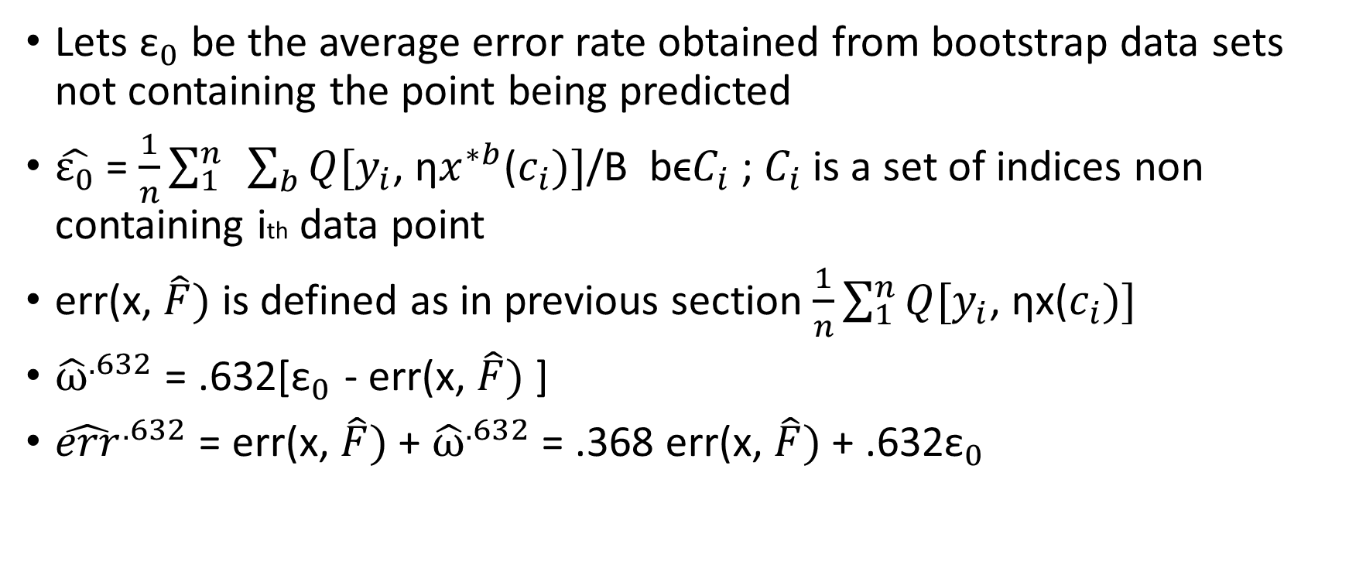
0.632 bootstrap estimator
Lets ${\text{ε}}_{0}$ be the average error rate obtained from bootstrap data sets not containing the point being predicted
$\hat{ε_{0}}$ = $\frac{1}{n}\sum_{1}^{n}{ }\sum_{b}{Q[y_{i}}$, η$x^{∗b}$($c_{i})]$/B bϵ$C_{i}$ ; $C_{i}$ is a set of indices non containing ith data point
err(x, $\hat{F})$ is defined as in previous section $\frac{1}{n}\sum_{1}^{n}{Q[y_{i}}$, ηx($c_{i})]$
${\hat{ω}}^{.632}$ = .632[${\text{ε}}_{0}$ - err(x, $\hat{F})$ ]
${\hat{err}}^{.632}$ = err(x, $\hat{F})$ + ${\hat{ω}}^{.632}$ = .368 err(x, $\hat{F})$ + .632${\text{ε}}_{0}$

Slide 25
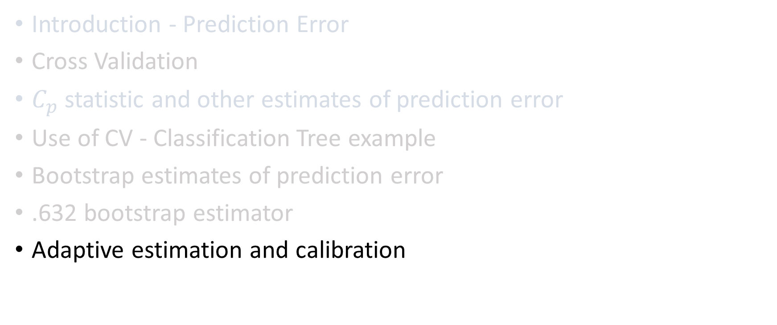
Agenda
Introduction - Prediction Error
Cross Validation
$C_{p}$ statistic and other estimates of prediction error
Use of CV - Classification Tree example
Bootstrap estimates of prediction error
.632 bootstrap estimator
Adaptive estimation and calibration

Slide 26

Introduction – adaptive estimation and calibration
Assume $\hat{θ_{λ}}$(x) depending on adjustable parameter λ. We need to choose the best λ in order to apply the estimator to data.
In this chapter we will use bootstrap to asses $\hat{θ_{λ}}$(x) for each fixed λ
Then we will choose $\hat{λ}$ that optimizes the performance of $\hat{θ_{λ}}$(x) .

Slide 27
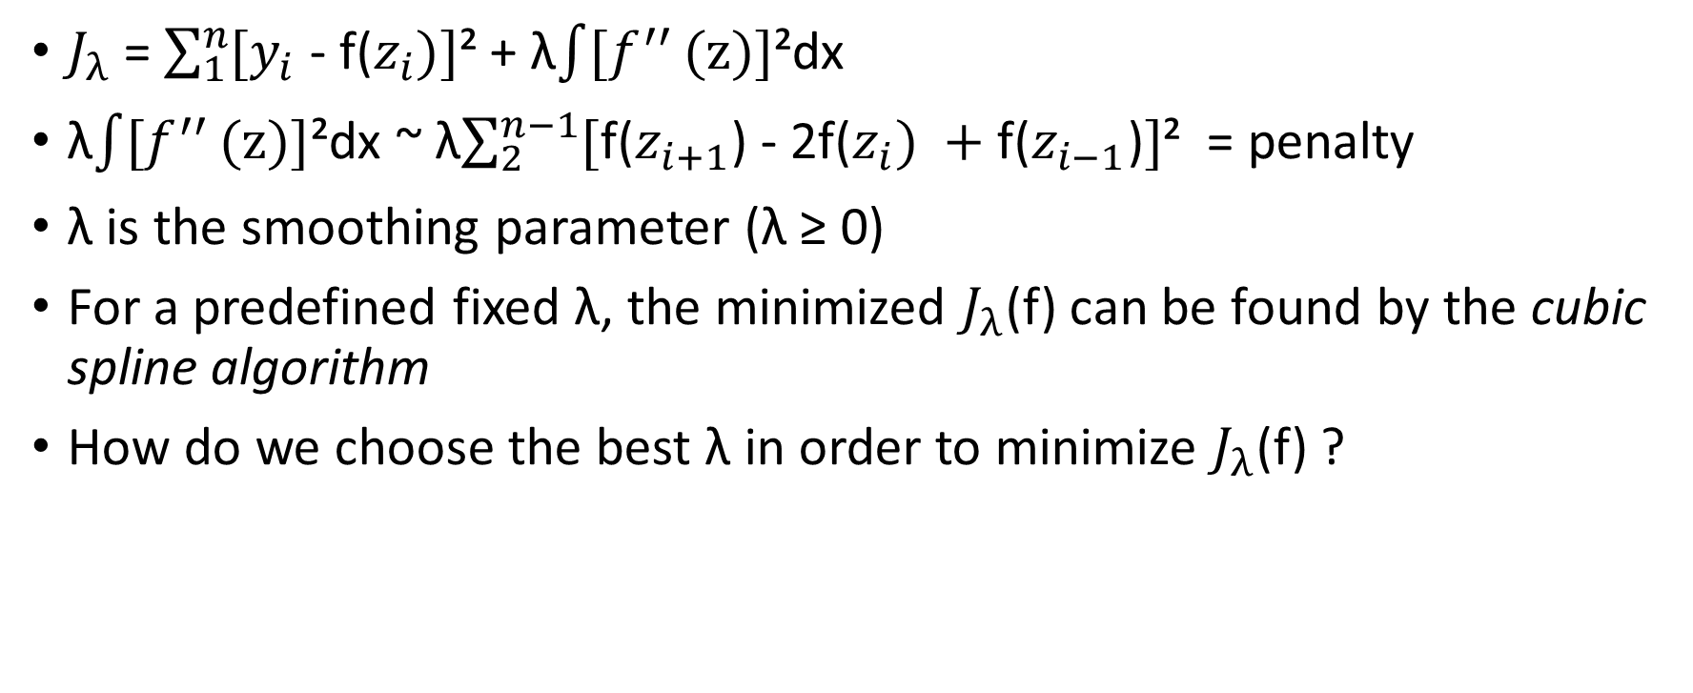
Example Smoothing Parameter for Curve Fitting
$J_{λ}$= $\sum_{1}^{n}{[y_{i}}$ - f($z_{i})]$² + λ$\int{[f^{′′}}(z)]$²dx
λ$\int{[f^{′′}}(z)]$²dx ~ λ$\sum_{2}^{n−1}{[}$f($z_{i+1}$) - 2f($z_{i}) +\text{f}\text{(}z_{i−1}\text{)}]$² = penalty
λ is the smoothing parameter (λ ≥ 0)
For a predefined fixed λ, the minimized $J_{λ}$(f) can be found by the cubic spline algorithm
How do we choose the best λ in order to minimize $J_{λ}$(f) ?

Slide 28
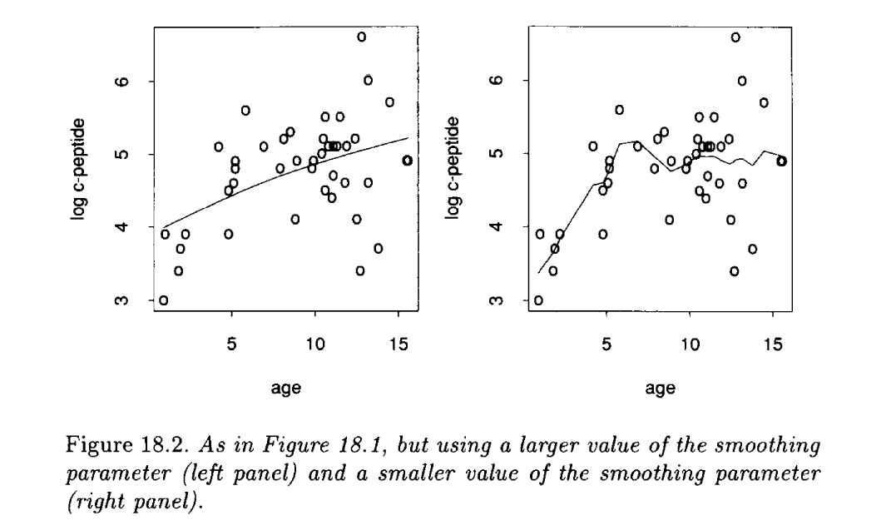
Smoothing Parameter Selection

Slide 29
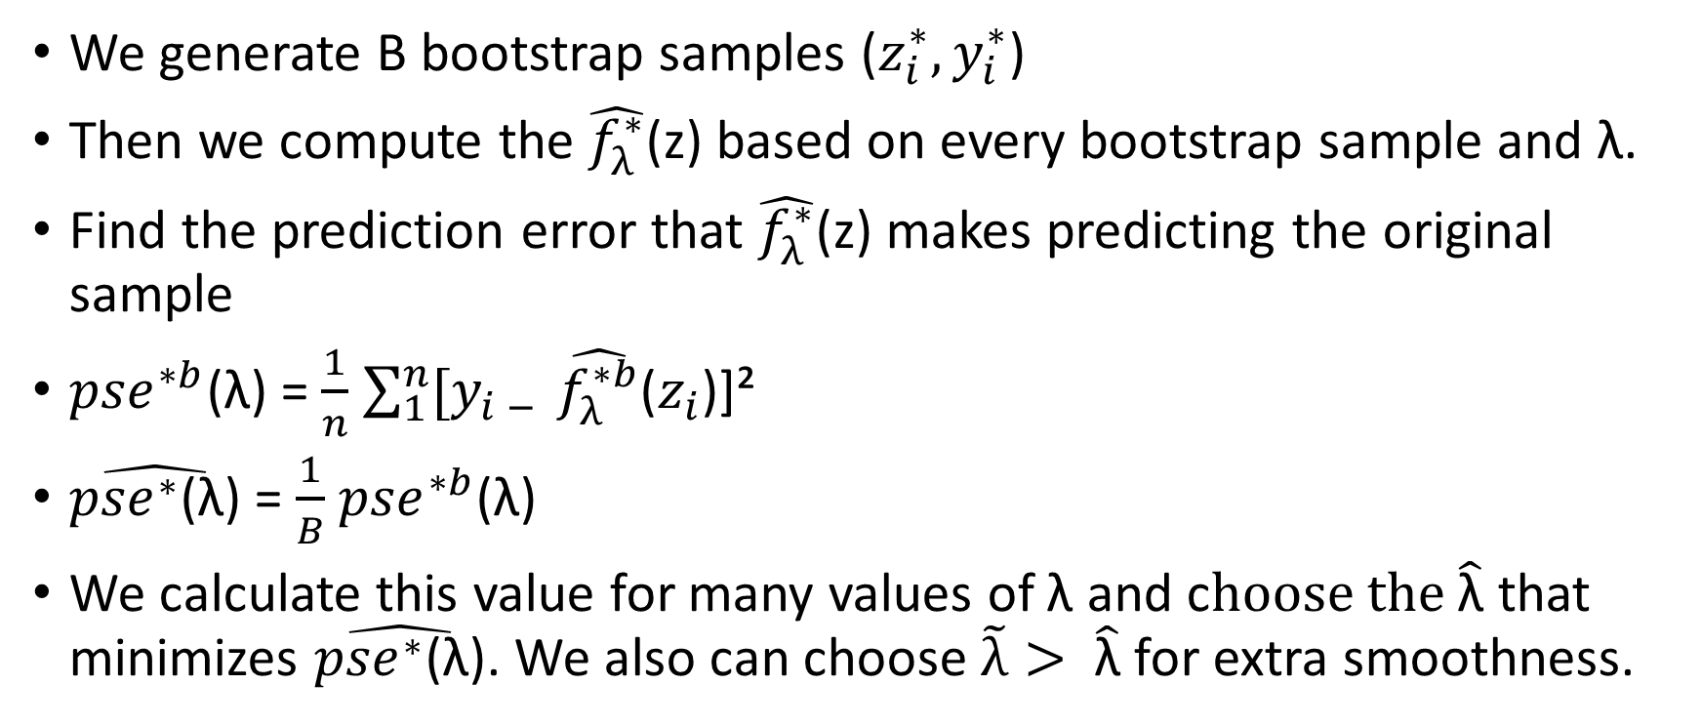
Choosing λ
We generate B bootstrap samples ($z_{i}^{∗}, y_{i}^{∗}$)
Then we compute the $\hat{f_{λ}^{∗}}$(z) based on every bootstrap sample and λ.
Find the prediction error that $\hat{f_{λ}^{∗}}$(z) makes predicting the original sample
${pse}^{∗b}$(λ) = $\frac{1}{n}$ $\sum_{1}^{n}{[y_{i − }}\hat{f_{λ}^{∗b}}$($z_{i}$)]²
$\hat{{pse}^{∗}\text{(}\text{λ}\text{)}}$ = $\frac{1}{B}$ ${pse}^{∗b}$(λ)
We calculate this value for many values of λ and c$hoose the \hat{\text{λ}}$ that minimizes $\hat{{pse}^{∗}\text{(}\text{λ}\text{)}}$. We also can choose $\tilde{λ}> \hat{\text{λ}}$ for extra smoothness.

Slide 30
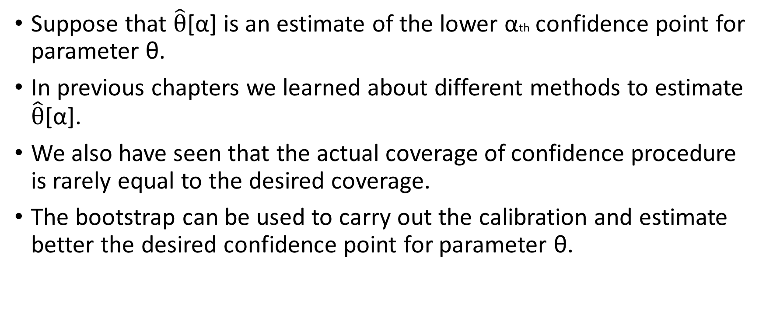
Another Example – Calibration of confidence point
Suppose that $\hat{θ}$[α] is an estimate of the lower αth confidence point for parameter θ.
In previous chapters we learned about different methods to estimate $\hat{θ}$[α].
We also have seen that the actual coverage of confidence procedure is rarely equal to the desired coverage.
The bootstrap can be used to carry out the calibration and estimate better the desired confidence point for parameter θ.

Slide 31
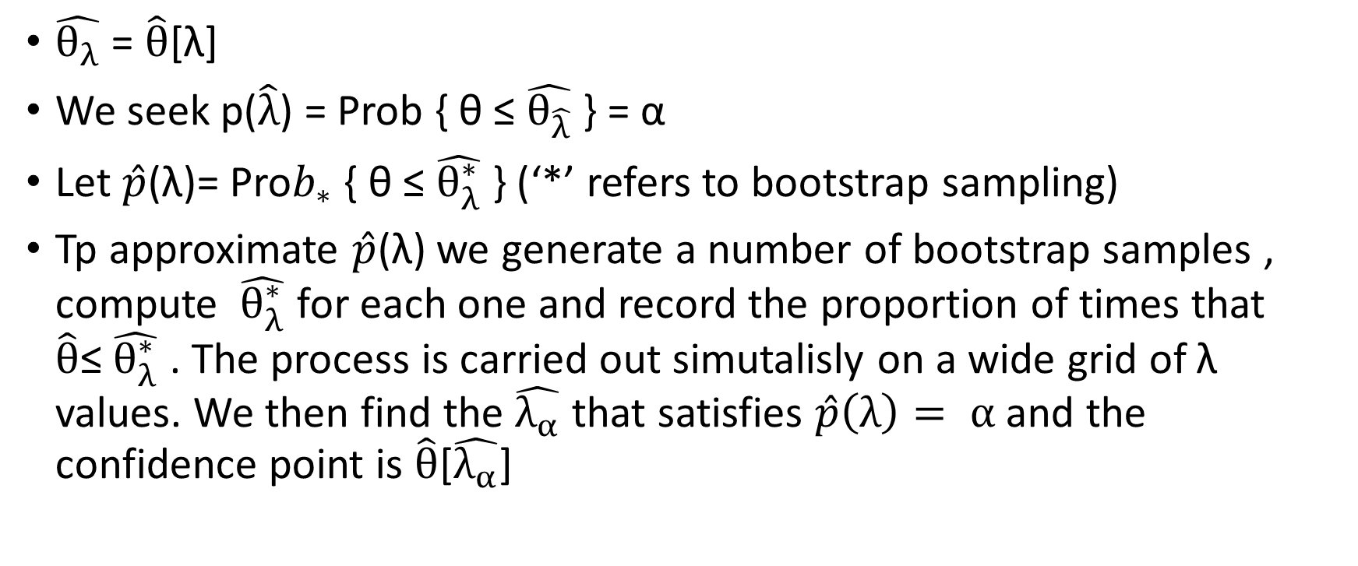
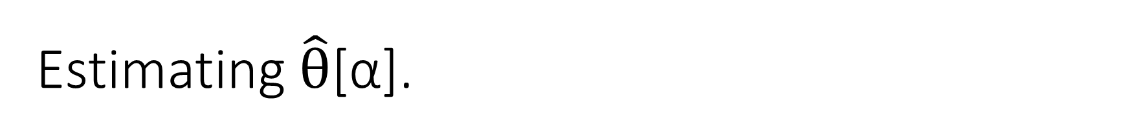
Estimating $\hat{θ}$[α].
$\hat{θ_{λ}}$ = $\hat{θ}$[λ]
We seek p($\hat{λ}$) = Prob { θ ≤ $\hat{θ_{\hat{λ}}}$ } = α
Let $\hat{p}$(λ)= Pro$b_{∗}$ { θ ≤ $\hat{θ_{λ}^{∗}}$ } (‘*’ refers to bootstrap sampling)
Tp approximate $\hat{p}$(λ) we generate a number of bootstrap samples , compute $\hat{θ_{λ}^{∗}}$ for each one and record the proportion of times that $\hat{θ}$≤ $\hat{θ_{λ}^{∗}}$ . The process is carried out simutalisly on a wide grid of λ values. We then find the $\hat{λ_{α}}$ that satisfies $\hat{p}\left(λ\right)= α$ and the confidence point is $\hat{θ}$[$\hat{λ_{α}}$]

Slide 32
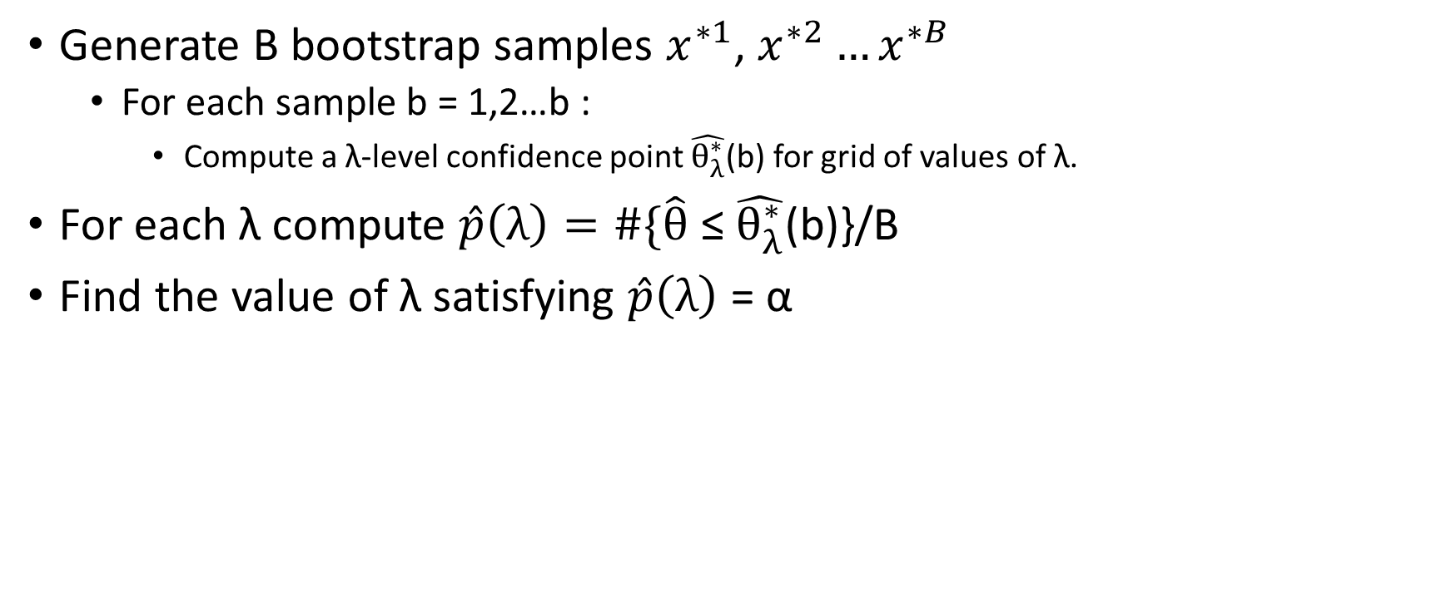
Confidence point calibration algorithm via bootstrap
Generate B bootstrap samples $x^{∗1}$, $x^{∗2}…x^{∗B}$
  For each sample b = 1,2…b :
    Compute a λ-level confidence point $\hat{θ_{λ}^{∗}}$(b) for grid of values of λ.
For each λ compute $\hat{p}\left(λ\right)=\#\{\hat{θ}$ ≤ $\hat{θ_{λ}^{∗}}$(b)}/B
Find the value of λ satisfying $\hat{p}\left(λ\right)$ = α

Slide 33
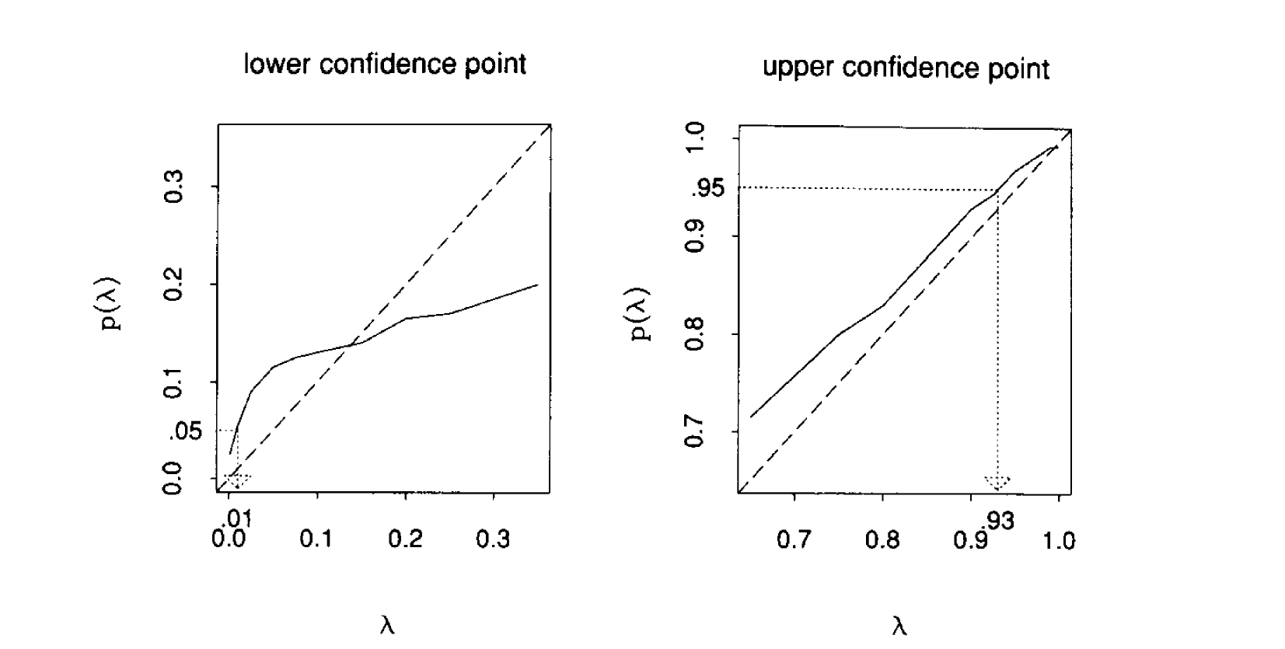
Confidence point example

Slide 34
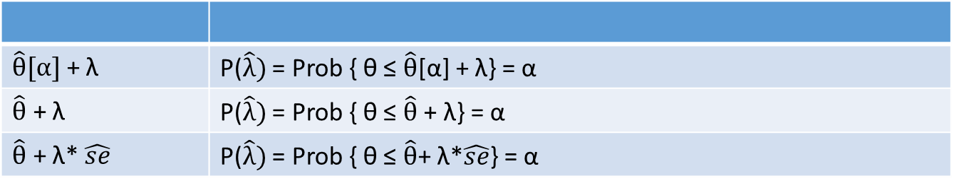

General considerations
Rather than defining $\hat{θ_{λ}}$ we could use
$\hat{θ}[α]$ + λ | P($\hat{λ})$ = Prob { θ ≤ $\hat{θ}$[α] + λ} = α
$\hat{θ}$ + λ | P($\hat{λ})$ = Prob { θ ≤ $\hat{θ}$ + λ} = α
$\hat{θ}$ + λ* $\hat{se}$ | P($\hat{λ})$ = Prob { θ ≤ $\hat{θ}$+ λ*$\hat{se}$} = α

Slide 35
Thank you!

