Slide 1
Estimates of Bias & The Jackknife
”An Introduction to the Bootstrap”, Bradley Efron & Robert J. Tibshirani,
Chapters 10-11
M.Sc. Seminar in Statistics, TAU, March ‘17
By Aviv Navon

Slide 2
Estimates of Bias
Chapter 10

Slide 3
Intro
Up until now, we concentrated on standard error as a measure of accuracy of an estimator $\hat{θ}$ (denoted by ${\hat{se}}_{B}$).
We will now focus on the bias of the estimator which defines as
$$bias_{F}\left(\hat{θ},θ\right)=𝔼_{F}[\hat{θ}]−t(F)$$

Slide 4
The Bootstrap Estimate of Bias
Consider the nonparametric one-sample situation, where $\hat{θ}=s\left(X\right)$.
We have,
$$bias_{F}\left(\hat{θ},θ\right)=𝔼_{F}\left[s\left(X\right)\right]−t(F)$$
We define the bootstrap estimate of bias as,
$bias_{\hat{F}}=𝔼_{\hat{F}}\left[s\left(X^{∗}\right)\right]−t\left(\hat{F}\right)$
Note that $bias_{\hat{F} }$ is the plug-in estimate of $bias_{F}$.
In general we will need to approximate $bias_{\hat{F}}$ using simulation:
Generate $B$ bootstrap samples $X^{∗1},…,X^{∗B}$
Approximate $𝔼_{\hat{F}}\left[s\left(X^{∗}\right)\right]$ by ${\hat{θ}}^{∗}\left(⋅\right)=\sum_{b=1}^{B}{{\hat{θ}}^{∗}\left(b\right)/B}=\sum_{b=1}^{B}{s\left(X^{∗b}\right)/B}$
Estimate bias by,
${\hat{bias}}_{B}={\hat{θ}}^{∗}\left(⋅\right)−t\left(\hat{F}\right)$

Slide 5
Example – The Patch Data
Eight subjects wore medical patches designed to infuse a certain hormone into the blood stream.
Each subject had his blood level of the hormone measured after wearing 3 different patches - old, new and placebo.
We are interesting in the parameter,
$$θ=\frac{𝔼\left(new\right)−𝔼\left(old\right)}{𝔼\left(old\right)−𝔼\left(placebo\right)}$$
Denote $z=old−placebo, y=new−old$, and $x_{i}=\left(z_{i},y_{i}\right)$, where $x_{i}$ obtained by random sampling an unknown distribution $F$.
We have,
$θ=t\left(F\right)=\frac{𝔼_{F}\left(y\right)}{𝔼_{F}\left(z\right)}$

Slide 6
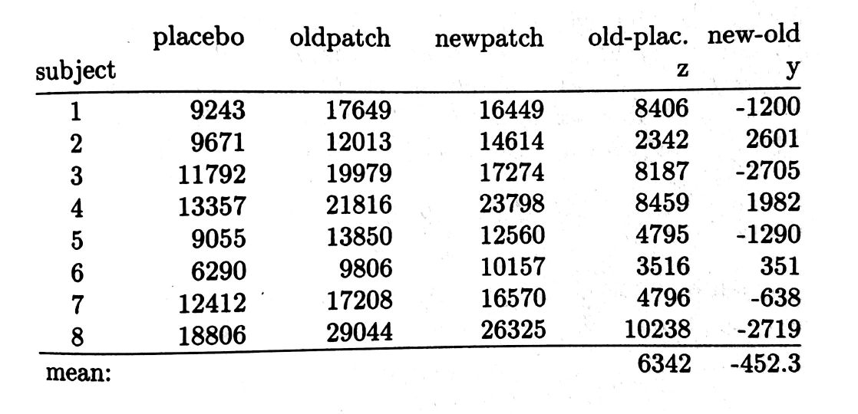
The Patch Data – Cont.
The plug-in estimate of $θ$ is
$$\hat{θ}=t\left(\hat{F}\right)=\frac{\overline{y}}{\overline{z}}$$
We take $s\left(X\right)=\hat{θ}=\frac{\overline{y}}{\overline{z}}$,
thus$\hat{θ}=−\frac{452.3}{6342}=−.0713$
Next we generate $B=400$ bootstrap samples, and get ${\hat{θ}}^{∗}\left(⋅\right)=−.0670$ which yields,
$${\hat{bias}}_{400}={\hat{θ}}^{∗}\left(⋅\right)−t\left(\hat{F}\right)=−.0670−\left(−.0713\right)=.0043$$

Slide 7
The Patch Data – Cont.
We know that $B=400$ is usually more than enough to obtain a good estimate of standard error. Is it enough to to obtain a good estimate of bias?
As it turns out, in this particular case, the answer is no.
* In general, biases are harder to estimate than standard errors.

Slide 8
An Improved Estimate of Bias
It turns out that there is a better method to approximate ${\hat{bias}}_{∞}=bias_{\hat{F}}$.
The better method applies when $\hat{θ}=t\left(\hat{F}\right)$ is the plug-in estimate of $t\left(F\right)$.
Notation
For a given bootstrap sample $X^{∗}=\left(x_{1}^{∗},…,x_{n}^{∗}\right)$, we define the resampling vector as $P^{∗}=\left(p_{1}^{∗},…,p_{n}^{∗}\right)$, where $p_{j}^{∗}=\frac{\left|\left\{i | x_{i}^{∗}=x_{j}\right\}\right|}{n}$. Denote $P^{0}=\left(\frac{1}{n},…,\frac{1}{n}\right)$.
For $\hat{θ}=t\left(\hat{F}\right)$, denote ${\hat{θ}}^{∗}=T\left(P^{∗}\right)$ (Note that $T\left(P^{0}\right)=\hat{θ}=t\left(\hat{F}\right)$).
The bootstrap samples $X^{∗1},…,X^{∗B}$ are corresponding with resampling vectors $P^{∗1},…,P^{∗B}$. Define ${\overline{P}}^{∗}$ to be the average of these vectors.

Slide 9
An Improved Estimate of Bias – Cont.
We can write the bootstrap bias estimate as,
$${\hat{bias}}_{B}={\hat{θ}}^{∗}\left(⋅\right)−T\left(P^{0}\right)$$
The better bootstrap bias estimate, denoted by ${\overline{bias}}_{B}$, is
$${\overline{bias}}_{B}={\hat{θ}}^{∗}\left(⋅\right)−T\left({\overline{P}}^{∗}\right)$$
Both ${\hat{bias}}_{B}$ and ${\overline{bias}}_{B}$ converge to ${\hat{bias}}_{∞}=bias_{\hat{F}}$, the ideal bootstrap estimate of bias, as $B→∞$, but the convergence is much faster for ${\overline{bias}}_{B}$.

Slide 10
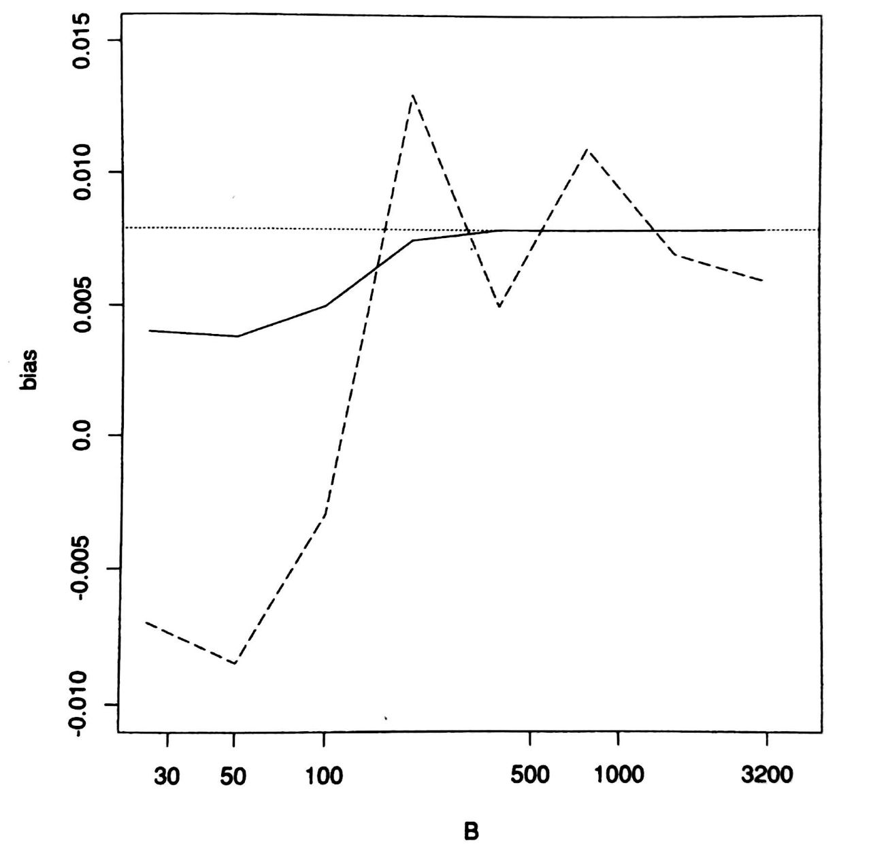
Back to the Patch Data Example
Note that for the patch example, ${\hat{θ}}^{∗}=T\left(P^{∗}\right)=\frac{∑p_{j}^{∗}y_{j}}{∑p_{j}^{∗}z_{j}}$
Using the 400 bootstrap samples from before, we have $T\left({\overline{P}}^{∗}\right)=\frac{∑{\overline{p}}_{j}^{∗}y_{j}}{∑{\overline{p}}_{j}^{∗}z_{j}}=−.0750$, and ${\overline{bias}}_{400}=−.0670−\left(−.0750\right)=.0080$, compared to ${\hat{bias}}_{400}=.0043$.
${\hat{bias}}_{∞}$ is approximated by ${\hat{bias}}_{100000}=.0079$, dashed horizontal line.
${\overline{bias}}_{B}$ - solid line, ${\hat{bias}}_{B}$ - dashed line.

Slide 11
Bias Correction
If $\hat{bias}$ is an estimate of $bias_{F}\left(\hat{θ},θ\right)$, then the obvious bias-corrected estimator is
$$\overline{θ}=\hat{θ}−\hat{bias}$$
Taking $\hat{bias}$ equal to ${\hat{bias}}_{B}={\hat{θ}}^{∗}\left(⋅\right)−\hat{θ}$ gives
$$\overline{θ}=2\hat{θ}−{\hat{θ}}^{∗}\left(⋅\right)$$
The bias correction can be dangerous to use in practice, due to high variability in $\hat{bias}$. Correcting the bias may cause a larger increase in standard error (hence, a larger MSE).

Slide 12
Framework
Real World
$$P→X=(x_{1},…,x_{n})$$
Bootstrap World
$$\hat{P}→X^{∗}=(x_{1}^{∗},…,x_{n}^{∗})$$
$$θ=θ\left(P\right)$$
$$\hat{θ}=s(X)$$
$$\hat{θ}=θ\left(\hat{P}\right)$$
$${\hat{θ}}^{∗}=s(X^{∗})$$
$$bias_{P}\left(\hat{θ},θ\right)$$
$$bias_{\hat{P}}\left({\hat{θ}}^{∗},\hat{θ}\right)$$

Slide 13
The Jackknife
Chapter 11

Slide 14
Intro
The jackknife predates the bootstrap and bears close similarities to it.
We will present the jackknife method for estimating bias and standard error.
Notation
Let $x_{\left(i\right)}=\left(x_{1},x_{2},…, x_{i−1},x_{i+1},…,x_{n}\right)$, for $i=1,…,n$ - the $i$th jackknife samples.
Let ${\hat{θ}}_{\left(i\right)}=s\left(x_{\left(i\right)}\right)$ be the $i$th jackknife replication of $\hat{θ}$.
Denote ${\hat{θ}}_{\left(⋅\right)}=\sum_{i=1}^{n}{{\hat{θ}}_{\left(i\right)}/n}$.

Slide 15
Jackknife Estimates for Bias and SE
The jackknife estimate of bias is defined by
$${\hat{bias}}_{jack}=\left(n−1\right)\left({\hat{θ}}_{\left(⋅\right)}−\hat{θ}\right)$$
The jackknife estimate of standard error defined by
$${\hat{se}}_{jack}={\left[\frac{n−1}{n}\sum_{i}{{\left({\hat{θ}}_{\left(i\right)}−{\hat{θ}}_{\left(⋅\right)}\right)}^{2}}\right]}^{1/2}$$
Where do these formulae come from?

Slide 16
Back to the Patch Data
Let us estimate bias and SE for the patch data, and the parameter $θ=\frac{𝔼y}{𝔼z}$. Recall that ${\hat{bias}}_{400}=.0043$, and ${\overline{bias}}_{400}=.0080$. In addition, ${\hat{se}}_{200}=.105$.
Using the jackknife method, we get
$${\hat{bias}}_{jack}=.0080, {\hat{se}}_{jack}=.106$$

Slide 17
Jackknife vs. Bootstrap
The jackknife can be viewed as an approximation to the bootstrap:
Consider a linear statistic of the form $\hat{θ}=s\left(X\right)=μ+\frac{1}{n}\sum_{i}{α\left(x_{i}\right)}$, where $β$ is a constant and $α\left(⋅\right)$ is a function (example $\overline{X}$: $μ=0,α\left(x_{i}\right)=x_{i}$).
For such a statistic, the jackknife and bootstrap estimate of SE agrees, up to a factor of ${\left\{{\left(n−1\right)}/n\right\}}^{1/2}$.
For non-linear statistics, the jackknife makes a linear approximation to the bootstrap: that is, it agrees with the bootstrap for a certain linear statistic that approximates $\hat{θ}$.
Similarly, the jackknife estimates of bias approximate the bootstrap in terms of quadratic statistics of the form $\hat{θ}=μ+\frac{1}{n}\sum_{i=1}^{n}{α\left(x_{i}\right)}+\frac{1}{n^{2}}\sum_{1≤i<j≤n}{β\left(x_{i},x_{j}\right)}$.
* More details in Chapter 20

Slide 18
Failure of the Jackknife
The jackknife can fail miserably if the statistic $\hat{θ}$ is not “smooth”.
A simple example is the median.
For example, consider observations $10, 27, 31, 40, 46, 50, 52, 104, 146$.We get, ${\hat{se}}_{jack}=6.68$.
Using 100 bootstrap samples, we get ${\hat{se}}_{100}=9.58$, considerably larger than the jackknife value.
Moreover, it can be shown that as $n→∞$, ${\hat{se}}_{jack}$ fail to converge to the true standard error (for $\hat{θ}=median\left(X\right)$).

Slide 19
The Delete-$d$ Jackknife
Instead of leaving out one observation at a time, we leave out $d$ observations, where $n=r⋅d$ for some integer $r$. Therefore, there are $\left({n \atop d}\right)$ jackknife samples (can get very large).
The delete-$d$ jackknife estimate of SE is given by: ${\left\{\frac{r}{\left({n \atop d}\right)}∑{\left({\hat{θ}}_{\left(s\right)}−{\hat{θ}}_{\left(⋅\right)}\right)}^{2}\right\}}^{1/2}$, Where ${\hat{θ}}_{\left(s\right)}$ denote $\hat{θ}$ applied to the data set with subset $s$ removed,
${\hat{θ}}_{\left(⋅\right)}=\frac{∑{\hat{θ}}_{\left(s\right)}}{\left({n \atop d}\right)}$, and the sum is over all subsets $s$ of size $n−d$.
It can be shown that if $d$ is appropriately chosen, then the delete-$d$ jackknife estimate of standard error of the median is consistent.

