Slide 1
Nir Keret
Based on “An Introduction to the Bootstrap” (Efron and Tibshirani)

Slide 2
The Percentile Interval

Slide 3
The Percentile Interval

Slide 4
The Percentile Interval

Slide 5
The Percentile Interval
Looks good… where does it go wrong?
Perhaps the assumption that such a transformation “m” exists is too strong an assumption?
We require that “m” is both normalizing and variance-stabilizing. Such a transformation need not necessarily exist.
In addition, we would like to correct for potential bias in the plug-in estimate. The percentile method does not deal with that.

Slide 6
The BCa Interval
The name BCa stands for “Bias-Correction and Acceleration”. It relaxes the assumption that the transformation “m” is variance-stabilizing, and in addition it corrects for potential bias in the estimate.
A motivational example:

Slide 7
The BCa Interval

Slide 8
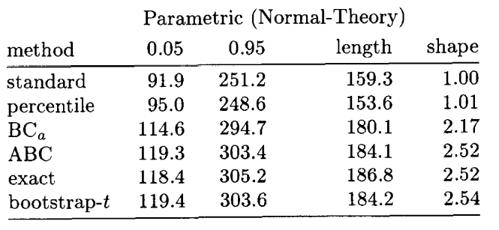
The BCa Interval
How do BCa and ABC perform compared with the percentile?

Slide 9
The BCa Interval
The exact CI:
is taking into account the fact that the mean had to be estimated, hence uses n-1 degrees of freedom for the chi-squared distribution.
In contrast, the sample variance, which we used as the plug-in estimate in the bootstrap CIs is biased. How come the BCa and ABC do not seem biased but the percentile is?
In addition, note that the shape of the percentile CI is nowhere near the exact. The right part of the CI should be about 2.5 times longer than the left part.

Slide 10
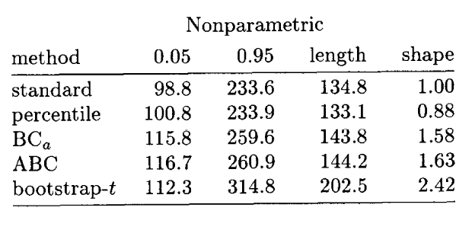
The BCa Interval
There is no golden standard for the non-parametric case, but we can see that there are big differences.

Slide 11
The BCa Interval
The BCa endpoints are also based on the bootstrap distribution percentiles, but not necessarily the same ones as the regular percentile interval.
The BCa percentiles depend on two numbers:
responsible for correcting non-stable variance (“acceleration”) and bias.

Slide 12
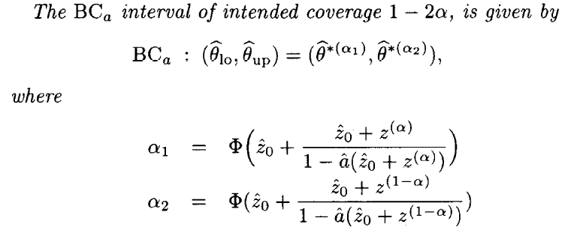
The BCa Interval

Slide 13
The BCa Interval
Where does this formula come from?

Slide 14
The BCa Interval

Slide 15
The BCa Interval

Slide 16
The BCa Interval

Slide 17
The BCa Interval - Bias Correction

Slide 18
The BCa Interval - Bias Correction

Slide 19
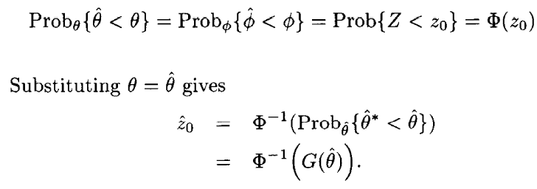
The BCa Interval - Bias Correction
Rationale for that formula:

Slide 20
The BCa Interval - Acceleration
One-Parameter Parametric Bootstrap

Slide 21
The BCa Interval - Acceleration
Parametric bootstrap with nuisance parameters
In most cases we will have more than one unknown parameter, and the former formula will not apply.
The solution is to reduce the problem to a one-parameter parametric family, and apply the formula on it.
How do we do that?

Slide 22
The BCa Interval - Acceleration
Least Favorable Family

Slide 23
The BCa Interval - Acceleration

Slide 24
The BCa Interval - Acceleration

Slide 25
The BCa Interval - Acceleration
Nonparametric Bootstrap

Slide 26
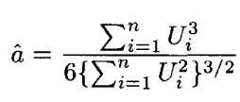
The BCa Interval - Acceleration

Slide 27
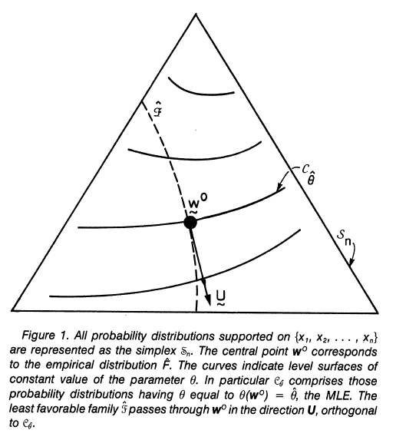
Geometrical interpretation

Slide 28
The BCa Interval - Influence Function
Gâteaux Derivative
The Gâteaux derivative of T at F in the direction G is defined by
Mathematically speaking, the Gâteaux derivative is a generalization of the concept of directional derivative.
Statistically speaking, it measures the rate of change in a statistical functional upon a small amount of contamination by another distribution G.

Slide 29
The BCa Interval - Influence Function
The Influence Function

Slide 30
The BCa Interval - Influence Function
Example: the mean

Slide 31
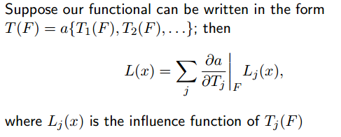
The BCa Interval - Influence Function
Example: the variance
We can take advantage of the chain rule:

Slide 32
The BCa Interval - Influence Function
Example: the variance:

Slide 33
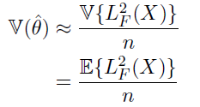
The BCa Interval - Influence Function
The influence components behave a lot like the score values:
For a parametric model:

Slide 34
The BCa Interval - Influence Function
In practice, in order to make the method general and not functional-specific, we can take the corresponding jackknife value as an
approximation for the influence component.
The jackknife practically replaces epsilon with
The jackknife approximation yields:

Slide 35
ABC Intervals
Stands for “Approximate Bootstrap CIs”
It tries to mimic the BCa intervals in an analytic fashion - without actually performing resampling at all. It requires second derivatives, hence works for smoothly defined parameters in exponential families or smoothly defined nonparametric problems.

Slide 36
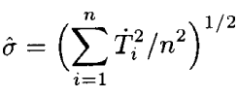
ABC Intervals

Slide 37
ABC Intervals

Slide 38
ABC Intervals

Slide 39
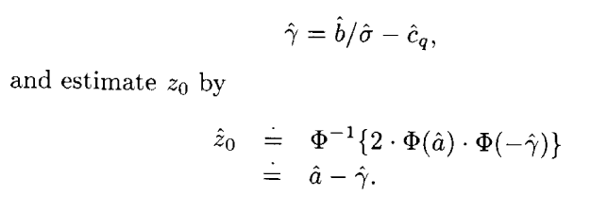
ABC Intervals

Slide 40
Convergence Order

Slide 41
Convergence Order
Correctness at a given level
Accuracy at the same level

Slide 42
 | ABC | BCa | Percentile | Bootstrap t
Second-order correct
Transformation - respecting

Slide 43
Thanks!

