Slide 1
Markov Chain Monte Carlo (MCMC) – How to Sample if You Must
Saharon Rosset
Tel Aviv University
UCLA CGSI, 15 July 2019

Slide 2
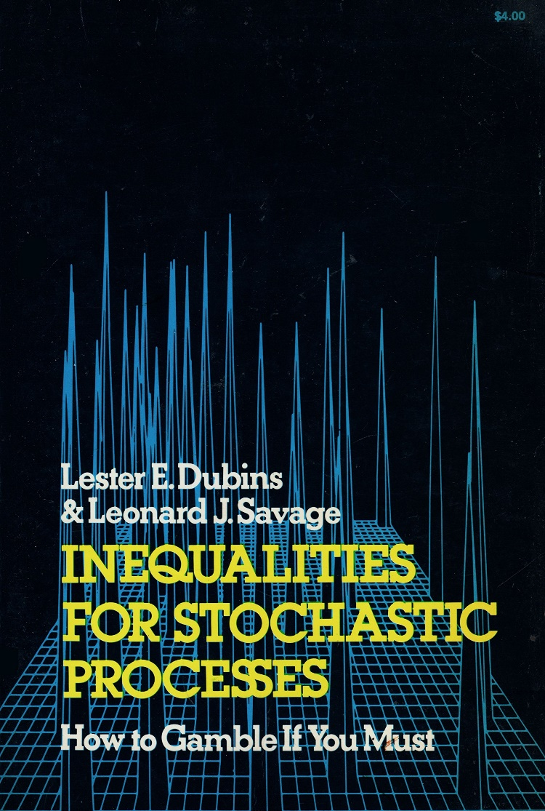
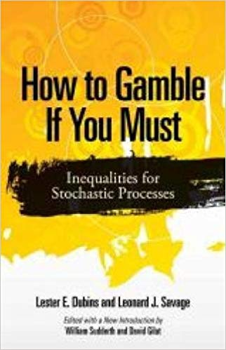
Aside: from first edition (left) to updated version (right)

Slide 3
A basic problem in science
I have some very complicated distribution (probability or density) f
Given a sample x, I can calculate f(x)
  Usually not exactly, but up to a scalar, so actually given x,y, I can evaluate f(x)/f(y)
Now I want to do something with f:
  Calculate some expectation E(g(X)) when X ~ f
  Or simply find argmax_{x}f(x)
  Or just draw random samples from f and look at them

Slide 4
Motivating example: Bayesian calculations
Very common in biological and genetic domains
A complicated system, like the population history and interactions between modern humans and Neanderthals
I assume it can be described with a bunch of parameters θ: # populations, population sizes, migrations, genetic interactions,…
I assume a prior π(θ), and given observations X can hopefully calculate the likelihood Pr(X| θ)

Slide 5
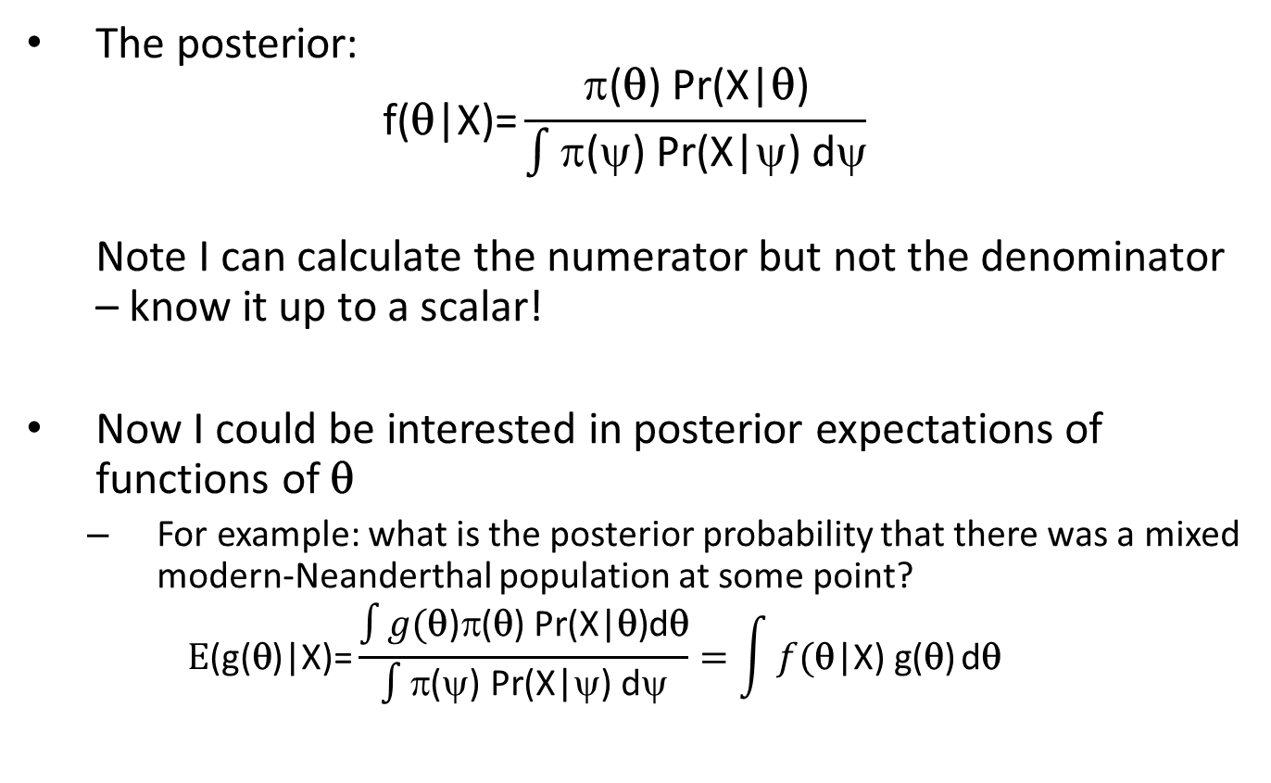
The Bayesian method
The posterior:
$\text{f}\text{(}\text{θ}\text{|}\text{X}\text{)=}\frac{\text{π(}\text{θ}\text{) }\text{Pr}\text{(}\text{X}\text{|}\text{θ}\text{)}}{\int{\text{π(}ψ\text{) }\text{Pr}\text{(}\text{X}\text{|}ψ\text{) }\text{d}ψ}}$
Note I can calculate the numerator but not the denominator – know it up to a scalar!
Now I could be interested in posterior expectations of functions of $\text{}$
  For example: what is the posterior probability that there was a mixed modern-Neanderthal population at some point?
  $$\text{E}\text{(}\text{g}\text{(}\text{}\text{)}\text{|}\text{X}\text{)=}\frac{\int{g(\text{}\text{)}\text{π(}\text{}\text{) }\text{Pr}\text{(}\text{X}\text{|}\text{}\text{)}\text{d}\text{}}}{\int{\text{π(}ψ\text{) }\text{Pr}\text{(}\text{X}\text{|}ψ\text{) }\text{d}ψ}}=\int{f(\text{}\text{|}\text{X}\text{) }\text{g}\text{(}\text{}\text{)}}\text{d}\text{}$$

Slide 6
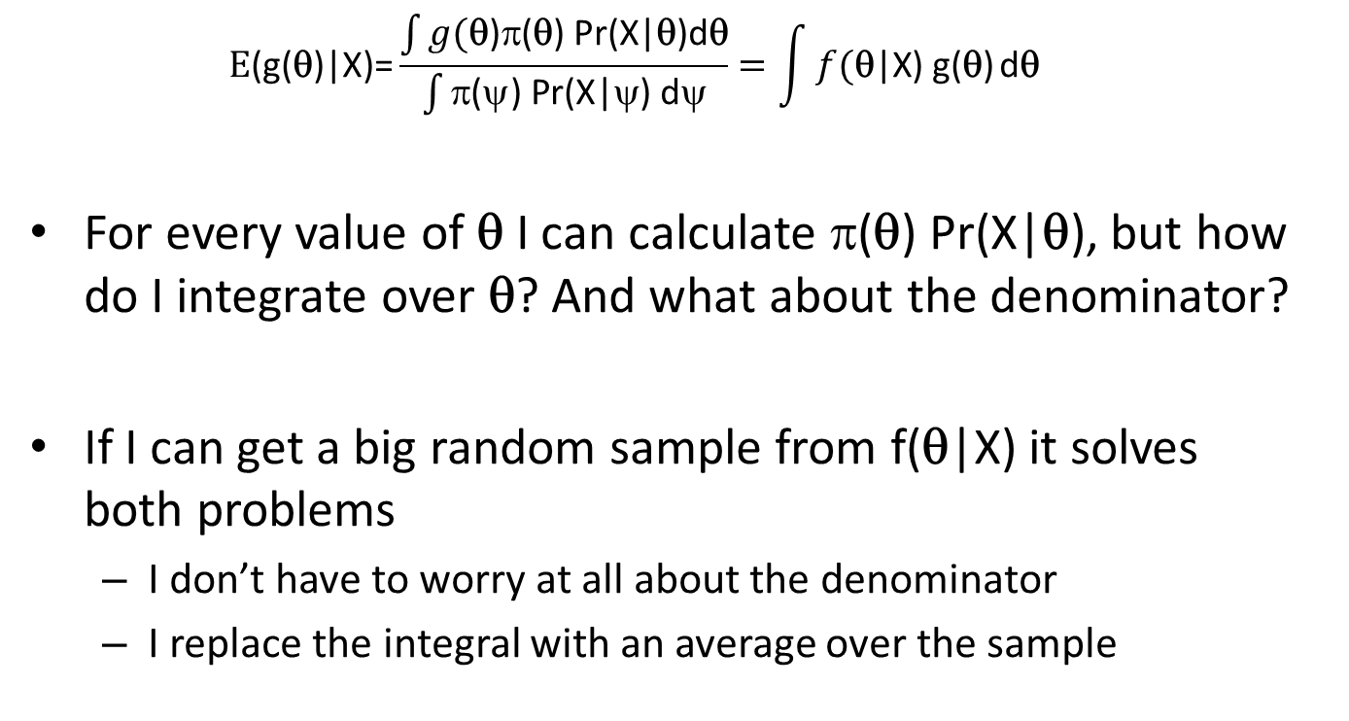
Sampling and Bayesian calculations
  $$\text{E}\text{(}\text{g}\text{(}\text{}\text{)|}\text{X}\text{)=}\frac{\int{g(\text{}\text{)π(}\text{}\text{) }\text{Pr}\text{(}\text{X}\text{|}\text{}\text{)}\text{d}\text{}}}{\int{\text{π(}ψ\text{) }\text{Pr}\text{(}\text{X}\text{|}ψ\text{) }\text{d}ψ}}=\int{f(\text{}\text{|}\text{X}\text{) }\text{g}\text{(}\text{}\text{)}}\text{d}\text{}$$
For every value of $\text{}$ I can calculate $\text{(}\text{θ}\text{) }\text{Pr}\text{(}\text{X}\text{|}\text{θ}\text{)}$, but how do I integrate over $\text{}$? And what about the denominator?
If I can get a big random sample from $\text{f}\text{(}\text{θ}\text{|}\text{X}\text{)}$ it solves both problems
  I don’t have to worry at all about the denominator
  I replace the integral with an average over the sample

Slide 7
Bayesian methods in genetics
Population genetics, like previous example, and many other problems
Statistical genetics: Bayesian LMM, phasing
Examples of well known tools: STRUCTURE, Mr Bayes, BEAST, BSLMM, MCMCcoal,…

Slide 8
OK, but what else
Bayesian methods are very important, but
  Kind of hard
  Need priors, and lead to arguments
Can we think of simpler, interesting and important problems where we can calculate f(x)/f(y) and want to sample from f or integrate over it?
We will consider two cute and simple non-genetic examples

Slide 9
Example 1 – Circles in a square
In a unit square, we drop n circles of a given radius ε
Circles cannot overlap, sometimes we assume they also “repel” each other
Is a typical solution “organized” or “messy”?
Obvious motivation: solid vs liquid
For simple no overlap:
c if no overlap in x
f(x) =
0 if there is overlap

Slide 10
Typical arrangements, n=15, ε=0.1
Only no overlap: liquid With repulsion: solid
Typical question: what % of “typical” arrangements are tidy?

Slide 11
What we know so far
If we can sample from f, we can do lots of things:
  Approximate integrals by averages
  See the typical behavior of samples from f(x)
But in these examples and many others, there is no way to sample directly from f
Importance sampling: replace f with a distribution g we know how to sample from
  Can be very useful if g “similar” to f
  We will not consider this option further here

Slide 12
Markov Chains
Reminder: Markov chain is a sequence of random variables X₁,X₂,… such that:
X_{i} is independent of X₁,X₂,…,X_{i-2} given X_{i-1}
Typically described through Pr(X_{i}|X_{i-1})
Stationary distribution of a homogeneous Markov chain: a distribution f such that if X_{i-1}~f then also X_{i}~f
Under mild conditions, if a Markov chain has stationary dist f, then regardless of starting point, X_{n}~f (approximately) for large n

Slide 13
The MCMC approach
We want to sample from f:
  Build a Markov Chain whose stationary distribution is f
  Run it for a large number of steps n, to get a sample from f
  Repeat to get more samples
So all we need is approach(es) to build such a chain!
  All the rest is (important) details

Slide 14
The Metropolis MCMC algorithm
First we choose some function h(u,v) which we call the proposal distribution:
h(u,v) = Pr(propose u at step t| X_{t-1}=v) = Pr(propose v at step t| X_{t-1}=u)
Only requirement: h(u,v) is “connected”, meaning we can arrive from any point in X space to the other by steps of h
Then, given X_{t-1}=v, our Markov chain rule is:
Apply h(⋅,v) to get a proposal u
Now either X_{t}=v or X_{t}=u, according to a simple transition rule

Slide 15
Metropolis transitions
(Apply h(⋅,v) to get a proposal u)
If f(u)/f(v) ≥ 1, then X_{t}=u (accept)
2. If p=f(u)/f(v) < 1, then we flip a Bernoulli(p) coin so:
a. X_{t}=u with probability p (accept)
b. Otherwise X_{t}=v (reject)
Claim: this simple recipe guarantees that the stationary distribution of this Markov chain is f

Slide 16
Beyond the Metropolis algorithm
Metropolis-Hastings: h(u,v) ≠ h(v,u), breaking the symmetry
  Makes sense if we have an idea what are “good” steps
  Almost the same algorithm works, except now we use (f(u)h(v,u)) / (f(v)h(u,v)) to decide whether to switch
  Still get f as the stationary distribution
Gibbs sampling: Assume given X_{t-1}~f, we know how to draw a sample X_{t}~f
  Stupid idea: X_{t}=X_{t-1}
  Less stupid: Assume that X=(x₁,x₂,..,x_{p}) is a vector, and that we cannot sample from f(X) but can sample from Pr(x_{i}|X_{-i}) the conditional distribution of the ith coordinate
  Then at each step of the MCMC we can choose a coordinate at random and draw from this conditional distribution
  The stationary distribution is f

Slide 17
Example: Gibbs sampling for circles in square
Without repulsion: If we fix the location of n-1 circles, we can draw the nth circle uniformly over all locations that don’t overlap with existing circle
With repulsion: It gets more complicated
Designing Metropolis or Metropolis-Hastings for this problem is much easier
But Gibbs sampling can give much faster convergence when applicable ⇒ faster sampling from f

Slide 18
Design issues
How to choose h
  Big steps: allow us to get out of “local maxima” in f
  High acceptance rate: allows us to explore the space and converge fast
  The two demands are often contradictory
How often to sample
  We typically want to treat samples we get as if they were i.i.d samples from f
  Sampling too often: the samples we take are highly dependent, inefficient and incorrect inference
  Sampling too rarely: would take a really long time
  More efficient: take all samples, and appropriately deal with the correlation
When to stop – when do we have enough samples?

Slide 19
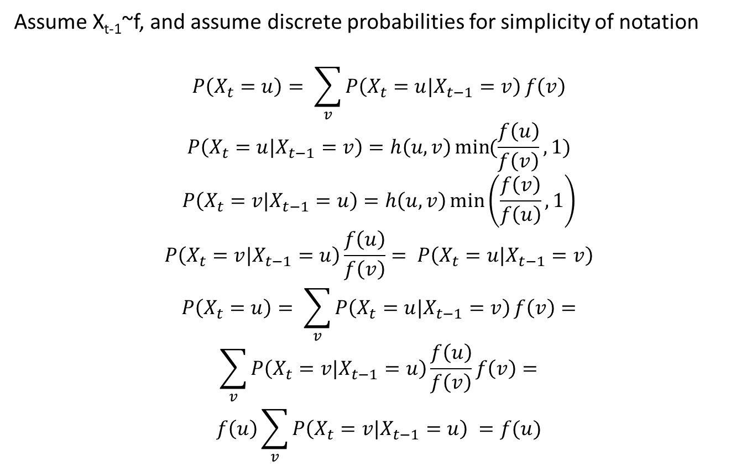
Proof for Metropolis
Assume X_{t-1}~f, and assume discrete probabilities for simplicity of notation
$$P\left(X_{t}=u\right)= \sum_{v}{P\left(X_{t}=u|X_{t−1}=v\right)}f\left(v\right)$$
$$P\left(X_{t}=u|X_{t−1}=v\right)=h\left(u,v\right)\min{(\frac{f\left(u\right)}{f\left(v\right)},1)}$$
$$P\left(X_{t}=v|X_{t−1}=u\right)=h\left(u,v\right)\min\left(\frac{f\left(v\right)}{f\left(u\right)},1\right)$$
$$P\left(X_{t}=v|X_{t−1}=u\right)\frac{f\left(u\right)}{f\left(v\right)}= P\left(X_{t}=u|X_{t−1}=v\right)$$
$$P\left(X_{t}=u\right)= \sum_{v}{P\left(X_{t}=u|X_{t−1}=v\right)}f\left(v\right)=$$
$$\sum_{v}{P\left(X_{t}=v|X_{t−1}=u\right)}\frac{f\left(u\right)}{f\left(v\right)}f\left(v\right)=$$
$$f\left(u\right)\sum_{v}{P\left(X_{t}=v|X_{t−1}=u\right)} =f(u)$$

Slide 20
Summary
MCMC is a conceptual framework for sampling from complex distributions – just need a Markov Chain with the right stationary distribution
Can be used for integration in Bayesian computation, but also for many other things
There is a lot of scientific wisdom in devising good MCMC methods, we only briefly touched on those aspects, did not discuss:
  Modern ideas like thermodynamic integration, Hamiltonian MCMC
  Computational topics like parallelization and chains that exchange information

Slide 21
Thanks!
saharon@post.tau.ac.il

