Slide 1
Quality preserving and everlasting databases – a retrospective
Saharon Rosset, Tel Aviv University
Loosely based on:
Generalized α-investing: definitions, optimality results and application to public databases‏
by Aharoni & R., JRSSB (2014)

Slide 2
Mapping the challenges of scientific discovery on shared data resources (“public databases”)
Basic challenge: preserve statistical validity of findings
  Control some measure of overall false discovery
Sequential use, future use not known in advance
  Need sequential methods for false discovery control
We want to make sure it will remain useful
  Can keep using it in the future
  Can keep making scientifically valid discoveries
Different modes of use for scientific discovery
  (Non-adaptive) Dependence between tests and queries
  Adaptive use: future questions depend on previous answers

Slide 3
Sequential procedures
Sequential
Procedure
Guarantees:
(some overall measure of false discoveries) ≤ α

Slide 4
Example: Alpha Spending controls FWER
α₁=0.01
Test 1: R₁=1 if p₁<α₁
Test 2: R₂=1 if p₂<α₂
α₂=0.007
Test 3: R₃=1 if p₃<α₃
.
.
.
α=0.05
α₃=0.005
α-wealth

Slide 5
The Quality Preserving Database (QPD)
Aharoni, Neuvirth, R. (2012) TCBB
R., Aharoni, Neuvirth (2014) Gen. Epi.
Motivation: as levels decrease, power also decreases
  Earlier users are “using up” the data
How can we compensate for usage?
  “Stable” method: user does not lose power by arriving later
  Two ways to achieve this:
    Not decrease level (impossible)
    Add samples ⇒ more power at same level
QPD basic problem: design “payment” schemes for usage which guarantee power to next users, while keeping costs bounded
  Turns out to be possible in many cases

Slide 6
QPD schematic view
α₁=0.025
100 samples
p₁<α₁ ?
100 samples
100 samples
α=0.05
α₂=0.0125
p₂<α₂ ?
1000 samples
α₃=0.00625
p₃<α₃ ?
α-wealth
Database

Slide 7
QPD implementation example
Stream of normal tests, each with effect size s_{i} and power requirement π_{i}
When test i arrives, we have n samples in the database
  Find c such that αq^{n}(1-q^{c}) is sufficient level for obtaining power π_{i}
  Request c samples (or equivalent cost) in payment from i
This simple recipe guarantees “stability”
  The ability to serve an infinite stream with bounded costs
  Bound is decreasing as sequence progresses ⇒ diminishing costs
Applicable well beyond normal distributions
Shows quickly diminishing costs

Slide 8
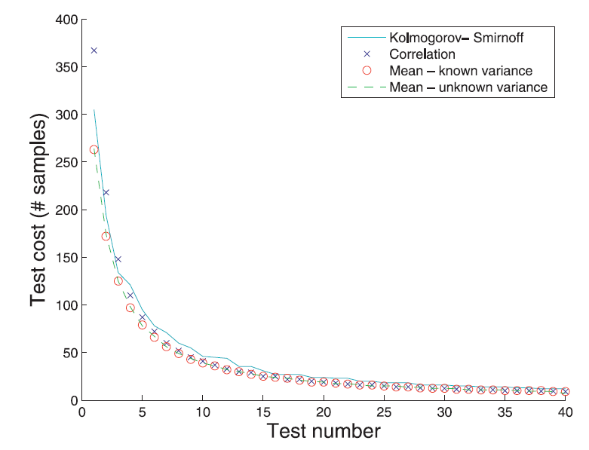
QPD simulations

Slide 9
Basic QPD Summary
Tool for false discovery control in public databases, with a management layer responsible for validity
Pay per use with samples or cost of sample acquisition
Can serve an infinite series of requests without loss of power
Uses Alpha Spending to control FWER
Scientists concentrated on discoveries (effect size and power)
Scientists do not see p-values, only R’s (reject/not reject H0)

Slide 10
QPD schema
Select test
Negotiation
Perform test
Report results
Researcher
DB manager
Define test basics: null hypothesis, test statistic
Suggest effect size and desired power
Pay agreed cost
Publish if significant (protected against publication bias!)
Any two determine the third
Record request
Determine cost (in samples or cost of acquisition)
Perform test
Return significant / non-significant

Slide 11
QPD use case: GWAS replication server
Assume a community (e.g. Type 2 diabetes researchers) builds a QPD for replicating findings
Initialize with, say, 500 samples
Comparison of different scenarios:
Replicate on own data:
Requires hundreds of samples, publication bias
Replicate on public data:
Requires no samples, but severe publication bias
Use QPD:
Requires <5 samples, protected from (replication) publication bias

Slide 12
Sequential control beyond FWER: Alpha Investing (Foster & Stine 2007)
Similar to Alpha Spending
Guarantees mFDR ≤ α
Requires “almost independence” of hypotheses
Marginal False Discovery Rate (mFDR):
V — the number of false discoveries
R — the total number of discoveries

Slide 13

Alpha Investing
Reward
x₁
p₁<x₁/(1+x₁)? Reward=x₁/(1+x₁)+α
x₂
p₂<x₂/(1+x₂)? Reward=x₂/(1+x₂)+α
x₃
p₃<x₃/(1+x₃)? Reward=x₃/(1+x₃)+α
wealth

Slide 14
Summary of results from Aharoni & R. (JRSSB, 2014)
Define Generalized Alpha Investing (GAI): what combinations of (level, reward) are legal to control mFDR
Can find Optimal GAI: maximizing expected reward and hence future levels and power
Can design variants that can be used within QPD (still under near-independence assumption)

Slide 15
Alpha Spending with Rewards
x_{i}
α _{i}=x_{i}, ψ_{i} =α
Level-reward tradeoff
ψ_{i}
α_{i}
wealth
Alpha Spending with Rewards

Slide 16
Generalized alpha investing and QPD
We can use these powerful sequential testing approaches to decrease QPD costs
In practice, Alpha Spending with Rewards can be integrated with QPD scheme
The rewards mean that costs decrease more quickly
  In typical cases most costs are zero!

Slide 17
Simulation
We simulated 100 requests for t-tests, where
  Power=0.95
  Effect-size=0.1
  Probability of a true null 0.9
Initial number of samples n₀=2000
Three variants of QPD, all with:
  α=0.05
  q=0.999

Slide 18
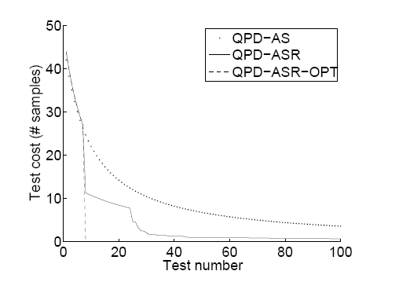
Alpha Spending with Rewards and QPD

Slide 19
QPD and FDR control
After our work, the topic of sequential FDR control has been investigated extensively, by Aaditya Ramdas and others
  Aaditya will discuss this further
Many of these methods are Generalized Alpha Investing rules
Some can be implemented within QPD to control FDR
  Those we have investigated are more conservative than QPD-ASR, but still gain compared to using Alpha Spending

Slide 20
Dependence vs Adaptation
Adaptive data analysis: Decide on next analysis given results of previous analyses
In the context of hypothesis testing: decide on the next test based on the results of previous tests
So it’s not only the outcomes of tests that are dependent, but the selection of the tests performed is dependent on previous results
QPD methods presented so far do not deal with adaptive tests

Slide 21
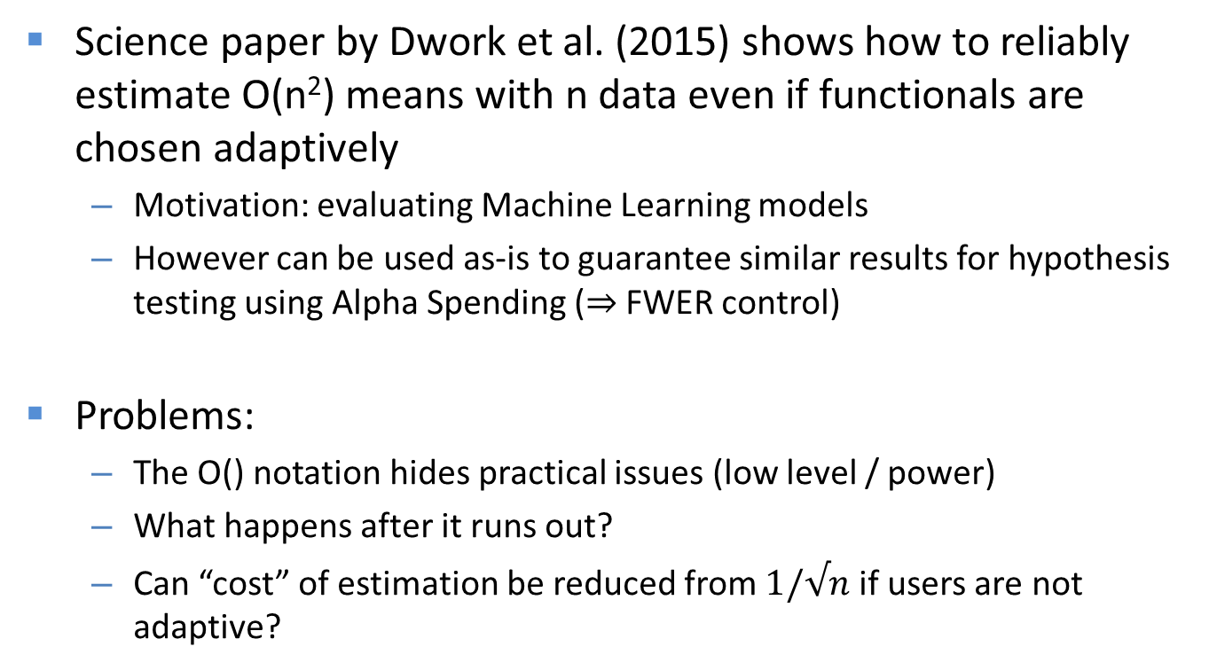
The reusable holdout
Science paper by Dwork et al. (2015) shows how to reliably estimate O(n²) means with n data even if functionals are chosen adaptively
  Motivation: evaluating Machine Learning models
  However can be used as-is to guarantee similar results for hypothesis testing using Alpha Spending ($⇒$FWER control)
Problems:
  The O() notation hides practical issues (low level / power)
  What happens after it runs out?
  Can “cost” of estimation be reduced from $1/√n$ if users are not adaptive?

Slide 22
The everlasting database
Goals:
  Maintain infinite usefulness
  Allow “cheap” non-adaptive queries/tests
  Adapt automatically to users’ adaptiveness
Implementation, using and enhancing “reusable holdout” techniques:
  Charge O(1/n) for query n
  Return “slightly” noisy answers (=decrease levels of tests)
  Monitor “overfitting”
  When overfitting too much – renew data and charge O(n)
Woodworth, Feldman, R., Srebro, NIPS 2018

Slide 23
The everlasting database
Guarantees (with high probability):
  Non adaptive users pay O(log m) for m queries
  Adaptive users pay O(m^{1/2}) on average because they will eventually trigger the penalty mechanism
  Power is preserved for all users
Concerns:
  Large constants in O() / low power
  Large initial data size needed
  Unbounded costs (penalty mechanism)
Woodworth, Feldman, R., Srebro, NIPS 2018

Slide 24
Summary
QPD: a paradigm for public database management
  False discovery and publication bias control
  No loss of power
  Cost: (slow) augmentation of database size
QPD can be implemented in practice:
  Fits well with trends of both sharing and security/privacy
  Requires change in how testing is done: no more p values!
  Practical issues: cultural acceptance, data quality, gaming
Challenges for both research and implementation:
  Controlling different criteria while allowing dependence
  Dealing with adaptive data analysis – can it be made practical?

Slide 25
Thanks!
saharon@tauex.tau.ac.il

