Slide 1
Quality Preserving Databases: Multiplicity Control on Infinite Streams
Saharon Rosset, Tel Aviv University
Joint with:
Udi Aharoni, Hani Neuvirth – IBM Research

Slide 2
Outline
Background:
  Multiple hypothesis testing
  The special case of public databases
The Quality Preserving Database (QPD)
Aharoni, Neuvirth, and Rosset
IEEE Trans. on Comp. Biol. And Bioinfo., 2010
Improving the QPD using “Generalized Alpha Investing”
Aharoni, Rosset
JRSSB, 2014
Rosset, Aharoni, Neuvirth
Genetic Epidemiology, 2014

Slide 3
Hypothesis Testing
Reject null R=1
is p<α
p<α
Two hypotheses:
Null
Alternative
p-value
p≥α
No-reject R=0
Type-I error (False Discovery): Rejecting a true null
Type-II error: not rejecting a false null
Test level α: Upper bound on type-I = P_{null}(R=1)
P(FalseDiscovery) ≤ α
Power π: Chance of discovery = P_{alternative} (R=1)

Slide 4
Multiple Hypothesis Testing
Procedure
Guarantees:
(some measure of false discoveries) ≤ α

Slide 5
Multiple Hypothesis Testing
Bonferroni
Correction
Guarantees: FWER ≤ α
Family Wise Error Rate (FWER): P(V>0)
V — the number of false discoveries

Slide 6
Multiple Hypothesis Testing
Benjamini-
Hochberg
Procedure
Guarantees: FDR ≤ α (under assumptions on dependence)
False Discovery Rate (FDR):
V — the number of false discoveries
R — the total number of discoveries
Less conservative measure ⇒ more discoveries

Slide 7
Multiple Hypothesis Testing Example
A single genome wide association study (GWAS) may test around 10⁶ hypotheses.
Naïve tests at level α=0.05 expected to produce 50,000 false discoveries.
Current protocols for publishing GWAS results call for p value threshold of 5*10⁻⁸, implicitly correcting for 10⁶ tests
However, many findings still do not replicate later!
Potential cause: publication bias

Slide 8
Does publication bias explain lack of replicability?
Meta analysis of genetic association studies supports a contribution of common variants to susceptibility to common disease
Lohmueller, Pearce, Pike, Lander, Hirschhorn
Nature Genetics 2003
Meta analysis of 25 genetic associations, tested in a total of 301 studies:
11 association results were replicated significantly
Publication bias: Assuming additional ~1500 unpublished studies, the replications can be attributed to chance
Evidence for fewer unpublished studies

Slide 9
Public Databases
Research
Group
Research
Group
Database
Research
Group
Research
Group
Examples:
  dbGap
  Stanford HIV database
  GEO Gene expression Omnibus
  NCBI Influenza Virus Sequence Database

Slide 10
Multiple Testing with Public Databases
Traditional techniques can not be used:
  Research groups are uncoordinated
  Future usage is unpredictable
Procedure

Slide 11
Sequential procedures
Sequential
Procedure
Guarantees:
(some overall measure of false discoveries) ≤ α

Slide 12
Example: Alpha Spending
α₁=0.01
Test 1: R₁=1 if p₁<α₁
Test 2: R₂=1 if p₂<α₂
α₂=0.007
Test 3: R₃=1 if p₃<α₃
.
.
.
α=0.05
α₃=0.005
α-wealth

Slide 13
The Quality Preserving Database (QPD)
Motivation: as levels decrease, power also decreases
  Earlier users are “using up” the data
How can we compensate for usage?
  “Stable” method: user does not lose power by arriving later
  Two ways to achieve this:
    Not decrease level (impossible)
    Add samples ⇒ more power at same level
QPD basic problem: design “payment” schemes for usage which guarantee power to next users, while keeping costs bounded
  Turns out to be possible in many cases

Slide 14
QPD schematic view
α₁=0.025
100 samples
p₁<α₁ ?
100 samples
100 samples
α=0.05
α₂=0.0125
p₂<α₂ ?
1000 samples
α₃=0.00625
p₃<α₃ ?
α-wealth
Database

Slide 15
QPD implementation example
Stream of normal tests, each with effect size s_{i} and power requirement π_{i}
When test i arrives, we have n samples in the database
  Find c such that αq^{n}(1-q^{c}) is sufficient level for obtaining power π_{i}
  Request c samples (or equivalent cost) in payment from i
This simple recipe guarantees “stability”
  The ability to serve an infinite stream with bounded costs
Applicable well beyond normal distributions
In practice, it leads to quickly diminishing costs

Slide 16
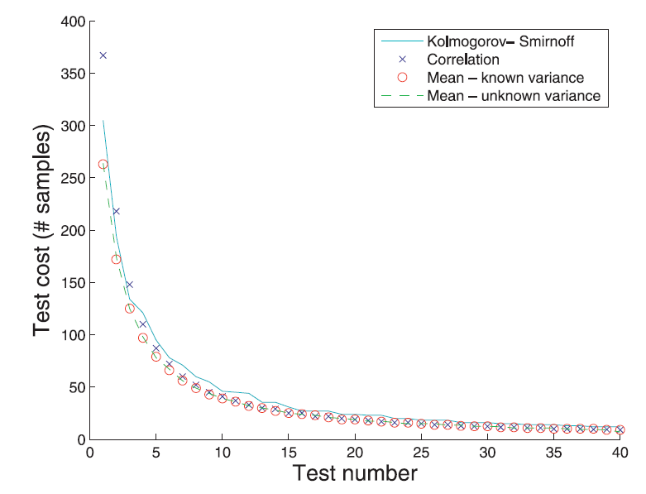
QPD simulations

Slide 17
Basic QPD Summary
Tool for false discovery control in public databases, with a management layer responsible for validity
Pay per use with samples or cost of sample acquisition
Can serve an infinite series of requests without loss of power
Uses Alpha Spending to control FWER
Scientists concentrated on discoveries (effect size and power)
Scientists do not see p-values, only R’s (reject/not reject H0)

Slide 18
QPD schema
Select test
Negotiation
Perform test
Report results
Researcher
DB manager
Define test basics: null hypothesis, test statistic
Suggest effect size and desired power
Pay agreed cost
Publish if significant (protected against publication bias!)
Any two determine the third
Record request
Determine cost (in samples or cost of acquisition)
Perform test
Return significant / non-significant

Slide 19
QPD use case: GWAS replication server
Assume a community (e.g. Type 2 diabetes researchers) builds a QPD for replicating findings
Initialize with, say, 500 samples
Comparison of different scenarios:
Replicate on own data:
Requires hundreds of samples, publication bias
Replicate on public data:
Requires no samples, but severe publication bias
Use QPD:
Requires <5 samples, protected from (replication) publication bias

Slide 20
Next step: moving beyond FWER control
Goal: improve the QPD by controlling FDR-type measure instead of FWER
Alpha Investing (Foster & Stine 2007): Sequential procedure that controls mFDR
Generalized Alpha Investing – a more general framework:
  Can be easily incorporated within the QPD.
  Reduces the “pay-per-use” costs to practically zero.
  Optimality results for simple-hypotheses

Slide 21
Alpha Investing (Foster & Stine 2007)
Similar to Alpha Spending
Guarantees mFDR ≤ α
Requires “almost independence” of hypotheses
Marginal False Discovery Rate (mFDR):
V — the number of false discoveries
R — the total number of discoveries

Slide 22

Alpha Investing
x₁
Reward
p₁<x₁/(1+x₁)? Reward=x₁/(1+x₁)+α
x₂
p₂<x₂/(1+x₂)? Reward=x₂/(1+x₂)+α
x₃
p₃<x₃/(1+x₃)? Reward=x₃/(1+x₃)+α
wealth

Slide 23
Alpha Investing algorithm
Initialize pool of “wealth” with W(0) = α(1-α)
At each iteration i:
  Draw x_{i} ≤ W(i) from the pool
  Test at level α_{i}=x_{i}/(1+x_{i})
  If R_{i}=1 increase pool by α+x_{i}
Guarantees mFDR control at level α

Slide 24
Generalized Alpha Investing: examine what combinations of (level, reward) are legal
x_{i}
α_{i}, Reward
Reward
α_{i}
wealth

Slide 25
Generalized Alpha Investing
At each iteration i we draw x_{i} ≤ W(i) from the wealth pool
This can be exchanged for various combinations of level α_{i} and reward ψ_{i}
Theorem 1
Any combination that complies with the following condition:
guarantees control of mFDR at level α
(ρ_{i} is “maximal possible power” for all alternatives to test i)

Slide 26
Example 1: Alpha Investing
x_{i}
α _{i}=x_{i}/(1+x_{i}), ψ_{i} =x_{i}+α
ψ_{i}
α_{i}
wealth
Alpha Investing

Slide 27
Alpha Spending with Rewards
x_{i}
α _{i}=x_{i}, ψ_{i} =α
ψ_{i}
α_{i}
wealth
Alpha Spending with Rewards

Slide 28
Reward Optimal Generalized Alpha Investing
x_{i}
α _{i}, ψ_{i}
ψ_{i}
α_{i}
wealth
Optimal Generalized Alpha Investing

Slide 29
Optimizing expected reward for simple hypotheses
ψ_{i}
E(R_{i}) ψ_{i}
α_{i}

Slide 30
Expected reward optimal procedures
Expected reward in case of false null: E(R_{i}) ψ_{i}
Where E(R_{i}) = π_{i} ≤ ρ_{i} (depends on level α_{i})
Question: how should we balance level and reward to maximize expected reward?
Theorem 2
For a sequence of UMP tests, an expected reward optimal procedure is obtained by choosing the level α_{i} such that:
Corollary: if ρ_{i}=1 then (regular) alpha investing is expected reward optimal

Slide 31
Simulation Results
We simulated an infinite series of z-tests
α=0.05, α_{i}=0.005
Method | # of tests | True discoveries | False discoveries | mFDR
Alpha Spending | 10.00 | 0.564 | 0.046 | 0.029
Alpha Investing | 32.86 | 1.820 | 0.140 | 0.048
Optimal Generalized Alpha Investing | 38.44 | 2.129 | 0.162 | 0.050
Best results are significantly better (p-values lower than 10⁻¹²)

Slide 32
Generalized alpha investing and QPD
Can we use these powerful sequential testing approaches to decrease QPD costs?
As it turns out, Alpha Spending with Rewards is the one that can be integrated with QPD
The rewards mean that costs decrease more quickly
  In typical cases most costs are zero!

Slide 33
Simulation
We simulated 100 requests for t-tests, where
  Power=0.95
  Effect-size=0.1
  Probability of a true null 0.9
Initial number of samples n₀=2000
Three variants of QPD, all with:
  α=0.05
  q=0.999

Slide 34
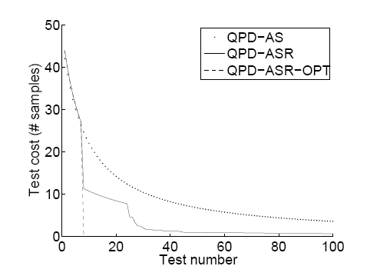
Generalized Alpha Investing and QPD

Slide 35
Summary
QPD: a new paradigm for public database management
  False discovery and publication bias control
  No loss of power
  Cost: (slow) augmentation of database size
QPD can be implemented in practice:
  Fits well with trends of both sharing and security/privacy
  Requires change in how testing is done: no more p values!
  Practical issues: cultural acceptance, data quality, gaming
Generalized alpha investing:
  Powerful general framework for mFDR control on streams of
  A variant can be implemented within QPD and bring costs down

Slide 36
Thanks!
saharon@post.tau.ac.il

Slide 37
Simulation
We simulated 100 requests for t-tests, where
  Power=0.95
  Effect-size=0.1
  Probability of a true null 0.9
Initial number of samples n₀=2000
We simulated three variants of QPD, all with:
  α=0.05
  q=0.999

Slide 38
Generalized Alpha Investing and QPD

Slide 39
Simulations
We simulated an infinite series of independent z-tests
For each test:
  30 samples from N(μ,1)
  μ=0 with probability 0.9, μ=5 otherwise
  H₀: μ=0
α=0.05
Each method was executed until its pool was depleted
Repeated experiment 100K times for each method

Slide 40
Simulation Results
Stops when:
Method | # of tests | True discoveries | False discoveries | mFDR
Alpha Spending | 135.00 | 2.505 | 0.045 | 0.013
Alpha Investing | 536.63 | 20.608 | 1.065 | 0.047
Alpha Spending with Rewards | 524.71 | 19.552 | 0.968 | 0.045
Optimal Generalized Alpha Investing | 547.74 | 21.380 | 1.156 | 0.049
Best results are significantly better (p-values lower than 10⁻¹⁵)

Slide 41
Simulation Results
Method | # of tests | True discoveries | False discoveries | mFDR
Alpha Spending | 20.00 | 0.947 | 0.045 | 0.023
Alpha Investing | 267.65 | 12.441 | 0.567 | 0.041
Alpha Spending with Rewards | 236.33 | 11.022 | 0.506 | 0.041
Optimal Generalized Alpha Investing | 305.64 | 14.220 | 0.648 | 0.041
Best results are significantly better (p-values lower than 10⁻³⁸)

Slide 42
Simulation Results
Stops after 200 tests
Method | # of tests | True discoveries | False discoveries | mFDR
Alpha Spending | 200 | 2.626 | 0.046 | 0.013
Alpha Investing | 200 | 7.641 | 0.392 | 0.044
Alpha Spending with Rewards | 200 | 7.511 | 0.367 | 0.042
Optimal Generalized Alpha Investing | 200 | 7.774 | 0.415 | 0.045
Best results are significantly better (p-values lower than 10⁻¹⁰)

Slide 43
QPD – Alpha Spending
Let denote the number of samples after the i’th test
We maintain the following invariant:
Level allocation in exchange for c new samples:
c is chosen so the level allocation will be just enough to perform the test with the required power.

Slide 44
QPD – Alpha Spending with Rewards
Let denote the number of samples after the i’th test
We maintain the following invariant:
Level allocation in exchange for c new samples:
c is chosen so the level allocation will be just enough to perform the test with the required power.

Slide 45
QPD – Alpha Spending with Rewards - Optimistic
Rewards

Slide 46
Generalized Alpha Investing
Reward
Level
Alpha Spending
with Rewards

