Slide 1
The New Phase in the Global Crisis
Assaf Razin
June 2010

Slide 2
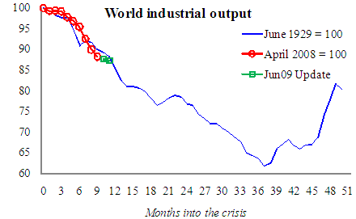
Tracking the Great Depression by months into the Crisis
Eichengreen and O’Rourke

Slide 3
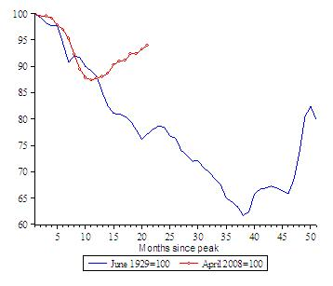
And, after 1 year…

Slide 4
Shocks are of similar magnitude but different policy actions
The Shocks in the great depression and the recent global crises were of similar
magnitudes.
In both episodes the interest rate went all the way down to the zero bound.
But..
Policy reaction in recent crises were swift and powerful: quantity easing and credit easing, fiscal stimuli, bailing out banks, etc.

Slide 5
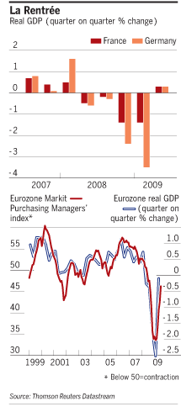
Eurozone Recovery
Germany and France, exited recession in the second quarter of 2009. Both countries’ 0.3 per cent quarter-on-quarter growth yanked up the eurozone as a whole to a mere 0.1 per cent contraction.

Slide 6
The global crisis’ new phase
Crisis in Europe, whereas us is recovering and emerging markets are growing.

Slide 7
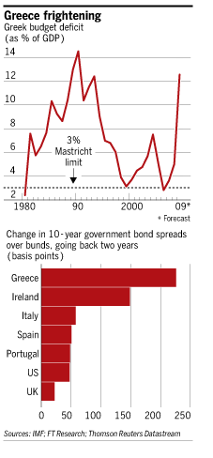
Greece
Greece
accounting for less than
3 per cent of
the euro-zone
economy

Slide 8
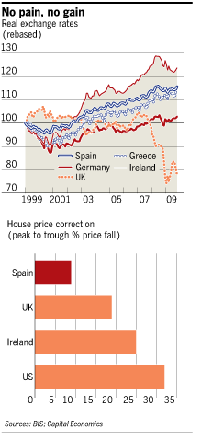
Spain, Portugal or Greece can’t devalue to restore lost competitiveness
UK Can!

Slide 9
European Bailout Facility is not easily tapped
Spain, Portugal and Greece
surrendered their ability to extend liquidity unilateraly

Slide 10
“Optimum Currency Area”
The benefits will be mainly in the form of lower transaction costs and of the disappearance of currency risks, and cross country credit possibilities.
The costs will be due to the inability of national governments and central banks to pursue independent monetary policies to stabilize the economy.
The extent to which the loss of this policy instrument will affect the adjustment to equilibrium will depend on the degree of flexibility of factor markets and the nature of the shocks hitting the economy: the more rigid factor markets and the more country-specific the shocks, the more important will be the loss of monetary autonomy.
If factors of production are not sufficiently mobile, asymmetric shocks result in high costs of adjustment, in terms of higher unemployment and lower output, in the presence of fixed exchange rates.

Slide 11
But, the euro-zone is not OCA
Conflicting national fiscal policies
Uncorrelated internal and external shocks

Slide 12
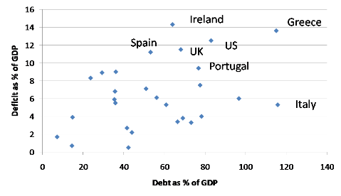
Sovereign Debt
But with similar debt burden spreads are high for Italy (a member of the Eurozone) but low for UK (not a member of the eurozone)

Slide 13
Euro-zone Debt : low average but highly heterogeneous
Some countries like Greece and Italy have very high public debt levels, others such as Ireland and Spain have public debt levels that are increasing fast. This situation has raised concerns about the capacity of these countries to continue to service their debts in an environment of low economic growth. A majority of countries in the Eurozone, however, experience a debt dynamics that is benign certainly when compared to the US (and also the UK).

Slide 14
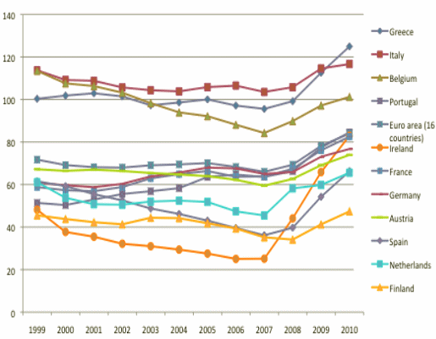
: Sovereign Debt Across the Euro Zone

Slide 15
Intra Euro-zone Differences
Some countries like Greece and Italy have very high public debt levels,
others such as Ireland and Spain have public debt levels that are increasing fast.
A majority of countries in the Euro-zone, however, experience a debt dynamics that is benign certainly when compared to the US (and also the UK).
Given the overall strength of the government finances within the Eurozone it should have been possible to deal with a problem of excessive debt accumulation in Greece, which after all represents only 2% of Euro-zone GDP.

Slide 16
The Heart of the Problem
The heart of the problem is that the Euro-zone is a monetary union without being a political union. In a political union there is a centralized budget that provides for an automatic insurance mechanism in times of crisis.

Slide 17
Insufficient political union behind the Euro
A weak political union in which the monetary union should can be embedded.
Such a political union should ensure that budgetary and economic policies are coordinated, preventing the large divergences in economic and budgetary
It implies that an automatic mechanism of financial transfers is in place to help resolve financial crises.

Slide 18
No Insurance Mechanism
Insurance can be organized using the technique of a monetary fund that obtains resources from its members to be disbursed in times of crisis (and using a sufficient amount of conditionality).

Slide 19
How to reduce relative costs and regain competitiveness
What makes Greek problems so intractable is the fact that there’s little hope for growth for years to come, because Greek costs and prices are out of line and will need years of painful deflation to gain its competitiveness.
Spain wouldn’t be in trouble at all if it weren’t for the fact that the bubble years left its costs too high, again requiring years of painful deflation.

Slide 20
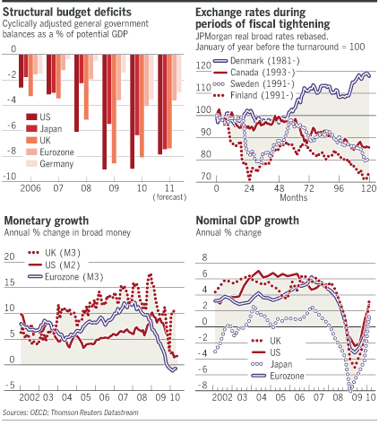
Fiscal Tightening and Growth?

Slide 21
Fiscal contraction and export growth
A reduction in the fiscal deficit must be offset by shifts in the private and foreign balances. If fiscal contraction is to be expansionary, net exports must increase and private spending must rise, or private savings fall. Thus, experience of fiscal contraction is going to be very different when it occurs in a few small countries, not in many big ones simultaneously; when the financial sector is in good health, not impaired; when the private sector is unindebted, not highly leveraged; when interest rates are high, not close to zero, when external demand is buoyant, not feeble; and when real exchange rates depreciate sharply rather than remain fixed.

Slide 22
Estonia as a model of “internal devaluation”?
Estonia is being hailed for its fiscal consolidation, to qualify for entry into the euro.
Latvia is often cited as an example for Greece as it undergoes a brutal “internal devaluation”—wage cuts, while keeping its currency pegged to the euro.

Slide 23
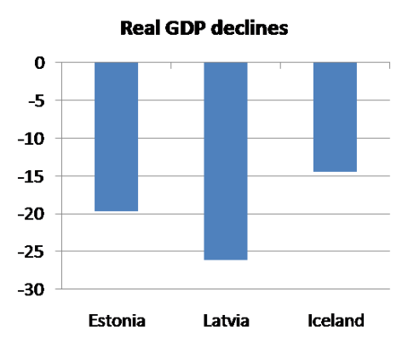
But adjustment is drastic

Slide 24
$ 950 billion (Eurozone plus IMF) bailout fund
But, rolling over debt cannot solve the problem of insolvency
Greek primary deficit is huge
Greek austerity program will generate a medium term rise in Greece sovereign debt
Even if Euro depreciates Greece’s competitiveness does not change vis a vis its eurozone counterparts

Slide 25
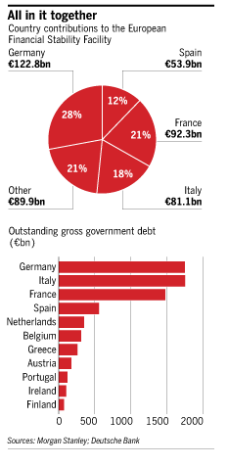
New fund authorized to borrow up to €440bn to lend to eurozone countries frozen out of the credit markets.

Slide 26
Threat to banks
the emergency action that the EU took with the International Monetary Fund in early May by rescuing Greece with a €110bn financial support plan. The threat facing the French and German banking sector was simply too great.

Slide 27
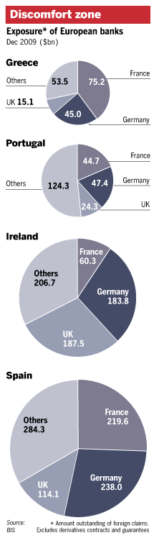
European Bank Exposure

Slide 28
Eurozone banks, though, are not undercapitalized
But public sector debt accounted for mere 16 percent of the total exposure of Eurozone banks to Greece, Ireland, Portugal and Spain.
That is, Eurozone banks made their loans overwhelmingly to the private sector borrowers.

Slide 29
Strings attached and market confidence
But only Germany and France have a triple A status in backing this fund.
Loans to borrowers need to be approved by -borrowers countries parliaments
A difficulty because with loans there are strings attached, such as labor market reforms

Slide 30
The mechanism for Eurozone rescue package
A “special purpose vehicle”, capable of raising 440 Bn euros is backed by member state individual guarantees, by all 16 members of the Eurozone.
Assistance is provided to failing countries only if a restructuring program is agreed with the country.

Slide 31
ECB Policy and Bond Yields
One part of the billion750 euro rescue plan was the European Central Bank’s decision to buy eurozone government bonds to stop the relentless rise in government bond yields of the weaker economies on the monetary union periphery

Slide 32
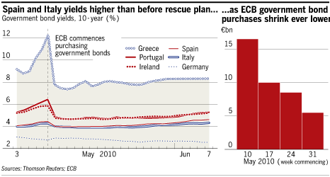
But, yields went up

Slide 33
A possible breakdown in the euro?
An alternative explanation for the depreciation of the euro is the fear of a breakdown of the single currency itself. In order to avoid having to bail-out weak Eurozone countries through debt monetization, the strong countries might push the weak ones outside the Eurozone.

Slide 34
Will the entire Euro enterprise collapse?
The answer is no. The decision to join the euro area is effectively irreversible. Exit is
effectively impossible

Slide 35
Reasons
A country that leaves the euro area because of problems of competitiveness would be expected to devalue its newly-reintroduced national currency. But workers would know this, and the resulting wage inflation would neutralize any benefits in terms of external competitiveness. Moreover, the country would be forced to pay higher interest rates on its public debt.
The private-sector balance sheet effects , causing defaults, will create massive bank runs, as in Argentina in 2001.

Slide 36
More reasons
A second reason why members will not exit, it is argued, is the political costs. A country that reneges on its euro commitments will antagonise its partners. It will not be welcomed at the table where other European Union-related decisions were made. It will be treated as a second class member of the EU to the extent that it remains a member at all.

Slide 37
Why is the euro depreciating?
A concern that the crisis spreads to other large Eurozone countries.
Even if Greece can be bailed out by other countries in the Eurozone, this would not be feasible for the much larger public debts of
Italy, Spain, and Portugal.
But the risk of monetization of the public debt by the ECB becomes more concrete.

Slide 38
But, why the Euro could be appreciate after all?
Germany competitiveness and export surplus is a
counter force to depreciation of the euro.
German industry has boosted the competitiveness of its exports over the past decade by keeping wages flat.
German wage restraint has led to a real depreciation of Germany’s fixed nominal exchange rate vis-à-vis the world and its Eurozone members, helping Germany to win market shares at the expense of Southern Europe. Germany’s real effective devaluation in terms of relative unit labour costs compared with the EU27 during 1994-2009 is about 20%.

Slide 39
How Germany lowered its relative unit cost
German firms offshored part of production to the new EU member states, Russia and Ukraine.

Slide 40
Effect within the Eurozone
Germany’s trade imbalance with its southern Eurozone neighbors has contributed to their recessionary pressures.

Slide 41
Global Imbalances and Saving Glut
41
Ben Barnanke (2005), “The Global Saving Glut and the U.S. Current Account Deficit,” offered a novel explanation for the rapid rise of the U.S. trade deficit in the early 21st century. The causes, argued Bernanke, lay not in America but in Asia.

Slide 42
Global Picture (Continued)
42
In the mid-1990s, Bernanke pointed out, the emerging economies of Asia had been major importers of capital, borrowing abroad to finance their development. But after the Asian financial crisis of 1997-98, these countries began protecting themselves by amassing huge war chests of foreign assets, in effect exporting capital to the rest of the world.

Slide 43
Global Picture (Continued)
43
Most of the Asia cheap money went to the United States — hence our giant trade deficit, because a trade deficit is the flip side of capital inflows. But as Mr. Bernanke correctly pointed out, money surged into other nations as well. In particular, a number of smaller European economies experienced capital inflows that, while much smaller in dollar terms than the flows into the United States, were much larger compared with the size of their economies.

Slide 44
Global Picture (Continued)
44
wide-open, loosely regulated financial systems characterized the US shadow banking system and mortgage institutions, as well as many of the other recipients of large capital inflows. This may explain the almost eerie correlation between conservative praise two or three years ago and economic disaster today. “Reforms have made Iceland a Nordic tiger,” declared a paper from the Cato Institute. “How Ireland Became the Celtic Tiger” was the title of one Heritage Foundation article; “The Estonian Economic Miracle” was the title of another. All three nations are in deep crisis now.

Slide 45
Global Picture (Continued)
45
For a while, the inrush of capital created the illusion of wealth in these countries, just as it did for American homeowners: asset prices were rising, currencies were strong, and everything looked fine. But bubbles always burst sooner or later, and yesterday’s miracle economies have become today’s basket cases, nations whose assets have evaporated but whose debts remain all too real. And these debts are an especially heavy burden because most of the loans were denominated in other countries’ currencies.

Slide 46
Global Picture (end)
46
Nor is the damage confined to the original borrowers. In America, the housing bubble mainly took place along the coasts, but when the bubble burst, demand for manufactured goods, especially cars, collapsed — and that has taken a terrible toll on the industrial heartland. Similarly, Europe’s bubbles were mainly around the continent’s periphery, yet industrial production in Germany — which never had a financial bubble but is Europe’s manufacturing core — is falling rapidly, thanks to a plunge in exports.

